Slide 1
Unit: Gas Laws
Day 5 – Notes
Dalton’s Law of Partial Pressures, Grahams Law,
and Real vs. Ideal Gases

Slide 2
After today you should be able to…
Describe Dalton’s law of partial pressures and calculate P_{total} or a partial pressure
Explain Graham’s law of effusion and calculate the rate at which gases effuse
Explain what is meant by the term “real” vs. “ideal” gases

Slide 3
Recall, gas pressure results from collisions of gas particles.
Gas pressure depends on the amount of gas and the KE of its particles.
Since particles in a mixture of gases at the same temperature contain the same average KE, the kind of particle is unimportant.

Slide 4
Example: Composition of Dry Air
Component | Volume | Partial Pressure
Nitrogen | 78.08% | 79.11 kPa
Oxygen | 20.95% | 21.22 kPa
Carbon dioxide | 0.04% | 0.04 kPa
MISC gases | 0.93% | 0.95 kPa
Total | 100.00% | 101.32 kPa

Slide 5
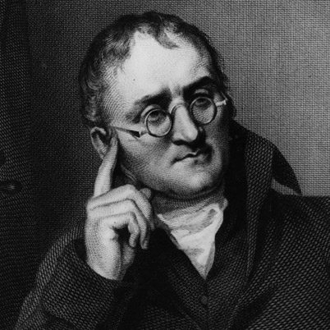
“The total pressure of a mixture of gases is equal to the sum of the individual (partial) pressures.”

Slide 6
Dalton’s Law of Partial Pressures
Units of pressure must match!
P_{total}= P₁ + P₂ + P₃…

Slide 7
Example: Dalton’s Law
What is the total pressure for a mixture of O₂ and CO₂ if P_{O2}= 0.719 atm and P_{CO2}= 423mmHg.
P_{O2}= 0.719atm
P_{CO2}= 423mmHg
760mmHg
x
=
546mmHg
1atm
P_{total}=546mmHg + 423mmHg
P_{total}=969mmHg

Slide 8
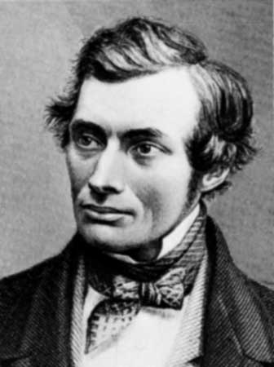
An ideal gas has:
No molecular volume
No attractive forces

Slide 9
Questions?
Complete WS#5

