Slide 1
Unit: Gas Laws
Day 1 – Notes
Review and Introduction

Slide 2
After today you should be able to…
Explain the factors that affect gas pressure
Describe real-world experiences and how they relate to gas pressure, temperature, and volume
Predict the behavior of a gas by changing one of its variables

Slide 3
Review: Kinetic Molecular Theory
KMT makes three major assumptions about the particles in a gas:
Their particles move in a straight line until they collide with other particles or the walls of their container.
The motion of the particles is constant and random.
There are no attractive or repulsive forces among the particles.

Slide 4
Review: Kinetic Molecular Theory
Four variables are generally used to describe a gas.
Pressure (kPa, mmHg, atm)
Volume (L or mL)
Temperature (always in Kelvin!)
Amount (moles)

Slide 5
Factors Affecting Gas Pressure
Effect of adding or removing gas:
When the amount of gas in a given volume is increased, pressure increases.
Example: Doubling amount of gas
= gas particle
2x Amount of gas, 2x Pressure

Slide 6
Factors Affecting Gas Pressure
More particles means more collisions, which means more pressure!
This is a direct relationship: If the number of particles double, pressure doubles.

Slide 7
Real-World Application: Whitewater Rafting!
The strength and flexibility of the raft are important when you go whitewater rafting.
Think about it! The raft must be able to withstand the pressure of the air inside the raft and the force of the rapids below.
If the raft is too inflated (too much gas is added) the raft will easily burst.
But if not enough gas is added, the raft will not stay afloat!

Slide 8
Factors Affecting Gas Pressure
Effect of changing volume of container:
When the volume of a gas is decreased (for a given amount of gas) pressure increases.
Example: Decreasing volume by half
= gas particle
½ Volume, 2x Pressure

Slide 9
Factors Affecting Gas Pressure
Particles are closer together in a container, which means more collisions, which really means more pressure!
This is an indirect relationship: If the volume is halved, pressure is doubled and vice-versa.

Slide 10
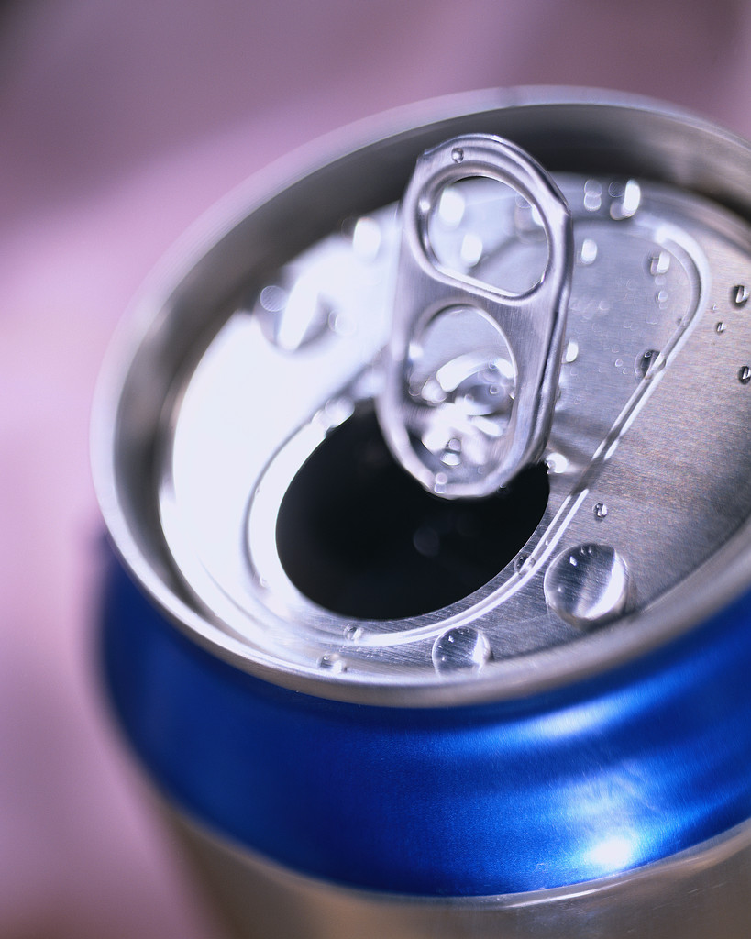
Real-World Application: Opening Soda Cans and Bottles
Soda cans or bottles are usually opened slowly because we’ve learned that popping them open too fast causes it to fizz up and spill all over the place!
When you open the cap, the gas is suddenly able to increase its volume and therefore decrease the pressure inside the can.
Shaking a carbonated beverage causes the gas bubbles to mix with the soda and before some of the gas can settle out, you’ve got quite the mess now don’t you?

Slide 11
Factors Affecting Gas Pressure
Effect of changing temperature of a gas:
When the temperature of a gas increases the particles have more KE, and pressure increases.
Example: Doubling temperature
= gas particle
298K
596K
2x Temperature, 2x Pressure

Slide 12
Factors Affecting Gas Pressure
The particles move faster when heated, and strike the walls of the container with more force, so the pressure builds.
This is a direct relationship: If the temperature is doubled, pressure is doubled and vice-versa.

Slide 13
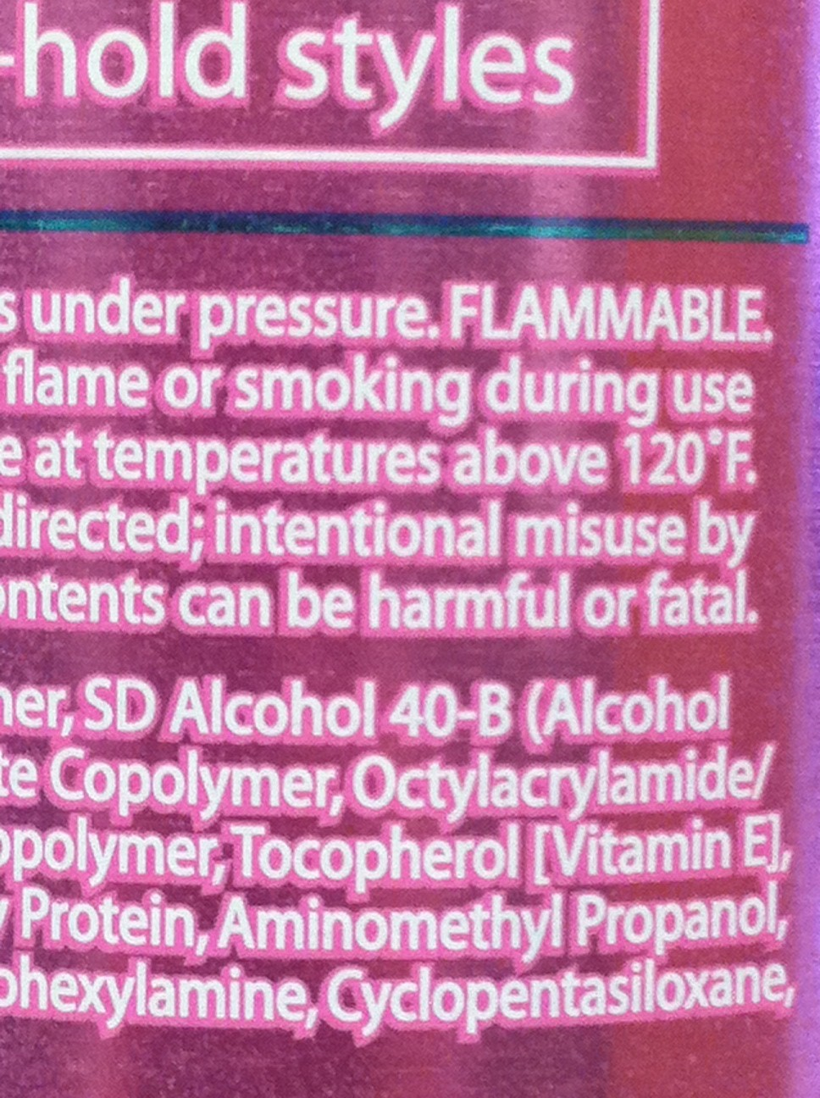
Real-World Application: Aerosol Cans
A gas in a sealed container can generate an enormous amount of pressure when heated.
That’s why all labels on aerosol cans say “DO NOT STORE ABOVE 120°F.”
Even “empty” aerosol cans still have some gas in them, so they will explode if thrown into a fire.
It is also wise to not store cans at temperatures that will freeze the substances in them. Freezing causes the substance to expand and will puncture the can.

Slide 14
Questions?
Complete WS#1

