Slide 1
Unit: Gas Laws
Day 2 – Notes
Boyle’s and Charles’s Laws

Slide 2
After today you should be able to…
Explain the effect on gas properties using Boyle’s and Charles’s laws
Calculate an unknown pressure, temperature, or volume by solving algebraically
Explain what an ideal gas is
Calculate an unknown pressure, temperature, volume, or amount of gas using the ideal gas law equation

Slide 3
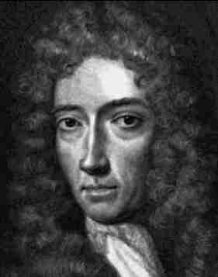
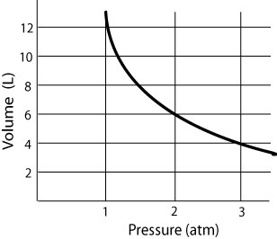
Boyle’s Law: Pressure and Volume
Robert Boyle was the first person to study the pressure-volume relationship of gases.
In 1662 Boyle proposed a law to describe this relationship.

Slide 4
“For a given mass of a gas at constant temperature, the volume of a gas varies inversely with pressure.”

Slide 5
Boyle’s Law: Pressure and Volume
We can simplify this relationship by the formula:
Where,
P₁, P₂ = pressure in any unit (atm, kPa, mmHg), BUT they must match!
V₁, V₂ = volume in any unit (usually, L or mL), BUT they must match!
P₁ V₁ = P₂ V₂

Slide 6
Boyle’s Law: Example
A gas has a volume of 30.0L at 150 kPa. What is the volume of the gas at 0.252 atm?
P₁=
V₁=
P₂=
V₂=
1 atm
P₁ V₁=P₂ V₂
150 kPa
x
=
1.5 atm
30.0L
101.3 kPa
0.252 atm
?
(1.5 atm)
(30.0L)
=
(0.252 atm)
(V₂)
V₂
=
180L

Slide 7
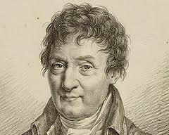
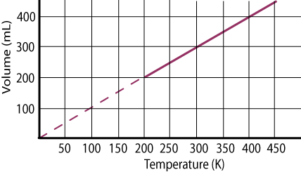
Charles’s Law: Temperature and Volume
Jacques Charles studied the effect of temperature on volume of a gas at constant pressure.
In 1787 Charles proposed a law to describe his observations.

Slide 8
“For a given mass of a gas, at constant pressure, the volume of the gas is directly proportional to its temperature in Kelvin.”

Slide 9
Charles’s Law: Temperature and Volume
We can simplify this relationship by the formula:
Where,
V₁, V₂ = volume in any unit (L or mL), BUT they must match!
T₁, T₂ = temperature is always in Kelvin! (Recall, just add 273 + °C)
V₁ V₂
T₁ T₂
=

Slide 10
Charles’s Law: Example
A gas has a volume of 4.0L at 27°C. What is its volume at 153°C?
V₁=
T₁=
V₂=
T₂=
V₁ V₂
T₁ T₂
4.0L
=
27°C +273= 300K
?
153°C+273= 426K
(4.0L)
(V₂)
=
(300K)
(426K)
V₂
=
5.7L

Slide 11
Ideal Gases
Ideal gases are gases that are said to follow all assumptions of kinetic molecular theory.
An ideal gas is also considered to conform to all gas laws.

Slide 12
Ideal Gases
Up until now we have only changed variables such as pressure, volume, and temperature of a gas.
In each of these cases the amount of gas was assumed constant.
The combined gas law can be modified to include the amount of gas by including the variable, n.

Slide 13
Ideal Gas Law
This gas law relates the amount of gas (in moles) to the volume it would occupy at a particular temperature and pressure.

Slide 14
Ideal Gas Law
Where,
P= pressure (atm)
V= volume (L)
n= moles (mol)
R= 0.0821 L·atm/mol·K
T= temperature (K)
PV=nRT
R is called the Ideal Gas Constant (it has multiple values, but for our purposes we will only use this one).

Slide 15
At what pressure would 0.212 mol of a gas occupy 6.84L at 89°C?
P=
V=
n=
R=
T=

Slide 17
Questions?
Complete WS#2

