Slide 1
Unit: Chemical Names and Formulas
Day 1 - Notes
Introduction and the Basics of Naming

Slide 2
After today you should be able to…
List differences between ionic and covalently bonded compounds
Identify polyatomic and monatomic ions and name them correctly

Slide 3
Review of Ionic Compounds (Crystals)
Transfer of electrons
Made from a metal and a non-metal
Metals lose electrons, nonmetals gain electrons
Chemical formula is arranged in the smallest whole number ratio (empirical formula)
Formula unit: the smallest repeating pattern within a crystal
Even though ionic compounds are made up of ions, they ARE ELECTRICALLY NEUTRAL!

Slide 4
Ions can be monatomic or polyatomic:
Monatomic: Made up of a single atom
Polyatomic: Made up of multiple atoms
Remember…
Group #: 1 2 13 14 15 16 17 18
Charge: +1 +2 +3 X -3 -2 -1 ☺

Slide 5
Monatomic cations have the same name as the element
Example: Na⁺¹ = Sodium ion, Ca⁺² = Calcium ion
Monatomic anions have the ending of the element name changed to “-ide”
Example: Cl⁻¹=chloride ion, O⁻²=oxide ion

Slide 6
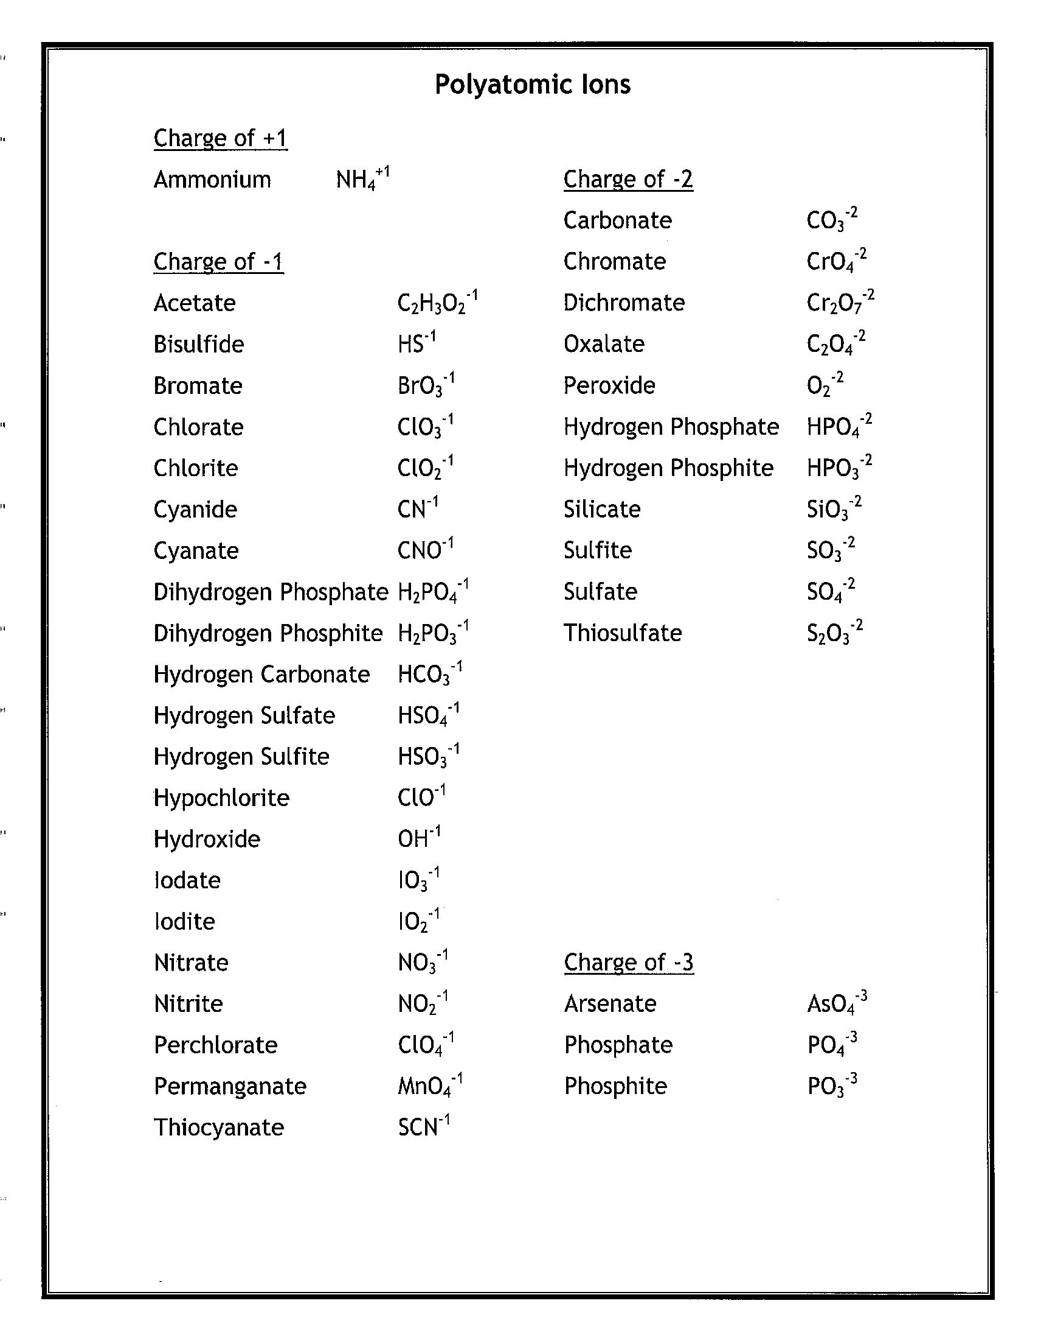
Polyatomic ions: (See polyatomic ion sheet) are made up of two or more elements covalently bonded together with an overall positive or negative charge.

Slide 7
Review Molecular Compounds (Molecules)
Sharing of electrons
Made from nonmetals only
Molecules of the same compound are IDENTICAL and INDEPENDENT of each other
Chemical formula indicates the exact makeup of one molecule (molecular formula)

Slide 8
Questions?
Begin WS#1

