Slide 1
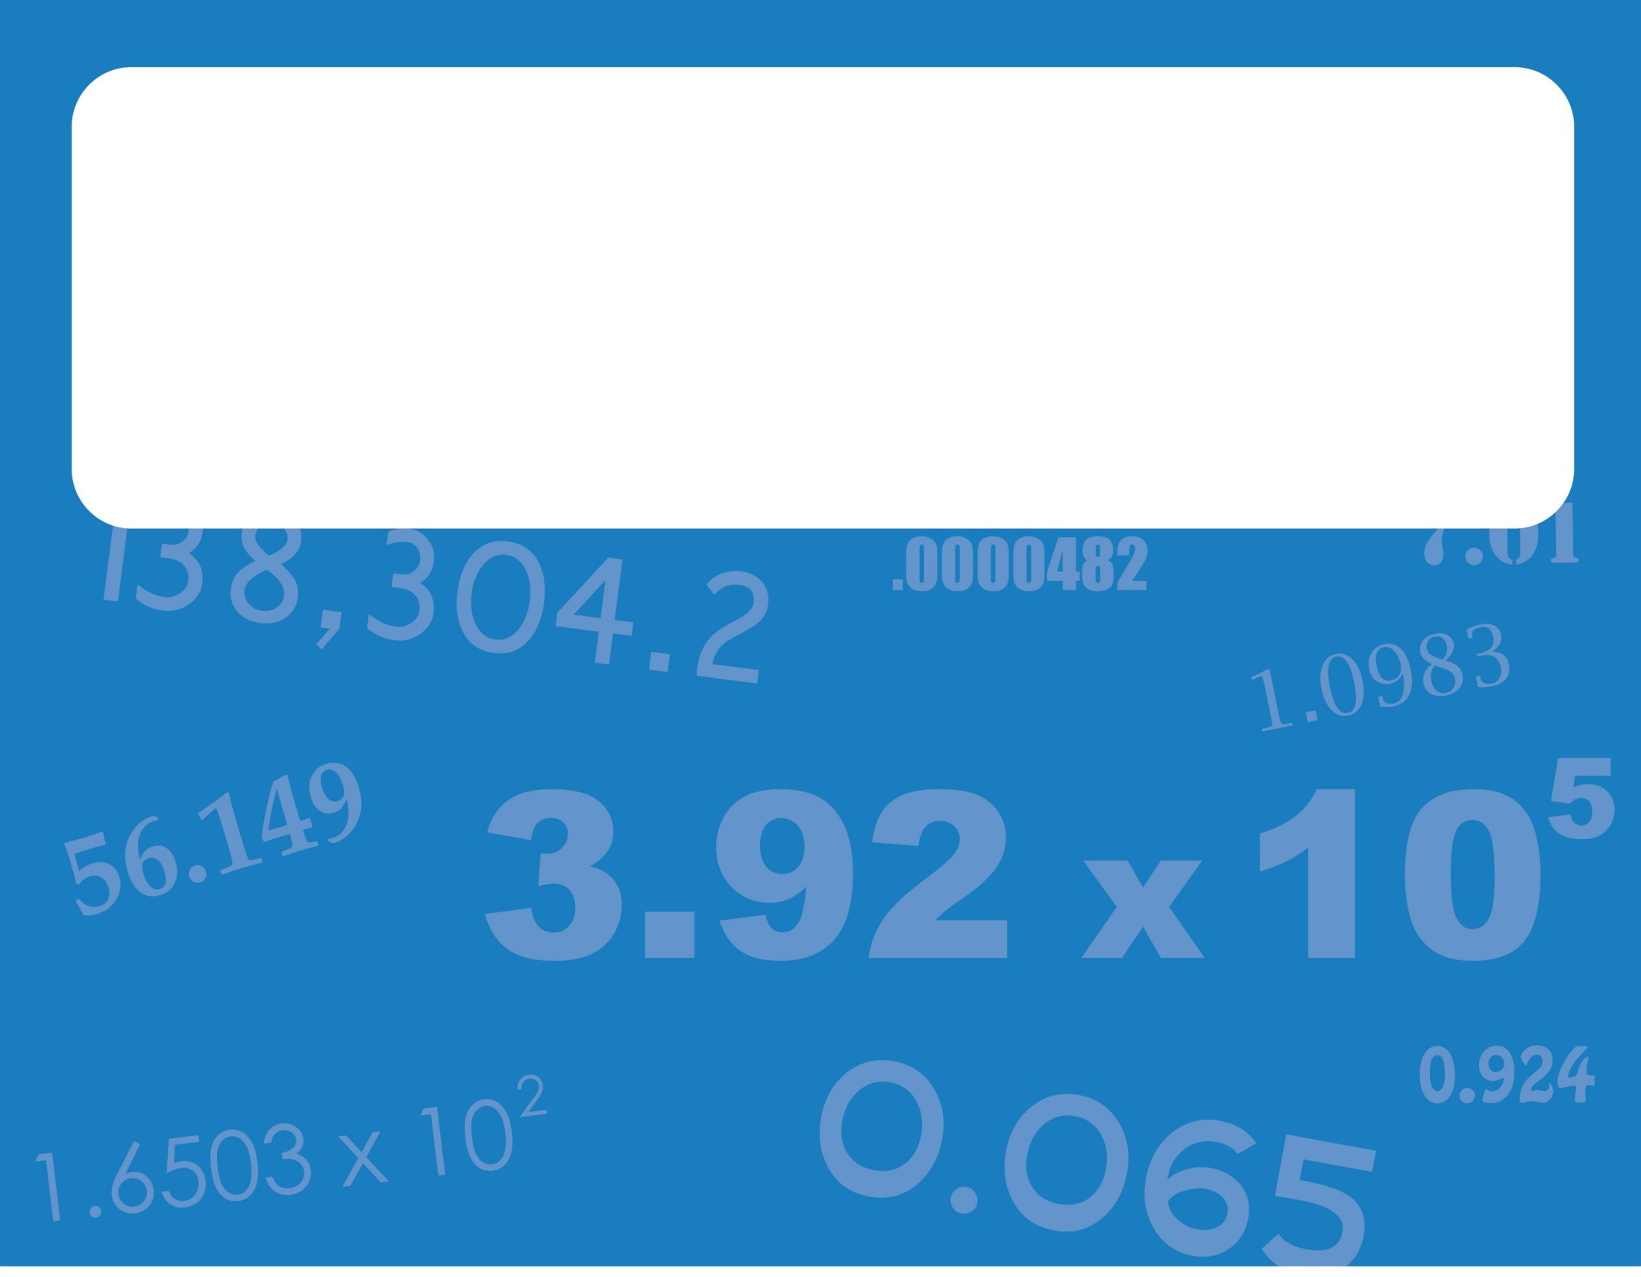
Unit: Introduction to Chemistry Significant Figures in Calculations
Day 6- Notes

Slide 2
After today, you should be able to:
Know and apply the rules for significant figures in calculations
Perform multiplication, division, addition, and subtraction and round to the correct number of significant figures
Write your answer with the correct units

Slide 3
Review of yesterday…
How many sig figs are in the following?
0.02 cm
0.020 L
20,020 mg
20,000 mL
2.0x10⁻³ m
2,002 g
✓
1
✓
✓
2
✓
✓
✓
✓
4
✓
1
✓
✓
2
✓
✓
✓
✓
4

Slide 4
Sig Figs in Calculations
Addition and Subtraction:
LOOK at the decimal places!
The answer is rounded to the same number of decimal places as the number used in the calculation with the least decimal places.
Ex: 5.7 m 7.12 g
+ 2.11 m –1.345 g
7.81~ 5.775 ~
7.8 m
5.78 g

Slide 5
Sig Figs in Calculations
More examples with addition and subtraction:
4.00 cm - 0.230 cm = 3.770 ~
5.0 g + 7.93 g = 12.93 ~
100.45 mL - 2.0 mL = 98.45 ~
5.96 cm + 5.2 cm + 0.230 cm = 11.39 ~
3.77 cm
12.9 g
98.5 mL
11.4 cm

Slide 6
Sig Figs in Calculations
Multiplication and Division:
LOOK at the total number of sig figs!
The answer is rounded to the same number of sig. figs. as the number used in the calculation with the least significant figures.
0.0561cm
Ex: 17.85 g/2.13 mL = 8.38028~ x 0.030 cm
0.001683~
8.38 g/mL
0.0017 cm²

Slide 7
Sig Figs in Calculations
More examples with multiplication and division:
4 cm x 2.3 cm = 9.2 ~
5.0 g / 7.77 L = 0.6435 ~
0.0045 mL x 2.05 mL = .009225 ~
11.7 cm x 3.522 cm x 0.013 cm = 0.5356 ~
9 cm²
0.64 g/L
0.0092 mL²
0.54 cm³

Slide 8
Questions?
Complete the exit ticket.

