Slide 1
Nuclear Chemistry

Slide 2
Radiation
Radiation comes from the nucleus of an atom.
Unstable nucleus emits a particle or energy α alpha
β beta
γ gamma

Slide 3
Nuclear Reaction
Nuclear Reactions: a nucleus loses or gains protons and neutrons.
Why do some nuclei undergo radioactive decay?
They are too big (too many protons)! - All elements with atomic numbers of 84 or higher are radioactive!
There are too many neutrons compared to protons.

Slide 4
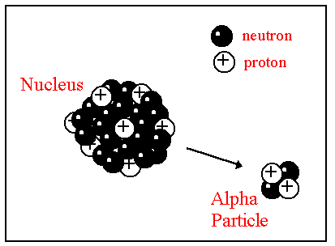
Alpha (α) Decay
Alpha (α) Decay: Nucleus releases an alpha particle.
Alpha particle: helium nucleus = He
2+ charge
Lowest energy radiation.
Can be stopped by a sheet of paper or skin.
Reduces mass number by 4 and atomic number by 2.
A new element is created (transmutation) because the atomic number changed.
42

Slide 5
Alpha decay

Slide 6
Alpha Decay Problems
Example: U →
Practice: 1. Th →
2. Po →
3. Write an equation that represents the alpha decay of Rn-222.
238
92
234
90
218
84

Slide 7
Beta (β) Decay
nº
p⁺
e⁻
Beta (β) Decay: A neutron in the nucleus is converted into a proton and an electron. The electron is created INSIDE the nucleus and is emitted as a beta particle.
Beta particle = a fast moving electron sent shooting out of nucleus
Negative charge
Can be stopped by aluminum foil or a piece of wood.
Increases the atomic number by 1 and does not change the mass number.
A new element is created (transmutation) because the atomic number changed.

Slide 8
Beta decay
²³⁴Th → ²³⁴Pa + ⁰e
90 91 −1
beta particle

Slide 9
Beta Decay Examples
Example: U →
Practice: 1. Po → 2. Write the equation for the beta decay of Pb-214.
238
92
218
84

Slide 10
Gamma Decay
Gamma (γ) Decay: A gamma ray (high energy electromagnetic wave) is released from the nucleus.
Highest energy radiation.
Most dangerous.
Can be stopped by several cm of lead or several meters of concrete.
The nucleus goes from an excited state to a normal (unexcited) state.
Almost always occurs with alpha or beta decay.
Does not change mass number or atomic number.
No new element is created

Slide 11
Gamma radiation
No change in atomic or mass number
¹¹B* ¹¹B + ⁰ γ
5 5 0
boron atom in a
high-energy state

Slide 12
Gamma Decay Examples
* excited state
U* →
Po* →
238
92
218
84

Slide 13
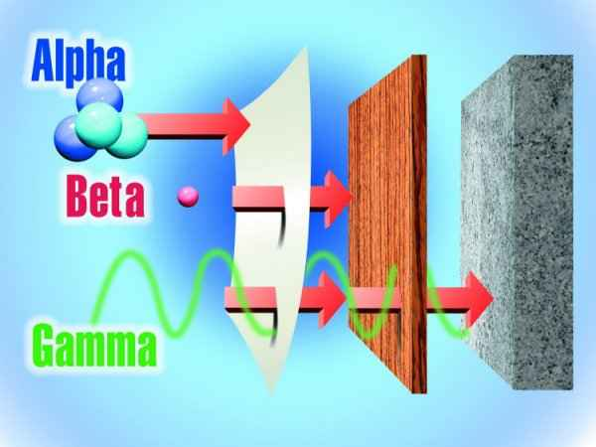

Slide 14
How would alpha, beta, and gamma radiation be affected by an electric field?
Positive (+) Plate
Lead Box with Radioactive Material
Negative (-) Plate

Slide 15
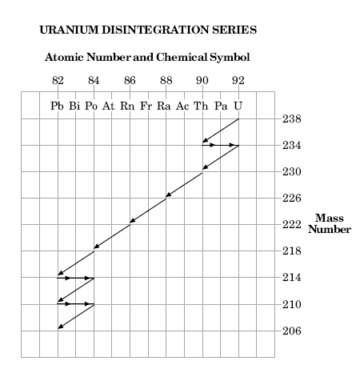

Slide 16
Nuclear Fission
Nuclear Fission: A large nucleus is split into two or more nuclei.
A neutron is sent into a uranium nucleus. The U nucleus splits into two smaller nuclei and three neutrons are released to hit other U nuclei.
Nuclear chain reaction: continuous series of fission reactions
Lots of energy released.
Atom bomb = uncontrolled fission reaction.
Nuclear power plants use controlled fission reactions to make electricity.

Slide 17
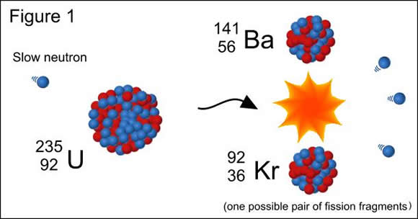
Nuclear Fission

Slide 18
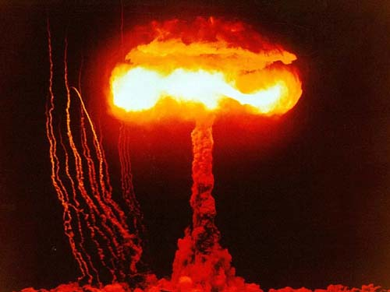
Uncontrolled Fission Reaction – Hydrogen Bomb

Slide 19
Nuclear Fusion
Nuclear Fusion: Two or more small nuclei combine to form a larger nucleus.
Occurs on the sun and other stars (not on Earth!).
Produces enormous amounts of energy
Why can’t we use this energy as a source of electricity???
To start a fusion reaction, temperature must be 200 million Kelvin (360 million degrees Fahrenheit).
Difficult to initiate and contain this reaction due to high temperature required (Remember Spiderman?…).

Slide 20
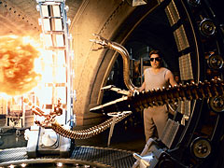
An attempt at controlling a fusion reaction on Earth…

Slide 21
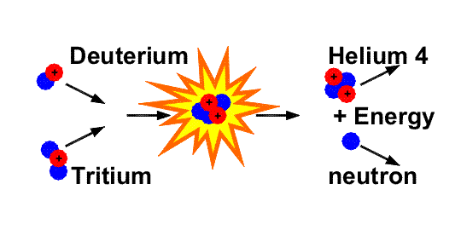
Nuclear Fusion
1 1 2 0
² H + ³ H → ⁴ He + ¹ n

Slide 22
Warm Up
Write the nuclear equation of a beta decay of Rn-222
Write the alpha decay equation of Po-237
Write the gamma decay of ²³⁷ U*

Slide 23
Half-Life
Radioactive Half-Life (t_{1/2}): the amount of time it takes for half of the atoms to undergo decay.
Use: dating fossils (carbon-14 dating), geological formations and human artifacts
Example Half Lives:
Potassium-40: Half-life = 1.25 years
Carbon-14: Half-life = 5739 years
Uranium-238: Half-life = 4.5 billion years
Rubidium-87: Half-life = 48 billion years

Slide 24
Half-Life Example Problems
The half-life of carbon-14 is 5739 years. You start with a sample of 16 grams of C-14.
How much will you have after 5739 years?
How much will you have after 11,478 years?
What fraction of the original amount will be left after 4 half-life periods?
After 7 half-life periods?

Slide 25
Half-Life Example Problems
A radioactive substance with a half-life of 8 years is allowed to decay. If the sample started out with 80 grams and ended with 10 grams, how many years have passed? Start Amount - Half Life - End Amount - Total Time -
You started with a sample of 70 grams of a radioactive material. After 30 years, you only had 8.75 grams left. What is the half-life of this substance? Start Amount - Half Life - End Amount - Total Time -

Slide 26
Half-Life Example Problems
You have 60 grams of Potassium-40 (half-life = 1.25 years). If this sample has been decaying for 10 years, how much did you start with? Start Amount - Half Life - End Amount - Total Time -

Slide 27
Uses of Nuclear Radiation
Dating Fossils
Smoke Detectors
Contain Americium which gives off alpha particles – producing a current. Smoke interrupts the current.
Detection of Diseases
Radioactive tracers
Radiation Therapy for Cancer

Slide 28
Why is radiation dangerous?
Alpha and Beta particles are charged.
They can ionize, or change the number of electrons in the atoms in your body.
Gamma Rays are energy (not charged).
They can give enough energy to the electrons in atoms to allow them to escape the atom (leaving an ion behind).

Slide 29
How much radiation have you been exposed to?
Have you ever….
Traveled in an airplane?
Gone through luggage inspection at the airport?
Worn a luminous watch?
Smoked?
Watched TV?
Sat in front of a computer screen?
Been near a smoke detector?
Had an x-ray?
Lived within 50 miles of a nuclear power plant?
Most organisms are adapted to survive low levels of background radiation.

Slide 30
Nuclear Waste
Fission
The products of fission reactions are often also radioactive. → used fuel rods must be stored in shielded containers away from ground water… forever…
Fusion
Produces very fast-moving neutrons. Shielding material in the reactor would have to be replaced periodically.

Slide 31
Warm Up
Describe the difference between alpha, beta, and gamma decay
An element has a half life of 10 hours. What fraction would remain after 40 hours?

