Slide 1
Unit: Electron Configurations
Day 3 - Notes
Noble gas abbreviations, Configurations for Ions, and Valence electrons

Slide 2
After today you should be able to…
Write electron configurations for elements and monatomic ions
Write noble gas abbreviations using the previous electron configuration objectives
Classify elements based on their outermost electron configuration
Obtain the amount of valence electrons from an electron configuration

Slide 3
Writing Electron Configurations from the Periodic Table
…You need a shiny new Periodic Table and 4 different colored markers/pens. Let’s label it!

Slide 4
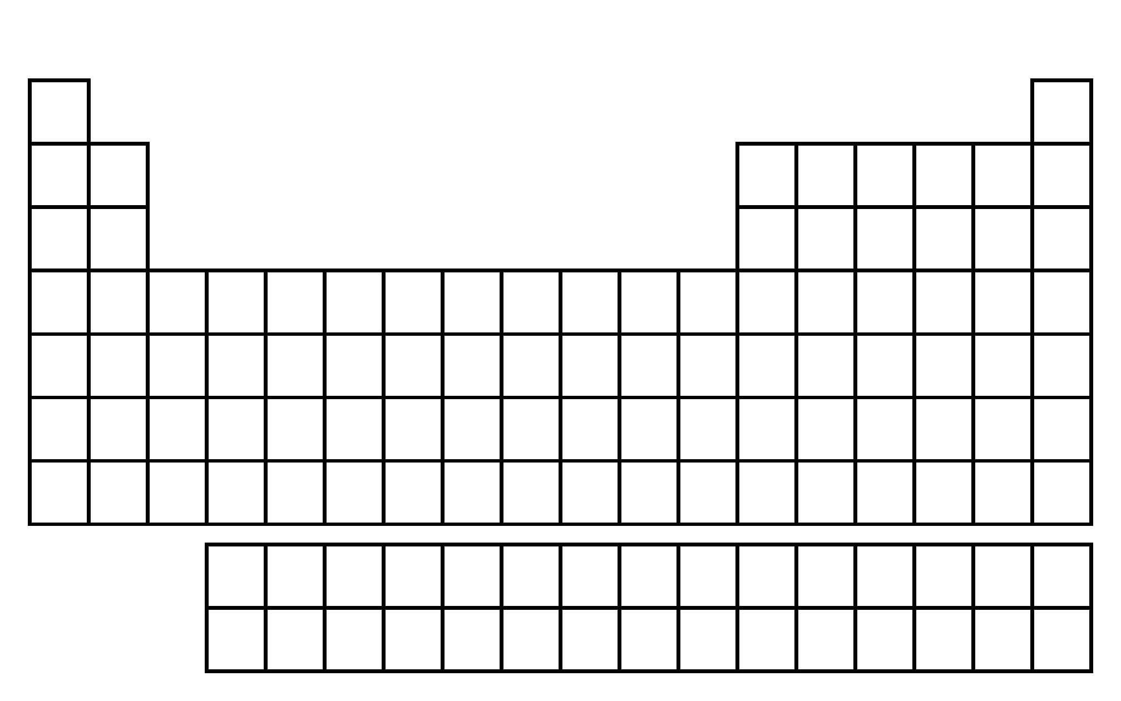
Labeling The Periodic Table:
Allow each box to represent an electron
Read from left to right →
1s
2s
Example: N, 1s² 2s² 2p³
2p
N
3s
Example: Cl, 1s² 2s² 2p⁶ 3s² 3p⁵
3p
Cl
4s
3d
4p
5s
Example: Ru, 1s² 2s² 2p⁶ 3s² 3p⁶ 4s² 3d¹⁰ 4p⁶ 5s² 4d⁶
4d
Ru
5p
6s
6p
5d
7s
6d
7p
4f
Careful!
5f

Slide 5
How to Write Noble Gas Abbreviations
Noble gases are located in group 18.
They include: He, Ne, Ar, Xe, Kr, Rn, Og
Pick the closest noble gas to the element you are writing the configuration for that comes before that element.
1s
1s
1s
He
He
He
2p
2p
2s
2p
2s
2s
Ne
Ne
Ne
3s
3s
3s
3p
3p
Mg
3p
Ar
Ar
Ar
4s
4s
4s
4p
4p
4p
Kr
Kr
3d
Kr
3d
K
3d
5s
5s
5s
5p
5p
5p
Xe
Xe
4d
Xe
4d
4d
6s
6s
6s
6p
6p
6p
Rn
Rn
5d
Rn
5d
5d
7s
Example: K
[Ar] 4s¹
7s
7s
6d
6d
6d
7p
7p
7p
4f
4f
4f
Example: Mg
[Ne] 3s²
5f
5f
5f
Bk
Example: Bk
[Rn] 7s² 5f⁹

Slide 6
Electron Configurations for Ions
You may recall that many elements will lose of gain electrons to obtain the same number of electrons as a noble gas.
If two atoms have the same number of electrons, they are said to be isoelectronic.

Slide 7
Examples: Write the electron configurations for the following ions:
O⁻²
O⁻² is isoelectronic with Neon.
Although O⁻² and Ne have the same electron configuration they are not identical.
1s² 2s² 2p⁶

Slide 8
Examples: Write the electron configurations for the following ions:
2. Rb⁺¹
Rb⁺¹ is isoelectronic with Krypton.
1s² 2s² 2p⁶ 3s² 3p⁶ 4s² 3d¹⁰ 4p⁶
Example: Given the electron configuration and charge, give the ion:
1s² 2s² 2p⁶, +2 charge
1s² 2s² 2p⁶ 3s² 3p⁶, -3 charge
Mg⁺²
P⁻³

Slide 9
Valence Electrons
Electrons located in the outermost energy level. (Responsible for bonding.)
To count the number of valence electrons in the electron configuration, you must look at the highest numbered energy level in the entire configuration.
Then add the electrons together.

Slide 10
Examples… How many valence electrons are in each of the following configurations?
Potassium (19e⁻)
1s² 2s² 2p⁶ 3s² 3p⁶ 4s¹
4th energy level is the valence shell
1 valence electron

Slide 11
Cobalt (27e⁻):
1s² 2s² 2p⁶ 3s² 3p⁶ 4s² 3d⁷
4th energy level is the valence shell
2 valence electrons

Slide 12
Neon (10e⁻):
1s² 2s² 2p⁶
2nd energy level is the valence shell
2 + 6 = 8 valence electrons

Slide 13
Questions? Begin Worksheet #3

