Slide 1
Unit: Periodic Trends
Day 1 - Notes
Basics of the Periodic Table
Notes:
Usually at the end of this lesson I show the similarities of the behavior of the alkali metals in water. I throw Li, Na, and K in water and show the similar reactions for each. If you don’t have access to these substances, I would recommend the video clip found at the end of the Power Point. ☺ Enjoy! -MsRazz ChemClass

Slide 2
After today, you should be able to…
Describe how the modern Periodic Table is arranged
Explain basic similarities and differences among groups and periods on the Periodic Table
Locate and label common groups on the Periodic Table
Locate and list properties of metals and nonmetals
Describe what a metalloid is

Slide 3
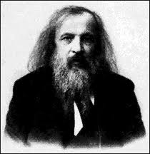
History of the Periodic Table: Dmitri Mendeleev
Mendeleev (1869):
Organized the elements by increasing atomic mass AND so that elements in the same row have similar properties.
TED-Ed: The Genius of Mendeleev’s PT

Slide 4
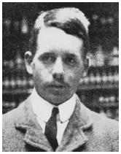
History of the Periodic Table: Henry Moseley
Moseley (1913): Rearranged the elements by increasing atomic number.
This is how the modern Periodic Table is arranged today.

Slide 5
Periodic Law: “When elements are arranged in order of increasing atomic number, there is a periodic pattern in their physical and chemical properties.”

Slide 6
Period: (series) The horizontal rows of the Periodic Table
Group: (families) The vertical columns on the Periodic Table

Slide 7
Elements in the same group have similar properties.
Groups are numbered 1-18

Slide 8
Elements in the same period do not have similar properties.
Periods are numbered 1-7
But they do have the same number of occupied energy levels.

Slide 9
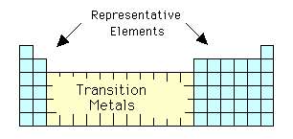
Blocks on the Periodic Table:
s and p blocks= Representative elements
d block = Transition metals
f block = Inner transition metals

Slide 10
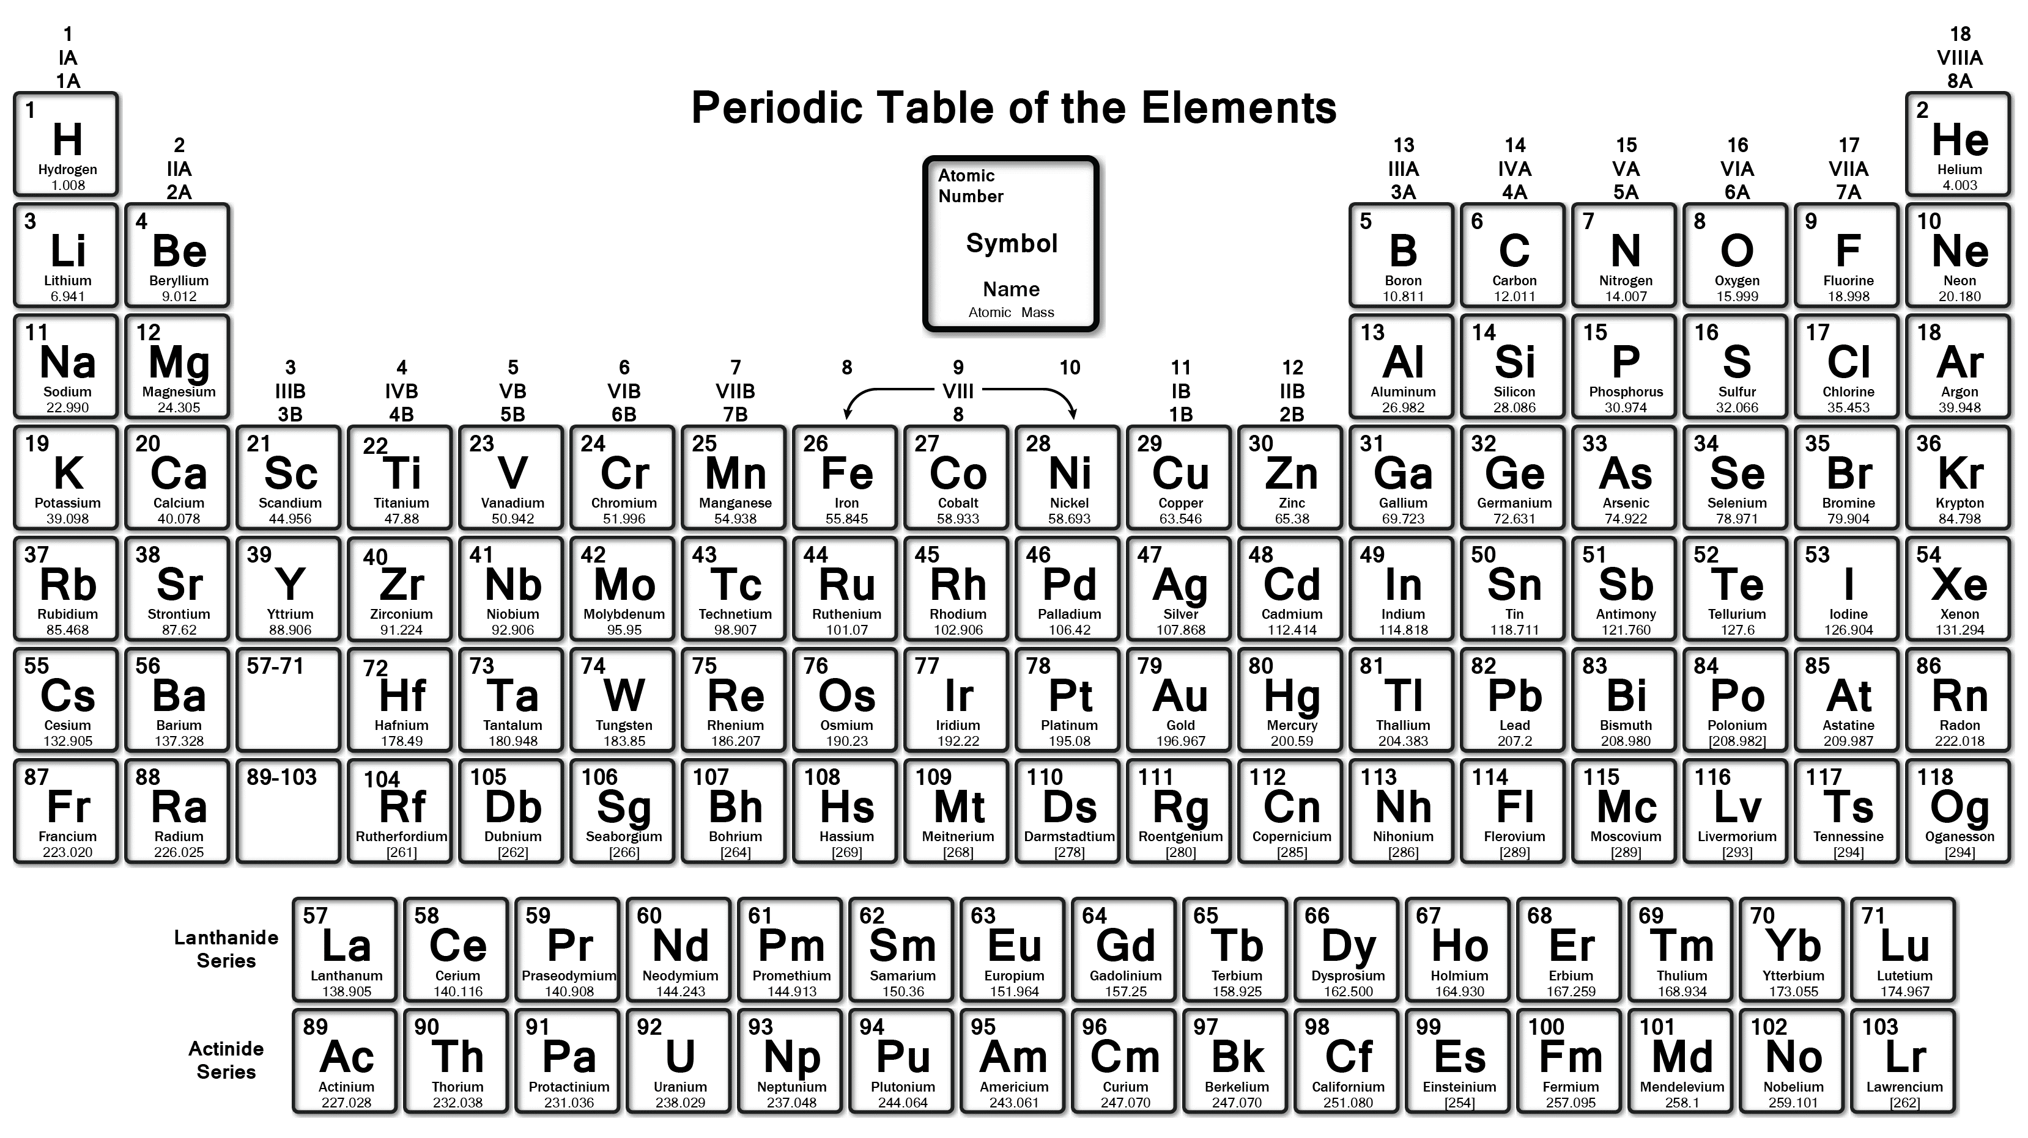
Common Names for Specific Groups on the Periodic Table:
Alkali metals
Noble gases
Alkaline earth metals
Halogens

Slide 11
The “staircase…”

Slide 12
Metals vs. Nonmetals
Left of staircase | Right side of staircase (include hydrogen!)
Lustrous (shiny) | Non-lustrous (dull)
Malleable (hammer into thin sheets) Ductile (make into thin wire) | Brittle (breaks easily)
Good conductors of heat and electricity | Poor conductors (good insulator)

Slide 13
Metalloids: Touch the staircase and have properties of both metals and nonmetals. (Note: Al is a metal!)
They are semiconductors which means they normally do not conduct electricity but will conduct at high temperatures or when certain substances are added.

Slide 14
Phenomenon: Alkali metals + Water

Slide 15
Questions?
Begin Worksheet #1

