Slide 1
Unit: Chemical Bonding
Day 7 - Notes
Intermolecular Forces

Slide 2
After today, you should be able to…
Identify the different types of intermolecular forces
Explain the differences
Definition:
Dipole – a molecule with positively and negatively charged sides

Slide 3
Intermolecular Forces
Intermolecular forces are attractive forces between molecules.
  Boiling a cup of water
Intramolecular forces are attractive forces between atoms in a molecule.
  Breaking break all O-H bonds in a cup of water
Generally, intermolecular forces are much weaker than intramolecular forces.

Slide 4
Types of Intermolecular Forces
Strongest to Weakest forces:
ion–dipole forces
hydrogen bonding (a special dipole–dipole force)
dipole–dipole forces
dispersion forces (or London dispersion forces)
  Aka Van Der Waals

Slide 5
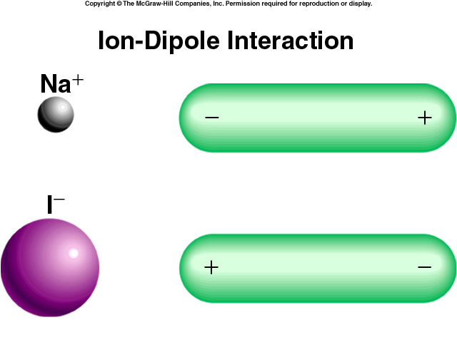
Ion-Dipole Forces
Attractive forces between an ion and a polar molecule
Ion-Dipole Interaction

Slide 6
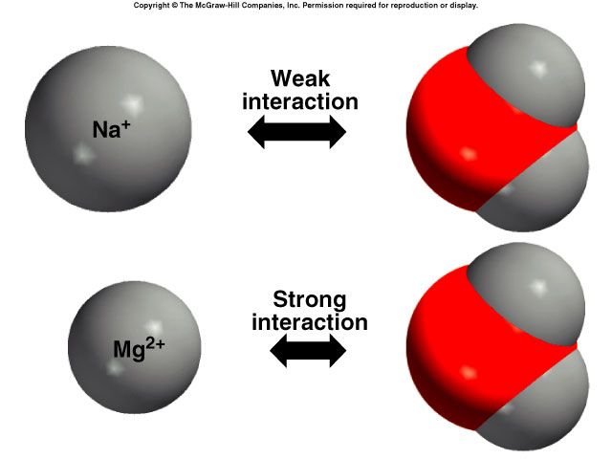

Slide 7
Types of Intermolecular Forces
1. Hydrogen Bond (strongest)
The hydrogen bond is a special dipole-dipole interaction between the hydrogen atom in a polar N-H, O-H, or F-H bond and an electronegative O, N, or F atom. IT IS NOT A BOND.
O
H
…
F
or
F
H
…
N

Slide 8
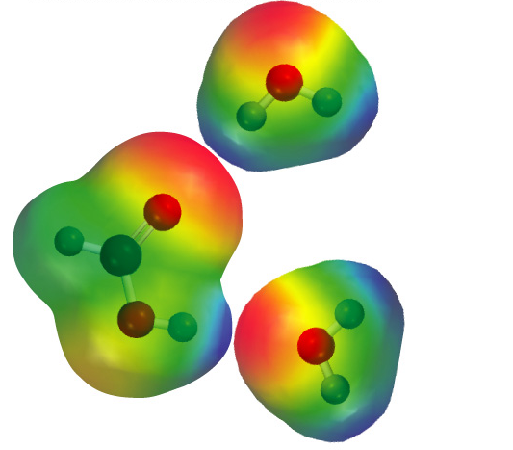
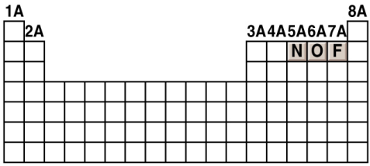

Slide 9
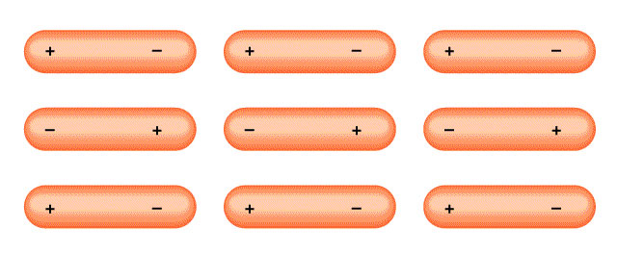
Dipole-Dipole Forces
Attractive forces between polar molecules
Orientation of Polar Molecules in a Solid

Slide 10
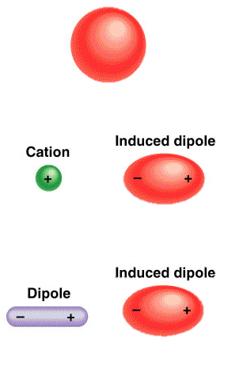
Dispersion Forces
van der Waals forces/London forces (weakest)
Attractive forces that arise as a result of temporary dipoles created in atoms or molecules
ion-induced dipole interaction
dipole-induced dipole interaction

Slide 11
What type(s) of intermolecular forces exist between each of the following molecules?
HBr
HBr is a polar molecule: dipole-dipole forces. There are also dispersion forces between HBr molecules.
CH₄
CH₄ is nonpolar: dispersion forces.
S
O
O
SO₂
SO₂ is a polar molecule: dipole-dipole forces. There are also dispersion forces between SO₂ molecules.

Slide 12
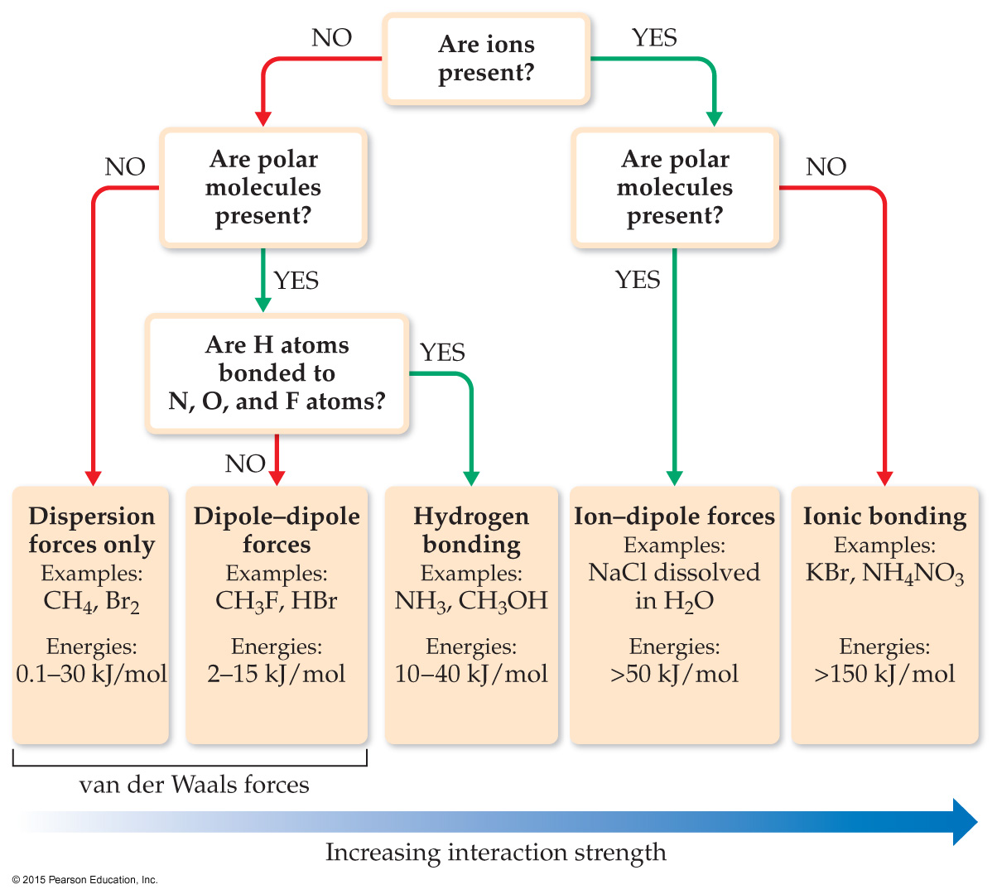
Summary

Slide 13
Questions?
Begin Worksheet #3

