Slide 1
Unit: Acids, Bases, and Solutions
Day 2 - Notes
Concentration

Slide 2
After today, you should be able to…
Define molarity in terms of its mathematical formula
Calculate moles, liters, or molarity of a given solution
Explain how to make a solution

Slide 3
Recall, concentration is a measure of the amount of solute dissolved in a given quantity of solvent.

Slide 4
Molarity
In chemistry, the most important unit of concentration is molarity.
Molarity: (M) is the number of moles of solute dissolved in one liter of solution.

Slide 5
Molarity
Molarity=
Moles of solute
Liters of solution
Important: The volume is the total volume of resulting solution, not the solvent alone.

Slide 6
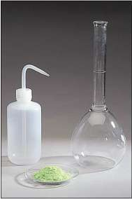
Steps for making a 0.5M solution
Add 0.5mol of solute to a 1.0L volumetric flask half-filled with distilled water

Slide 7
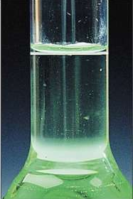
Steps for making a 0.5M solution
2. Swirl the flask to dissolve the solute.
3. Fill the flask to the mark etched on the side of the flask (1-L mark).

Slide 8
Performing Calculations With Molarity
Example: What is the molarity of a solution that contains 0.25 moles of NaCl in 0.75L of solution?
M=
mol=
L=
?
0.25 mol NaCl
0.75L
0.25 mol NaCl
M
=
0.75L
Molarity
=
0.33 mol/L or 0.33M

Slide 9
Performing Calculations With Molarity
Example: What volume of a 1.08M KI solution would contain 0.642 moles of KI?
M=
mol=
L=
1.08 M
0.642 mol KI
?
0.642 mol KI
1.08 M
=
L
Volume
=
0.594L

Slide 10
Performing Calculations With Molarity
Example: How many grams of CaBr₂ are dissolved in 0.455L of a 0.39M CaBr₂ solution?
M=
mol=
L=
1 Ca=40.08
0.39 M CaBr₂
2 Br=79.90(2)
mol
199.88g
?
0.39 M
=
0.455L
0.455L
mol
=
0.18 mol CaBr₂
0.18 mol CaBr₂
199.88gCaBr₂
x
=
36g CaBr₂
1 mol CaBr₂

Slide 11
Questions?
Begin WS#2

