Slide 1
Lists in Lists
Lists can consist of scalars (namely numbers) and elements of a much more complex structure (you've already seen such examples as strings, booleans, or even other lists in the previous Section Summary lessons). Let's have a closer look at the case where a list's elements are just lists.
We often find such arrays in our lives. Probably the best example of this is a chessboard.
PE1: 3.7.1.1

Slide 2
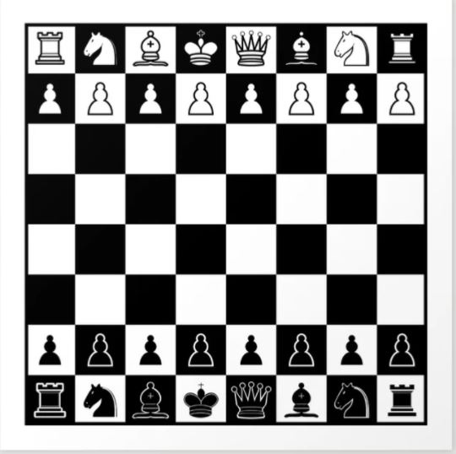

Slide 3
Lists in Lists
A chessboard is composed of rows and columns. There are eight rows and eight columns. Each column is marked with the letters A through H. Each line is marked with a number from one to eight.
The location of each field is identified by letter-digit pairs. Thus, we know that the bottom left corner of the board (the one with the white rook) is A1, while the opposite corner is H8.
Let's assume that we're able to use the selected numbers to represent any chess piece. We can also assume that every row on the chessboard is a list.

Slide 4
Lists in Lists
Look at the code below:
row = []
for i in range(8):
row.append(WHITE_PAWN)
It builds a list containing eight elements representing the second row of the chessboard - the one filled with pawns (assume that WHITE_PAWN is a predefined symbol representing a white pawn).

Slide 5
Lists in Lists
The same effect may be achieved by means of a list comprehension; the special syntax used by Python in order to fill massive lists.
A list comprehension is actually a list but created on-the-fly during program execution and is not described statically.
Take a look at the snippet:
row = [WHITE_PAWN for i in range(8)]
The part of the code placed inside the brackets specifies:
the data to be used to fill the list (WHITE_PAWN)
the clause specifying how many times the data occurs inside the list (for i in range(8))

Slide 6
Lists in Lists
Let us show you some other list comprehension examples:
Example #1:
squares = [x ** 2 for x in range(10)]
The snippet produces a ten-element list filled with squares of ten integer numbers starting from zero (0, 1, 4, 9, 16, 25, 36, 49, 64, 81)

Slide 7
Lists in Lists
Let us show you some other list comprehension examples:
Example #2:
twos = [2 ** i for i in range(8)]
The snippet creates an eight-element array containing the first eight powers of two (1, 2, 4, 8, 16, 32, 64, 128)

Slide 8
Lists in Lists
Let us show you some other list comprehension examples:
Example #3:
odds = [x for x in squares if x % 2 != 0 ]
The snippet makes a list with only the odd elements of the squares list

Slide 9
Lists in Advanced applications – Arrays PE1: 3.7.1.2
Lists in lists: two-dimensional arrays
Let's also assume that a predefined symbol named EMPTY designates an empty field on the chessboard.
So, if we want to create a list of lists representing the whole chessboard, it may be done in the following way:
board = []
for i in range(8):
row = [EMPTY for i in range(8)]
board.append(row)
Note:
the inner part of the loop creates a row consisting of eight elements (each of them equal to EMPTY) and appends it to the board list;
the outer part repeats it eight times;
in total, the board list consists of 64 elements (all equal to EMPTY)

Slide 10
Lists in Advanced applications – Arrays PE1: 3.7.1.2
This model perfectly mimics the real chessboard, which is in fact an eight-element list of elements, all being single rows. Let's summarize our observations:
the elements of the rows are fields, eight of them per row;
the elements of the chessboard are rows, eight of them per chessboard.
The board variable is now a two-dimensional array. It's also called, by analogy to algebraic terms, a matrix.
As list comprehensions can be nested, we can shorten the board creation in the following way:
board = [[EMPTY for i in range(8)] for j in range(8)]
The inner part creates a row, and the outer part builds a list of rows.

Slide 11
Lists in Advanced applications – Arrays PE1: 3.7.1.2
The board variable is now a two-dimensional array. It's also called, by analogy to algebraic terms, a matrix.
As list comprehensions can be nested, we can shorten the board creation in the following way:
board = [[EMPTY for i in range(8)] for j in range(8)]
The inner part creates a row, and the outer part builds a list of rows.

Slide 12
Lists in lists: two-dimensional arrays – continued PE1: 3.7.1.3
Access to the selected field of the board requires two indices –
the first selects the row;
the second - the field number inside the row, which is de facto a column number.
Take a look at the chessboard. Every field contains a pair of indices which should be given to access the field's content:

Slide 13
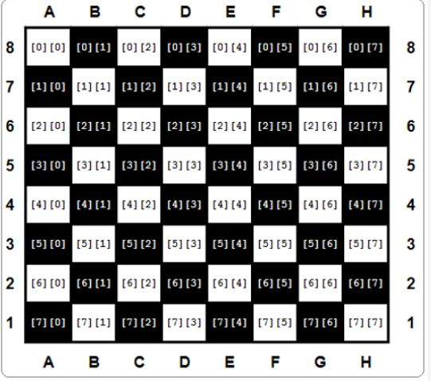

Slide 14
Lists in lists: two-dimensional arrays – continued PE1: 3.7.1.3
Access to the selected field of the board requires two indices –
the first selects the row;
the second - the field number inside the row, which is de facto a column number.
Take a look at the chessboard. Every field contains a pair of indices which should be given to access the field's content:
Glancing at the figure shown above, let's set some chess pieces on the board. First, let's add all the rooks:
board[0][0] = ROOK
board[0][7] = ROOK
board[7][0] = ROOK
board[7][7] = ROOK

Slide 15
Lists in lists: two-dimensional arrays – continued PE1: 3.7.1.3
Glancing at the figure shown above, let's set some chess pieces on the board. First, let's add all the rooks:
board[0][0] = ROOK
board[0][7] = ROOK
board[7][0] = ROOK
board[7][7] = ROOK
==========================================
EMPTY = "-"
ROOK = "ROOK"
board = []
for i in range(8):
row = [EMPTY for i in range(8)]
board.append(row)
board[0][0] = ROOK
board[0][7] = ROOK
board[7][0] = ROOK
board[7][7] = ROOK
print(board)

Slide 16
Lists in lists: two-dimensional arrays – continued PE1: 3.7.1.3
Glancing at the figure shown above, let's set some chess pieces on the board. If you want to add a knight to C4, you do it as follows:
board[4][2] = KNIGHT
And now a pawn to E5:
board[3][4] = PAWN
print(board)

Slide 17
Lists in lists: two-dimensional arrays – continued PE1: 3.7.1.3
And now – Finish coding the 2 rows

Slide 18
Multidimensional nature of lists: advanced applications PE1: 3.7.1.4
Let's go deeper into the multidimensional nature of lists. To find any element of a two-dimensional list, you have to use two coordinates:
a vertical one (row number)
and a horizontal one (column number).
Imagine that you develop a piece of software for an automatic weather station. The device records the air temperature on an hourly basis and does it throughout the month. This gives you a total of 24 × 31 = 744 values. Let's try to design a list capable of storing all these results.
First, you have to decide which data type would be adequate for this application. In this case, a float would be best, since this thermometer is able to measure the temperature with an accuracy of 0.1 ℃.

Slide 19
Multidimensional nature of lists: advanced applications PE1: 3.7.1.4
Then you take an arbitrary decision that the rows will record the readings every hour on the hour (so the row will have 24 elements) and each of the rows will be assigned to one day of the month (let's assume that each month has 31 days, so you need 31 rows). Here's the appropriate pair of comprehensions (h is for hour, d for day):
temps = [[0.0 for h in range(24)] for d in range(31)]
The whole matrix is filled with zeros now. You can assume that it's updated automatically using special hardware agents. The thing you have to do is to wait for the matrix to be filled with measurements.

Slide 20
Multidimensional nature of lists: advanced applications PE1: 3.7.1.4
Now it's time to determine the monthly average noon temperature. Add up all 31 readings
recorded at noon and divide the sum by 31. You can assume that the midnight temperature is stored first. Here's the relevant code:
temps = [[0.0 for h in range(24)] for d in range(31)]
#
# The matrix is magically updated here.
#
total = 0.0
for day in temps:
total += day[11]
average = total / 31
print("Average temperature at noon:", average)
Note: the day variable used by the for loop is not a scalar - each pass trough the temps matrix assigns it
with the subsequent rows of the matrix; hence, it's a list. It has to be indexed with 11 to access the
temperature value measured at noon.

Slide 21
Multidimensional nature of lists: advanced applications PE1: 3.7.1.4
Now find the highest temperature during the whole month - see the code:
temps = [[0.0 for h in range(24)] for d in range(31)]
#
# The matrix is magically updated here.
#
highest = -100.0
for day in temps:
for temp in day:
if temp > highest:
highest = temp
print("The highest temperature was:", highest)
Note:
the day variable iterates through all the rows in the temps matrix;
the temp variable iterates through all the measurements taken in one day.

Slide 22
Multidimensional nature of lists: advanced applications PE1: 3.7.1.4
Now count the days when the temperature at noon was at least 20 ℃:
temps = [[0.0 for h in range(24)] for d in range(31)]
#
# The matrix is magically updated here.
#
hot_days = 0
for day in temps:
if day[11] > 20.0:
hot_days += 1
print(hot_days, "days were hot.")

Slide 23
Three-dimensional arrays PE1: 3.7.1.5
Python does not limit the depth of list-in-list inclusion. Here you can see an example of a three-dimensional array:
Imagine a hotel. It's a huge hotel consisting of three buildings, 15 floors each. There are 20 rooms on each floor. For this, you need an array which can collect and process information on the occupied/free rooms.
First step - the type of the array's elements. In this case, a Boolean value (True/False) would fit.
Step two - calm analysis of the situation. Summarize the available information: three buildings, 15 floors, 20 rooms.
Now you can create the array:
rooms = [[[False for r in range(20)] for f in range(15)] for t in range(3)]
The first index ( 0 through 2 ) selects one of the buildings; the second ( 0 through 14 ) selects the floor, the third ( 0 through 19 ) selects the room number. All rooms are initially free.
Now you can book a room for two newlyweds: in the second building, on the tenth floor, room 14:
rooms[1][9][13] = True
and release the second room on the fifth floor located in the first building:
rooms[0][4][1] = False

Slide 24
Three-dimensional arrays PE1: 3.7.1.5
Check if there are any vacancies on the 15th floor of the third building:
vacancy = 0
for room_number in range(20):
if not rooms[2][14][room_number]:
vacancy += 1
The vacancy variable contains 0 if all the rooms are occupied, or the number available rooms otherwise.
Congratulations , you have made it to the end of the module. Keep up the good work!

Slide 25
Three-dimensional arrays PE1: 3.7.1.5
rooms = [[[False for r in range(20)] for f in range(15)] for t in range(3)]
#20 rooms, 15 floors, 3 buildings
rooms[1][9][13] = True
rooms[0][4][1] = False
vacancy = 0
for room_number in range(20):
if not rooms[2][14][room_number]:
vacancy += 1
print(vacancy)
for i in rooms:
print(i)

Slide 26
Key takeaways PE1: 3.7.1.6 Section Summary
1. List comprehension allows you to create new lists from existing ones in a concise and elegant way. The syntax of a list comprehension looks as follows:
[expression for element in list if conditional]
which is actually an equivalent of the following code:
for element in list: if conditional: expression
Here's an example of a list comprehension - the code creates a five-element list filled with with the first five natural numbers raised to the power of 3:
cubed = [num ** 3 for num in range(5)]
print(cubed) # outputs: [0, 1, 8, 27, 64]

Slide 27
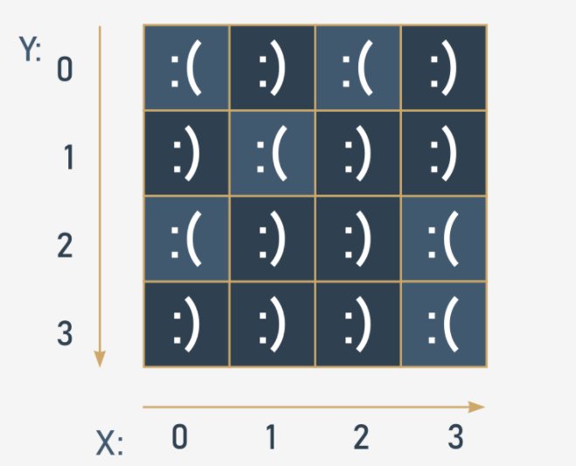
Key takeaways PE1: 3.7.1.6 Section Summary
2. You can use nested lists in Python to create matrices (i.e., two-dimensional lists). For example:
# A four-column/four-row table - a two dimensional array (4x4)
table = [[":(", ":)", ":(", ":)"],
[":)", ":(", ":)", ":)"],
[":(", ":)", ":)", ":("],
[":)", ":)", ":)", ":("]]
print(table)
print(table[0][0]) # outputs: ':('
print(table[0][3]) # outputs: ':)'

Slide 28
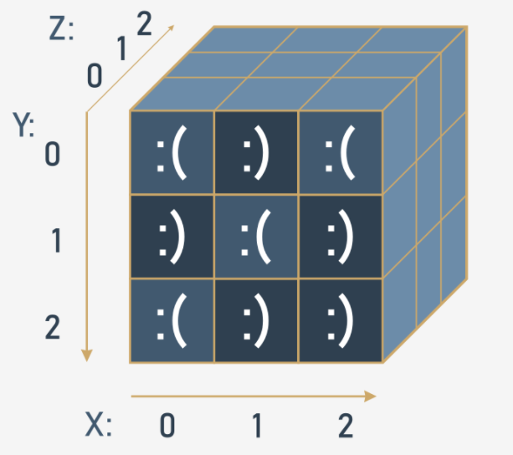
Key takeaways PE1: 3.7.1.6 Section Summary
3. You can nest as many lists in lists as you want, and therefore create n-dimensional lists, e.g., three-, four- or even sixty-four-dimensional arrays. For example:
# Cube - a three-dimensional array (3x3x3)
cube = [[[':(', 'x', 'x'],
[':)', 'x', 'x'],
[':(', 'x', 'x']],
[[':)', 'x', 'x'],
[':(', 'x', 'x'],
[':)', 'x', 'x']],
[[':(', 'x', 'x'],
[':)', 'x', 'x'],
[':)', 'x', 'x']]]
print(cube)
print(cube[0][0][0]) # outputs: ':('
print(cube[2][2][0]) # outputs: ':)'

Slide 29
Module Completion PE1: 3.7.1.7 Module Completion
Congratulations! You have completed Module 3.
Well done! You've reached the end of Module 3 and completed a major milestone in your Python programming education. Here's a short summary of the objectives you've covered and got familiar with in Module 3:
Boolean values to compare different values and control the execution paths using the if and if-else instructions;
the utilization of loops (while and for) and how to control their behavior using the break and continue instructions;
the difference between logical and bitwise operations;
the concept of lists and list processing, including the iteration provided by the for loop, and slicing;

