Slide 1
1.00 | Understand ethics.
1.01 | Understand the nature of ethics.
Emotional Intelligence LAP 123

Slide 2
Ethics
The basic principles that govern your behavior
Ethical principles
Do not change when you’re in a new situation
The same at school, home, and work
Notes:
What is ethics?
When you think of ethics, what comes to mind?
Doing what people say you should do?
Obeying the law?
While these can both be part of ethical behavior, it takes a lot more than just listening to authority figures or doing what’s legal to be an ethical person.
DISCUSSION #1: Ask students to discuss what ethical behavior means to them.
Being ethical means doing what’s right, no matter what, even when it doesn’t benefit you.
Ethics are the basic principles that govern your behavior.
Although some people have different views on what ethics means, following ethical principles means your ethical beliefs don’t change when you’re in a new situation.
You follow the same ethical principles at school, home, and work.
Ethical principles can guide you through dilemmas with your friends, your teachers, and your coworkers.
At first, it might seem restrictive to have a basic set of principles to help you make your decisions.
But following ethical principles can actually make your decision-making process much easier!
When you have a set of rules to guide your behavior, you have a game plan in place when it comes to tough decisions.

Slide 3
Ethical Situations
Involve deciding whether something is right or wrong
Someone (or something) could be harmed.
Notes:
You solve problems and deal with complex situations every day, but not every issue you encounter involves ethics.
Deciding what you’re going to eat for lunch or choosing which class you want to study for tonight aren’t ethical issues—they’re simply decisions.
So how do you figure out if the problem you’re dealing with is just one of the many decisions you face every day or an ethical situation that can be solved using ethical principles?
When you’re dealing with an ethical situation, you’re deciding whether something is right or wrong.
Often in an ethical situation, if you pick the wrong choice, someone (or something) could be harmed.
This doesn’t necessarily mean that the issue must be life or death, but that the wrong action could cause someone or something to be hurt.
No one will be harmed if you decide to have a burger instead of pizza for lunch, because neither of those decisions is right or wrong.
But what about if you see that a classmate is being bullied, or consider taking the money that just fell out of your coworker’s purse, or are considering taking the day off work even though you have a scheduled shift?
In those situations, there’s a right and wrong thing to do.
If you don’t stick up for your classmate, s/he will continue to be hurt by bullies.
If you take your coworker’s money, s/he won’t have the money s/he may have been depending on for lunch.
And if you don’t show up for work, your boss and coworkers will have to cover for you.
Ethical situations don’t just deal with choices—they deal with right and wrong choices.
DISCUSSION #2: Ask students to give examples of ethical situations they’ve faced recently.
ON THE WEB: Another way to identify ethical issues is by using the “Viral News Test,” as explained in the article “Ethics Tests” by Ethics Ops: https://www.ethicsops.com/viral-news-test. The Viral News Test uses a series of questions about reputation to help determine whether an issue is ethical or not.

Slide 4
Consequences of Unethical Behavior
Lost trust
Legal problems
A poor reputation
A bad example
Notes:
Ethical behavior is important because if people aren’t ethical, they can face major consequences.
Lost trust
Being unethical can cause others to stop trusting you in every aspect of your life.
At home, your parents won’t trust you if you repeatedly lie to them or skip out on your chores.
At school, your teachers won’t trust you if you cheat on a test or plagiarize a paper.
And at work, your boss won’t trust you if you spend your whole shift texting instead of helping customers.
Legal problems
Although being unethical doesn’t always mean breaking the law, sometimes unethical actions can have legal consequences.
Parking in a handicapped spot (even though you aren’t handicapped) because you really want to be close to the entrance of the movie theater definitely isn’t ethical.
It’s also illegal and can lead to some pretty hefty fines!
A poor reputation
If you make a habit of unethical behavior, your reputation may suffer.
But you aren’t the only one who can be hurt!
Your business and school could also earn a reputation for being unethical if many employees or students don’t follow ethical principles.
Unethical behavior doesn’t just harm you—it harms everyone.
A bad example.
One person behaving unethically can set an example for a whole group.
This is especially true when the unethical person is in a leadership position.
If you know your boss is stealing office supplies from your job, you might be tempted to do the same, even though you know it’s unethical.
When one person is unethical, it can bring everyone down!
DISCUSSION #3: Ask students to name other consequences of behaving unethically.

Slide 5
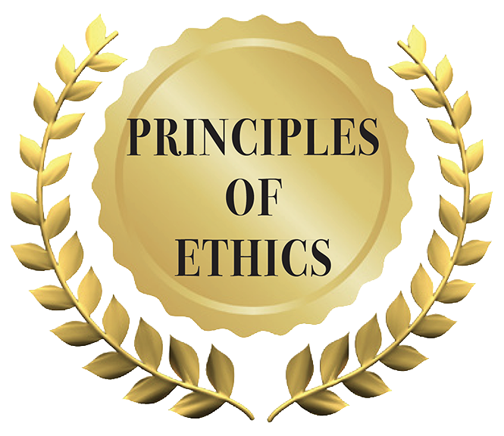
Ethical Principles: Standards that govern behavior; not dependent on circumstance.

Slide 6
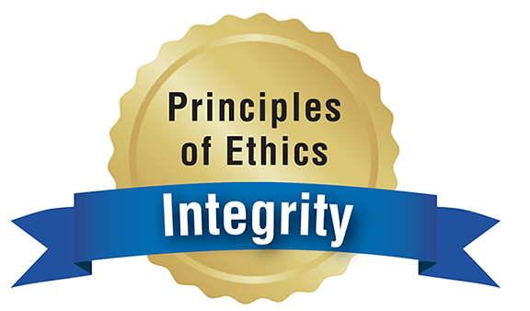
Ethical Principles
Integrity
Adhering to an established set of personal ethics and sound moral principles; acting with honesty in all situations
Acting with honesty in all situations
“Academic Integrity” at https://www.youtube.com/watch?v=2wvXEAO4Q44&feature=youtu.be&list=PL0LEcCrzCkHrF6i3W_aWQXZCTzzuGViE1.
Notes:
Ethical principles can help people make the right decisions all the time, even when facing tough situations.
Integrity
Integrity is acting with honesty in all situations.
This means that you do the right thing even when no one else is watching, when it isn’t easy, or when it might not be in your best interest.
Example:
You typically receive $20 a night at your regular babysitting job.
What would you do if your employer accidentally handed you a $50 bill?
You could use the money, and it’s not like you stole it out of your employer’s wallet.
But is taking the money the right thing to do?
If you have integrity, you’ll be honest and let your employer know that s/he overpaid you.
What if you’re scheduled to work, but you really want to spend the day hanging out with your best friend?
You might consider calling in sick so you can have the day off.
But, if you have integrity, you’ll be honest and honor your commitment to your job.
Oprah Winfrey got to the heart of integrity when she said, “Real integrity is doing the right thing, knowing that nobody’s going to know whether you did it or not.”
Your employer might never know you pocketed the extra money, and your boss might never know you were faking being sick, but your personal integrity will still suffer if you are dishonest.
ON THE WEB: Learn more about integrity and its role in the classroom from the video “Academic Integrity” by Stefanie Stauber: https://www.youtube.com/watch?v=2wvXEAO4Q44&feature=youtu.be&list=PL0LEcCrzCkHrF6i3W_aWQXZCTzzuGViE1.
DISCUSSION #4: Ask students to discuss times they’ve acted with integrity.

Slide 7
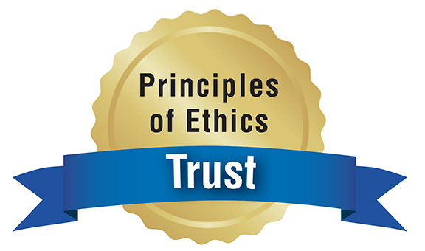
Ethical Principles
Trust
Reliable; deserving the confidence of others
Being trustworthy in all your relationships—with your teachers, coworkers, friends, and family members
Notes:
Trust
Behaving ethically means being trustworthy in all your relationships—with your teachers, coworkers, friends, and family members.
This involves doing what you say you will do (no matter what!) and telling the truth.
If you say you’ll work on Saturday night, you’ll show up for your shift.
If your teacher gives you an extension on a paper, you’re sure to turn it in by the agreed-upon due date.
And if you promise a friend you’ll attend her band’s show, you show up, even if another friend asks you to do something more fun that night.
Keeping your word is a big part of building trust.
Building trust also means not gossiping about your friends or coworkers.
If a friend tells you something in confidence, you keep her/his secret instead of sharing it with the rest of your friends.
DISCUSSION #5: Ask students to discuss what trustworthy behavior means to them.

Slide 8
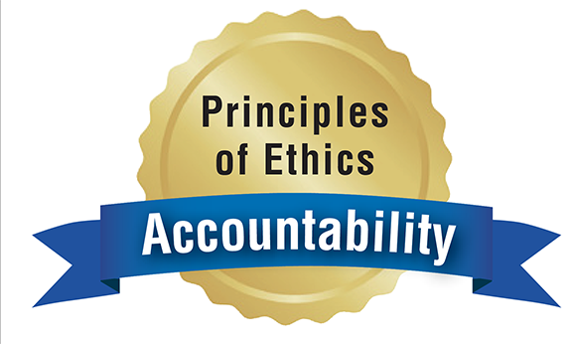
Ethical Principles
Accountability
The condition of having to answer for or be liable for your actions;
Accepting responsibility for all your decisions
“What It Means To Be Responsible and Accountable in the Workplace” at http://woman.thenest.com/means-responsible-accountable-workplace-11051.html.
Notes:
Accountability
People who are accountable for their actions accept responsibility for all their decisions.
Just imagine what would happen if no one was accountable for her/his actions—you wouldn’t be able to count on anyone!
Imagine that you have a basketball game tomorrow. It’s your responsibility to go to bed at a reasonable time instead of staying up until four in the morning.
Taking accountability for your actions means making the right decision that will benefit your team members and help you perform to the best of your abilities.
Accountable people also accept blame when they don’t live up to their promises.
If you do stay up late and perform poorly in your game because you’re too tired, you’ll accept accountability for your mistake and apologize to your teammates.
ON THE WEB: You can read more about accountability—and how it relates to responsibility—in the article “What It Means To Be Responsible and Accountable in the Workplace” by Laurie Brenner: http://woman.thenest.com/means-responsible-accountable-workplace-11051.html.
DISCUSSION #6: Ask students to name some accountable people they know. How do they display ethical behavior?

Slide 9
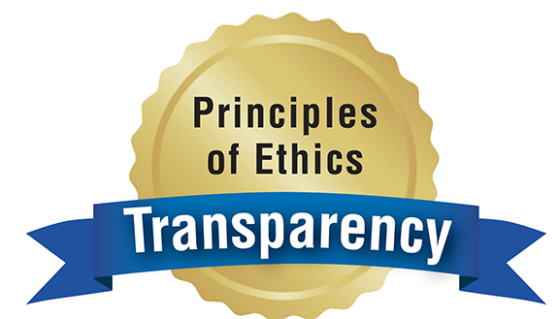
Ethical Principles
Transparency
The quality of being just as one seems; being open and truthful when communicating
Being truthful when you communicate
Notes:
Transparency
Transparency means being truthful when you communicate.
This is more than just avoiding lies (although that’s important, too!).
It also involves speaking up about your feelings and communicating openly, even when it’s difficult.
Example: If you’re working on a group project and you know you’re running behind on your portion of the work, it’s not ethical to hide that from your group members.
Transparency also means not spinning your accomplishments to be something they’re not.
It might seem like just a little white lie to make up experience on your résumé, but that’s not being transparent to your potential employer.
And if a teacher congratulates you on your latest group project, it’s not transparent to take all the credit without pointing out your group members’ contributions.
Remember, being transparent isn’t just about you—it also involves encouraging others to be open and honest.
If you know a classmate is having a hard time with your group project, encourage him/her to share his/her struggles with you.
DISCUSSION #7: Ask students to name some consequences of not being transparent.

Slide 10
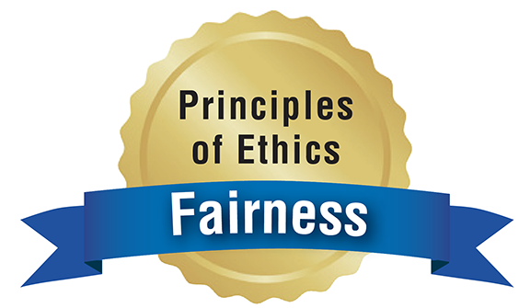
Ethical Principles
Fairness
The ability to make judgments without favoritism or self-interest; engaging in fair competition and creating equal relationships
Treating others the way you’d like to be treated
Notes:
Fairness
Your kindergarten teacher may have told you about the Golden Rule: Do unto others as you would have others do unto you.
Essentially, this is what fairness means—treating others the way you’d like to be treated.
Fairness means creating relationships that are equal.
Fair people don’t take advantage of their classmates by trying to cheat off them or giving them more work in a group project.
And if an ethical person brought cookies in to share with the class, s/he wouldn’t give more to his/her best friends and skip over the people s/he didn’t like. S/He would share with everyone because that’s what’s fair.
Fairness also means sticking up for people who are being treated unfairly.
If you see a coworker taking advantage of another coworker, speaking up is the ethical thing to do.
DISCUSSION #8: Ask students to name other examples of fair behavior.

Slide 11
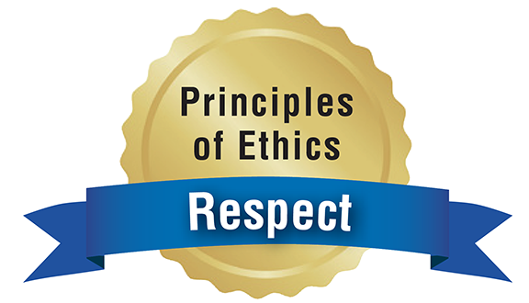
Ethical Principles
Respect
Regard or esteem
Honoring the rights, freedoms, views, and property of others
“How To Demonstrate Respect in the Workplace” at https://www.thebalancecareers.com/how-to-demonstrate-respect-in-the-workplace-1919376.
Notes:
Respect
Ethical people always honor the rights, freedoms, views, and property of others.
In other words, they’re respectful.
Ethical people respect other people’s opinions. They don’t start an argument or insult someone just because they don’t agree.
Showing respect means listening to others when they speak, not interrupting, and using basic manners (such as being polite, saying “please” and “thank you,” and maintaining proper eye contact).
ON THE WEB: The article “How To Demonstrate Respect in the Workplace” by Susan M. Heathfield details several ways you can show respect for coworkers: https://www.thebalancecareers.com/how-to-demonstrate-respect-in-the-workplace-1919376. You can also use most of these tips at school or at home.
ON THE WEB: This article by Greg Toppo, “Respect at School in Decline, Survey Shows,” explains that many people feel students, teachers, and parents aren’t respectful of each other: http://www.usatoday.com/story/news/nation/2014/ 01/23/respect-schools-teachers-parents-students/4789283/. What do you think? Have things changed since 2014, when the article was written? If respect is in decline, what do you think this means for the state of ethical behavior?
DISCUSSION #9: Ask students to discuss times they’ve been respectful in the past.

Slide 12
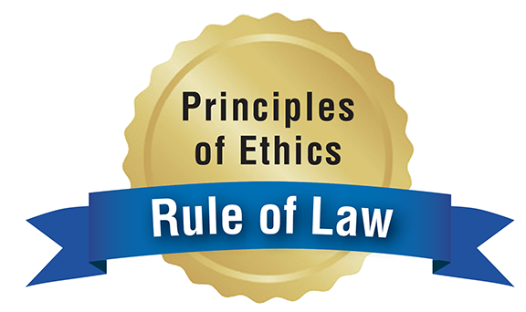
Ethical Principles
Rule of law
Complying with laws and regulations
Respecting the rules and laws of your city and country
Notes:
Rule of law
Being ethical doesn’t just mean following the law.
You can technically follow the law and still be unethical!
However, part of being ethical means respecting the rules and laws of your city and country.
Stealing clothing from a retail store is both unethical and illegal.
Although the rules at your school and work are not laws, it’s still ethically important to follow them.
If your boss says you’re not allowed to text while you’re on the clock, it isn’t ethical to text your friends whenever she’s not around.
DISCUSSION #10: Ask students to name rules that should be followed at their school.

Slide 13
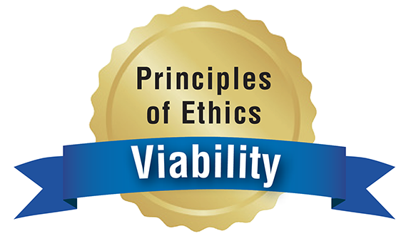
Ethical Principles
Viability
Ensuring that your actions are helpful in the long term, not just the short term
“Making Ethical Decisions: Things To Ask Yourself” from UC San Diego: http://blink.ucsd.edu/finance/accountability/ethics/ask.html.
Notes:
Viability
What’s the impact of your actions in the long term?
How will your actions affect others in the coming weeks, months, and years?
These are questions ethical people ask themselves.
Viability means ensuring that your actions are helpful in the long term, not just the short term.
What might this look like in practice?
Imagine your friend asks to copy your Spanish worksheet because she didn’t have enough time to do her homework the night before.
In the short term, you might not think this is a big deal—it’s just one worksheet!
But how will your friend be affected in the long term if she never learns the material on the worksheet?
She could do poorly on the next test or eventually fail the class.
It might not seem that bad if you see a coworker at your fast-food job steal a few dollars out of the cash register, but think about what will happen to the company in the long run if he steals a few dollars every day.
That would add up to a serious loss!
DISCUSSION #11: Ask students to discuss other examples of viability in practice.
ON THE WEB: Following ethical principles can help you ensure that you’re acting ethically, but what about those times when you just don’t know? This handy list from UC San Diego, “Making Ethical Decisions: Things To Ask Yourself,” is a great checklist to keep in mind when trying to figure out if your actions are ethical: http://blink.ucsd.edu/finance/accountability/ethics/ask.html.

Slide 14
A cashier forgets to charge you for a shirt.
What should you do?
Notes:
The Gray Zone
One Saturday afternoon, you pick up a few new shirts at a major department store at the mall.
Everything’s on sale, and when you check out, your shirts are even cheaper than you thought they would be!
But when you get home, you take a look at your receipt and realize the cashier forgot to charge you for one of the shirts.
You’re not sure what to do.
On one hand, you know that keeping the shirt will cost the store—and possibly the cashier—money.
But on the other hand, will a huge department store really notice one shirt?
You could use the extra money you saved to order a pizza tonight.
What should you do?
Is it ethical to keep the shirt, or should you go back to the store and tell an employee what happened?

Slide 15
Acknowledgments
Original Developers:
Christopher C. Burke, Kerry Winfrey-Davis and Kate Terentyev, MBA Research
Version 2.0
Copyright © 2020
MBA Research and Curriculum Center

Slide 16
Digital-Based Photography Sources
ThinkStock Photos
Various images used in this presentation are ©2020 ThinkStock Photos. All rights reserved www.ThinkStockPhotos.com
Getty Images
Various images used in this presentation are ©2020 Getty Images Photos. All rights reserved www.gettyimages.com

Slide 17
Copyright
All photographic digital images in this PowerPoint are owned by the aforementioned photographic resources or their licensors and are protected by the United States copyright laws, international treaty provisions, and applicable laws. No title to or intellectual property rights to the images in this PowerPoint are transferred to you. These sources retain all rights and are not to be used, digitally copied, transferred, or manipulated in any way. To do so is a violation of federal copyright laws.

Slide 18
1.01A KEY TERMS
1.Ethics: The basic principles that govern your behavior.
2.Ethical Principles: Standards that govern behavior; not dependent on circumstance.
3. Ethical Situation: An issue in which you must decide whether something is right or wrong
4. Integrity: Adhering to an established set of personal ethics and sound moral principles; acting with honesty in all situations
5. Trustworthy: Reliable; deserving the confidence of others
6. Accountability: The condition of having to answer for or be liable for your actions; accepting responsibility for your decisions
7. Transparency: The quality of being just as one seems; being open and truthful when communicating
8. Fairness: The ability to make judgments without favoritism or self-interest; engaging in fair competition and creating equal relationships
9. Respect: Regard or esteem; honoring the rights, freedoms, views, and property of others
10. Rule of Law: Complying with laws and regulations
11. Viability: The long-term value of your choices

