Slide 1
2.00 | Understand the business environment.
2.01 | Understand the role of business in society.
Economics LAP 70

Slide 2
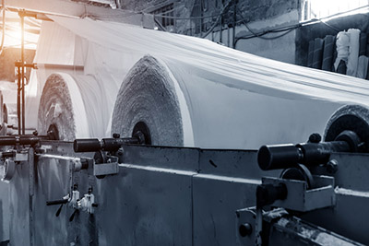
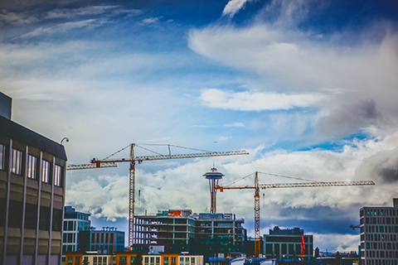
Producers: The people who make or provide goods and services
Types:
Raw-goods producers - provides goods in their natural state
Manufacturers - changes the shapes or forms of materials so that they will be useful to consumers
Builders - constructs roads, bridges, buildings, houses, etc.
Notes:
There are three broad categories that cover all types of businesses: producers, trade industries, and service businesses.
Producers—people who make or provide goods and services
Raw-goods producers
These producers provide goods in their natural, or raw, states.
They include businesses such as farms, mines, fisheries, and lumber companies.
DISCUSSION #1: Ask students to give more examples of raw-goods producers.
Without raw-goods producers, we wouldn’t have cars to drive, a variety of foods to eat, or houses to live in.
These producers are the foundation upon which all other businesses depend.
Keep this fact in mind the next time you read or hear headlines such as:
“Fire destroys thousands of acres of timberland”
“Drought kills crops and cattle”
“Polluted water destroys fish”
“Striking miners seek better working conditions”
“Oil discovered in North Carolina”
“Bumper crops expected this year”
Though you might not realize it right away, each of these events will probably affect the goods you buy.
Manufacturers
Since very few materials are actually used in their raw states, we rely on manufacturers to change the shapes or forms of materials so that they will be useful to consumers.
Example:
How useful would raw materials such as sand, cotton, wood, wheat, and crude oil be to you?
In their natural states, they are of little or no use to the average consumer; however, when these same raw materials become finished products (such as glass, clothing, paper, cereal, and gasoline), they will be quite useful.
Builders
Roads, bridges, schools, hospitals, houses, office buildings, places of worship—we rely on builders to construct them for us.
Without these producers, our daily lives would be much different.
DISCUSSION #2: Ask students to give more examples of what builders construct.

Slide 3
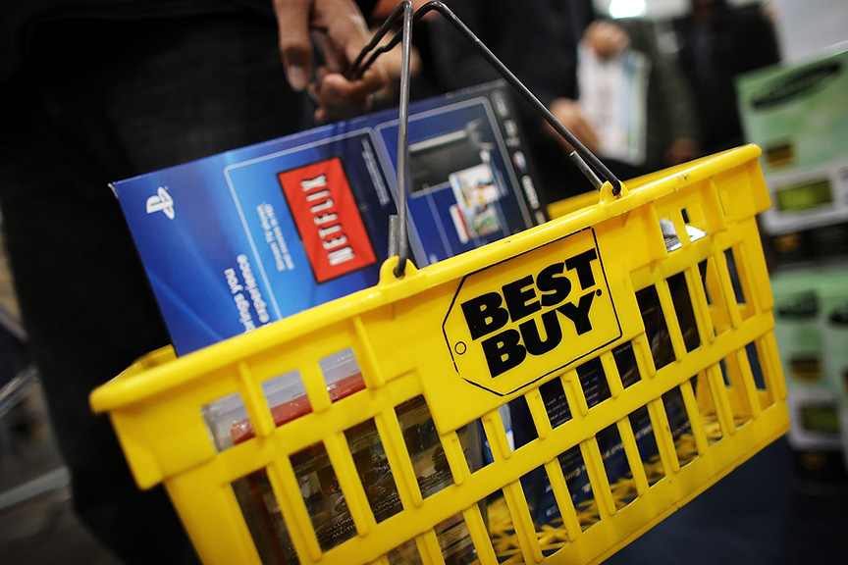
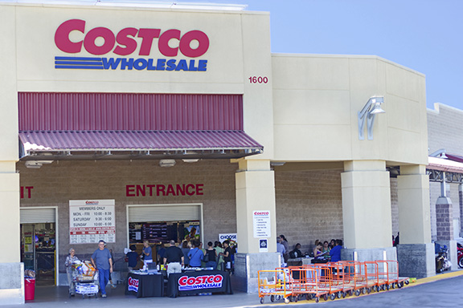
Trade Industries
Buy and sell goods to others
Don’t modify or change products
Can be retailers or wholesalers
Retailer: A business that buys consumer goods or services and sells them to the ultimate consumer
Wholesalers: Intermediaries who help move goods between producers and retailers by buying goods from producers and selling them to retailers
Notes:
Trade industries are businesses that buy and sell goods to others.
They don’t modify or change the form of the products.
Instead, they are responsible for moving goods from producers to consumers or industrial users.
The two main divisions of the trade industry are retailers and wholesalers.
Traditionally, retailers sell to ultimate consumers, while wholesalers sell to other businesses.
As consumers, we’re usually more familiar with retailers. Walmart, Home Depot, Target, Amazon, Best Buy, Macy’s, Best Buy, Ikea, H&M, grocery stores, and hardware stores are just a few examples.
All retailers sell products to ultimate consumers.
Wholesalers supply the goods that will be sold to retailers or used by businesses in their operations.
Although you probably aren’t as familiar with wholesalers as you are with retailers, there are many wholesalers that now do business with ultimate consumers as well as other businesses.
Wholesalers such as Sam’s Club and Costco allow ultimate consumers to purchase memberships and shop at their wholesale warehouses.
DISCUSSION #3: Ask students if they have ever visited a wholesale business. How did it differ from visiting a retailer?

Slide 4
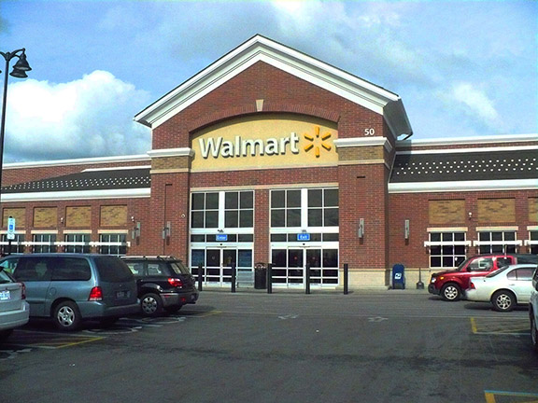
Difference in Trade Industries
Size
Kinds and variety of products sold
Ownership
Amount of service
Prices
Existence of premises
Notes:
Trade industries can differ based on a number of factors:
Size
Some trade businesses employ thousands of workers and are recognized nationwide.
However, the majority of retail trade businesses are small, employing fewer than 20 people.
In the wholesale trade, most businesses are small, independently owned companies that service areas within 150 miles of the main office.
DISCUSSION #4: Ask students to give examples of small retail businesses in their community.
Kinds and variety of products sold
The variety of products that are sold by trade industries is endless.
Basically everything that you or businesses own has been sold by trade businesses— clothes, cars, sporting equipment, computers, furniture, food, books, etc.
Some trade businesses offer a full line of products.
Think about the variety of goods that you can find at Target or similar department stores—toys, appliances, hardware and garden equipment, jewelry, cosmetics, and clothing and accessories.
Other trade businesses offer a limited- or single-product line.
These businesses specialize in the products that they offer for sale.
Examples of these businesses include florists, toy shops, dress shops, auto parts dealers, car dealers, carpet stores, computer stores, and food brokers who supply food products to supermarkets.
In the past, customers knew what products to expect to find in specific types of trade industries.
For example, grocery stores offered canned goods, fresh fruits and vegetables, frozen food items, household cleaners, and dairy and meat products.
Now, customers can find a broader range of products in grocery stores.
They often find greeting cards, plants and flowers, baked goods, deli items, pharmaceuticals, cosmetics, alcoholic beverages, housewares, packaged toys, and sometimes even furniture or clothing.
Although the types of products carried by grocery stores have expanded, we still know that we would go to a grocery store to buy a pound of hamburger.
We wouldn’t expect to find the hamburger at local clothing stores, electronics stores, or hardware stores.
We associate certain types of businesses with certain products—products that fit and support the image and purpose of the business.
Ownership
Some trade industries are owned independently by one or two people.
These businesses enjoy a lot of flexibility.
The owners can easily change policies, advertising, pricing, store layout, etc.
Other businesses are a part of chains.
They have a central management that determines policies, advertising, and pricing for all stores.
A big advantage of being part of a chain is that the business can get better prices when it buys goods because it is able to order large quantities of merchandise.
Sometimes, a number of independent business owners voluntarily join together when buying merchandise to get the discount prices available to chain stores.
They maintain their own management and flexibility but simply order their merchandise together.
An example of one of these “voluntary chains” is Independent Grocers Alliance (IGA).
ON THE WEB: Check out IGA’s website: http://www.iga.com/about. What are some of the benefits that this voluntary chain claims to offer customers?
Amount of service
Many trade industries offer a full line of services to their customers.
Wholesalers often provide services such as credit, delivery, marketing information, storage, bulk breaking, buying, and selling.
Full-service retailers will perform many of these same activities.
In addition, they might provide layaway, wrapping and packing, customer notification about new product offerings, and pleasing shopping facilities.
On the other hand, some trade industries limit the amount of service they provide.
Some wholesalers are so limited in their services that they only perform selling activities to connect buyers and sellers.
Many retailers who offer discount prices also limit their services.
Prices
Some trade businesses pride themselves on offering the lowest available prices.
Think of the businesses in your community that offer low prices.
How do the interiors of these businesses compare with those of businesses that are known for having high prices?
They’re usually not as appealing.
These business owners want customers to feel that they don’t have to pay for plush interiors and services.
The interiors and services that are offered by businesses with higher prices are costly to maintain.
You’ll find that the trade businesses that offer full services also generally charge higher prices than businesses with limited services.
DISCUSSION #5: Ask students to give more examples of the differences between businesses with low prices and businesses with high prices.
Existence of premises
Whenever a sale of goods to the ultimate consumer takes place, retailing has occurred.
Let’s look at some examples with which you are probably familiar:
In a store—You stop by the local grocery store to buy butter, sugar, and flour so you can make cookies.
Online
Most major retailers offer online shopping for their customers, and many e-tailers (retailers that operate exclusively online) are now operating as well.
These businesses save a lot of money by not having to pay the overhead for a brick-and-mortar store.
DISCUSSION #6: Ask students to list advantages and disadvantages of online retailing—for both businesses and customers.
In a customer’s home
Your doorbell rings, and an AT&T salesperson is there to sell the company’s TV, Internet, and phone services.
Door-to-door sales are much less common than they were in past decades, but they still occur.
In another person’s home—Your friend hosts a Mary Kay party, where you purchase several items.
DISCUSSION #7: Ask students to identify other products/brands that are sold through parties.
By mail
Due to the popularity of online shopping, retailing by mail is also not as common as it used to be.
However, you may see an advertisement for tulip bulbs in the Sunday paper and send your check and order form to the company in Michigan.
By vending machine
You know you can get a can of Coke or a Snickers bar out of a vending machine.
However, the use of these machines is rapidly evolving.
In many locations, you can now purchase electronics, nail polish, and high-quality skincare products from vending machines as well.
ON THE WEB: Vending machines offer even stranger things, too—like pecan pie, caviar, and live crabs. Check out this slideshow, “11 of the Coolest Vending Machines Around the World,” from Insider: https://www.insider.com/worlds-coolest-vending-machines-2019-1.
On street corners—On your lunch break from work, you buy a hot dog from a street vendor.
Over the phone
This method is less common now than it may have been even 10 years ago because of online shopping.
You see an advertisement on television for a great line of skincare products.
You call the toll-free number at the bottom of the screen to place your order.
DISCUSSION #8: Ask students if they have ever made a purchase over the phone. What did they buy?
Wholesalers also use a variety of business premises.
Some maintain warehouses that buyers can visit.
Others maintain storage facilities but don’t make them accessible to buyers.
Instead, buyers order from catalogs, by telephone, or online.
Some wholesalers sell goods directly from their trucks.
This method is used a lot for perishable products.
Other wholesalers don’t take possession of the products they sell.
Therefore, they don’t have any products on hand and don’t need any storage facilities.

Slide 5
Service Businesses
Perform intangible activities
Includes categories such as private education, business services, and transportation
Not always black and white
Brick and mortar: A business that operates out of a physical facility (instead of online)
E-tailers: Retailers who operate solely online
Notes:
Service businesses perform intangible activities that satisfy the needs and wants of consumers and industrial users.
People buy the service that is being provided, not a good.
Most service businesses can be classified in the following manner:
Housing—hotels, motels, apartments
Household operations—utilities, housecleaning service, home repair, landscaping, appliance repair
Recreation—amusement parks, sporting events, theaters, rental and repair of recreational equipment
Personal care—beauty salons, dry cleaners, photo studios, fitness centers
Medical and other health care—doctors, dentists, psychiatrists, optometrists, nurses, hospitals
Private education—driving classes, tutoring, photography classes, skiing lessons, golf lessons
Business services—bookkeepers and accountants, consultants, computer programmers, lawyers, advertisers
Insurance and financial—business and personal insurance, credit card and loan services, tax advisors, investment brokers
Transportation—car rental and repair, freight and passenger service
Communications—telephone, broadcast, Internet, cellular service
DISCUSSION #9: Ask students to give examples of local service businesses.
However, business categories aren’t always black and white.
Think about beauty salons.
They perform services such as cutting, coloring, and styling hair.
They often sell shampoo, conditioner, and other high-quality haircare products.
Although beauty salons are primarily part of the service industry, in this way they might also be considered part of the trade industry, since they are providing goods to ultimate consumers.
DISCUSSION #10: Ask students to give other examples of service businesses that also sell goods.

Slide 6
Social Responsibility
A duty to contribute to the well-being of society
Businesses demonstrate it in two ways:
Maximizing profits
Contributing to public interests
Notes:
Most businesses recognize that they have a social responsibility, or a duty to contribute to the well-being of society.
Since businesses play a leading role in our society, and we interact with them on a daily basis, it just makes sense that they have the potential to make a big impact on the world around them—either positive or negative.
Businesses demonstrate social responsibility in two ways:
By maximizing their profits
Some people feel that the best way for companies to contribute to society’s well-being is by trying to maximize their profits.
To do this, businesses must offer quality products at competitive prices, meet the needs of consumers, and minimize their costs and expenses.
This might be considered “minding the store”—focusing on ways to improve the business operation so that customers get the best products at the best prices.
By contributing to public interests
These wide-ranging contributions help create goodwill and foster a positive image of the company.
The contributions could include support of environmental efforts; participation in or sponsorship of workshops, advisory councils, etc.; and financial support of art, education, or research.
Here are some specific examples of businesses’ contributions to public interests:
McDonald’s sponsors Ronald McDonald Houses throughout the world to provide a home away from home for families with critically ill children receiving treatment at a nearby hospital. The program allows almost 9 million families to stay together each year.
Oil companies are often seen as harmful, so many companies attempt to counteract that image by focusing on environmental efforts.
ON THE WEB: Read about Shell Oil’s sustainability efforts on their website: http://www.shell.com/global/environment-society.html.
Coca-Cola participates in disaster relief efforts all over the globe, helping provide infrastructure reconstruction, water and sanitation reconstruction, and revitalization of the economy.
ON THE WEB: Check out some of Coca-Cola’s efforts on the company’s website: http://www.coca-colacompany.com/topics/sustainability.
A number of companies, including Nike, AT&T, and Starbucks, sponsor Mentor, a Boston nonprofit that works to connect at-risk youth with mentors. Mentors support these youth via recreational activities, reading, life advice, and other activities.
The Hershey Company has a variety of social initiatives that it supports each year. On its website, you can find information about the company’s sustainability practices; an anti-bullying campaign called the Hershey Heartwarming Project; and Cocoa for Good, an initiative to support communities that grow cocoa around the world.
ON THE WEB: You can read about more of the company’s social responsibility efforts on its website: http://www.thehersheycompany.com/social-responsibility/shared-goodness/goodbusiness.
DISCUSSION #11: Ask students to give more examples of social responsibility—local, national, and global.
ON THE WEB: In this article, “Does It Pay for Companies To Do Good?” by Greg Rosalsky, a study found that job applications for companies increased if the businesses advertised that they supported social causes, even if the jobs were paying less than normal. The story can be read here: https://www.npr.org/sections/money/2019/09/17/761312221/does-it-pay-for-companies-to-do-good. Many people agree that the best way a company can make an impact on the world is by maximizing profits. What do you think? Can companies do good while putting people first, or should money always be a company’s number one priority?
To some extent, all businesses should be socially responsible because they have an impact on our society.
All businesses should try to maximize their profits.
However, the very nature of some businesses encourages the business owners to assume added responsibility for our society’s well-being.
For example, producers are ultimately responsible for product safety and for the pollution they create.
Also, national and global corporations have a greater impact than smaller, local businesses do; therefore, some believe their social responsibility is greater as well.
DISCUSSION #12: Ask students what businesses they feel have added social responsibility and why.

Slide 7
Who Benefits?
Product users
Consumers: People who use goods and services to satisfy their wants
The community
Employees
“Why You Should Treat Your Employees Like Your Most Loyal Customers” by Brigette Hyacinth”— https://www.linkedin.com/pulse/why-you-should-treat-your-employees-like-most-loyal-brigette-hyacinth
The company itself
Notes:
In addition to being socially responsible to the users of their products, businesses are responsible to their communities, to their employees, and to their companies.
Product users
Every business has the responsibility of producing and/or offering safe, quality products.
Businesses are able to provide these products by conducting research to determine consumer desires, developing the desired products, and testing their quality and safety.
If businesses fail to be sensitive to the well-being of their product users, not only will the businesses’ products not sell, but the businesses will probably fail.
Imagine what would happen to toy manufacturers if they were not concerned about making their toys safe for children.
When producers recognize that there is a safety problem with their products, they often issue product recalls to fix the problem or to replace the product.
DISCUSSION #13: Ask students to discuss recent product recalls.
The community
If you stop to think about it, many of the decisions that business owners make affect not only the business but the community in which the business exists.
Examples:
How could a business’s decisions about production, employment, taxes, or pollution control affect your community?
What about a business’s contributions to educational, cultural, and training programs?
Employees
To continue to exist, businesses must be socially responsible to their employees.
They must provide safe, secure working environments.
They must make employees aware of possible working hazards and take precautions to reduce those conditions.
For example, steel-toed boots should be required for construction jobs, and machinery should be equipped with emergency switches to be used in case of accidents.
Businesses need to consider the quality of the working environment as well.
Is work interesting and challenging to employees?
Do employees receive satisfaction from their work?
Many businesses now recognize that they have a social responsibility to the overall well-being of employees.
They want their employees to be mentally satisfied with their jobs.
They feel that workers cannot be focused on their work if their attention, interest, or motivation is divided.
To help with this, businesses may offer such things as:
Counseling for personal and professional problems
Day care centers for children of employees
Career planning
Retirement planning
Flexible scheduling
Training
DISCUSSION #14: Ask students how their current places of employment demonstrate social responsibility to workers.
ON THE WEB: More and more businesses are realizing that treating employees well can also lead to a better business. The article “Why You Should Treat Your Employees Like Your Most Loyal Customers” by Brigette Hyacinth explains how companies like Airbnb are realizing that they can become more successful by keeping their employees happy: https://www.linkedin.com/pulse/why-you-should-treat-your-employees-like-most-loyal-brigette-hyacinth.
The company itself
The business is socially responsible for maximizing its profits so that the company can grow and prosper.
In this way, the company’s owners can make as much money as possible on their investments.

Slide 8
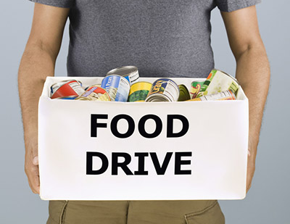
Walmart Thanksgiving food drive
The food drive was for employees
What do you think?
Notes:
The Gray Zone
Many companies do what they can to help out their employees during hard times, but some people weren’t happy when one Walmart store organized a Thanksgiving food drive for needy employees.
A Walmart spokesman said the food drive showed how much the company values taking care of employees when they face tough times.
However, many other people thought that the food drive was a sign of Walmart’s poor treatment of employees.
They believe the company should pay its employees higher wages so that they won’t need an in-store food drive to afford Thanksgiving dinner.
What do you think?
Was Walmart’s behavior unethical?
Are company food drives a way of caring for employees or simply a sign of poor treatment?

