Slide 1
Ready, Set, Compete!
Competition
Economics LAP 912

Slide 2
Objectives
Explain the nature of competition.
Distinguish among market structures.
Describe the effects of competition in a private enterprise economy.

Slide 3
Explain the nature of competition.
Notes:
DISCUSSION #1: Ask students if they have heard the old expression “A little competition never hurt anybody.” Ask them to discuss what the expression means to them. Also ask them to discuss where, when, and with whom they compete.

Slide 4
Competition
The rivalry between two or more businesses to attract scarce, or limited, customer dollars
Notes:
Competition is the rivalry between two or more businesses to attract scarce, or limited, customer dollars.
Suppose you owned an online movie and TV show streaming business—the only business of its type on the web.
If you were the only streaming service online, you wouldn’t need to worry about competition.
If customers wanted to watch movies and shows online, they would have to come to you.
In reality, customers are able to stream movies and shows from different sources, including Netflix, Hulu, and Amazon Prime Video.
Customers have a choice of sellers.
Competition is fierce.
All of these streaming services are trying to capture the attention and dollars of the same group of customers, or market.
All of them offer goods or services that will satisfy the same customer needs and wants.
These businesses compete directly against each other.

Slide 5
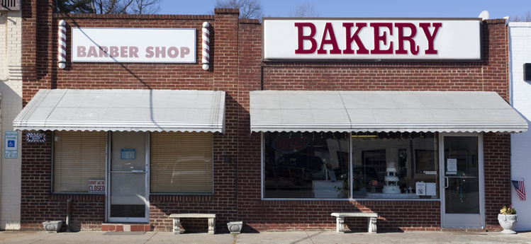
Types of Competition
Direct competition
Occurs between or among businesses that offer similar types of goods or services
Indirect competition
Occurs between or among businesses that offer dissimilar goods or services
Notes:
Direct competition occurs between or among businesses that offer similar types of goods or services.
Many fast-food restaurants, such as McDonald’s, Wendy’s, and Burger King, are direct competitors of each other because they all sell hamburgers and french fries.
Many clothing stores, such as Forever 21, Urban Outfitters, and H&M, are also direct competitors because they all sell clothing for young adults.
DISCUSSION #2: Ask students to share other examples of direct competitors.
Indirect competition occurs when businesses compete for scarce customer dollars that might be spent on goods or services different from their own.
Every seller experiences indirect competition.
Each customer has a limited amount of money to spend, and every business—whether it sells food or gasoline or shoes—wants customers to spend their cold hard cash at that particular business and no other.
Restaurants indirectly compete with gas stations, shoe stores, clothing chains, and an endless number of other businesses.
They compete indirectly with each other to get the limited money that customers have to spend.
DISCUSSION #3: Ask students to identify businesses that might be indirect competitors of the businesses for which they work.
Most businesses focus their efforts on competing with their direct competitors.
They know who their direct competitors are.
They plan their competitive strategies with those businesses in mind.
This means that a restaurant is more likely to try to take business from other restaurants than from a gas station.
DISCUSSION #4: Ask students to discuss why businesses focus their efforts on competing with their direct competitors rather than their indirect competitors.
ON THE WEB: How can food trucks demonstrate the difference between direct and indirect competition? Find out with this article from Mobile Cuisine’s Richard Myrick, “Direct and Indirect Competitors for Your Food Truck,” at: https://mobile-cuisine.com/business/direct-and-indirect-competitors-for-your-food-truck/.

Slide 6
Price Competition
Using prices to attract scarce customer dollars
Discount coupons
Special sales
Price matching
Rebates
Notes:
The two main ways to compete are through price and nonprice competition.
Price competition is a type of rivalry between or among businesses that focuses on the use of price to attract scarce customer dollars.
This type of competition is successful because customers are often interested in getting goods and services at the most reasonable prices.
If the price of a product is lowered, more customers are likely to purchase it, which can ultimately result in more income for the business.
It’s a situation where everyone wins.
Customers get more for their money.
Businesses get more income.
Here are a few forms of price competition that businesses use to attract customers:
Discount coupons
Special sales
Price matching
Rebates
DISCUSSION #5: Ask students to share examples of discount coupons, special sales, price matching, and rebates. Also, ask them to discuss which forms of price competition seem to be most successful in increasing sales at the businesses where they work or shop.

Slide 7
Nonprice Competition
Competing on a basis other than price to attract scarce customer dollars
Exceptional quality
Special features
Trained personnel
Outstanding customer service
Convenience
Modern facilities
Wide variety of products
Notes:
Nonprice competition occurs when businesses compete on a basis other than price to attract scarce customer dollars.
Some popular examples of nonprice competition include promoting the following:
Exceptional quality
Special features
Trained personnel
Outstanding customer service
Convenience
Modern facilities
Wide variety of products
Many times, the quality or new feature is much more important than price.
Think about laser eye surgery as an example.
While you might be concerned about how much the procedure will cost, you’d probably be even more concerned about whether the doctor is well qualified and using the latest technology.
Other times, service and convenience might make the difference.
Think about the supermarket industry, which has fairly uniform prices.
What attracts you to do business with one versus another?
Is it the bank, the coffee shop, the pharmacy, and the gas station all located in or near the store?
Or, is it the longer hours, the self-checkout, and the child care service available while you shop.
At times, it is truly amazing what lengths a business will go to in order to make shopping more convenient and appealing for customers.
DISCUSSION #6: Ask students to determine what forms of nonprice competition local supermarkets use to attract customers.
Most businesses use a combination of price and nonprice competition.
Nordstrom department stores offer half-yearly and anniversary sales, as well as fantastic customer service.
Toyota offers rebates while emphasizing its vehicles’ great gas mileage.
Whether it’s price competition, nonprice competition, or a combination of the two, the goal is the same.
Businesses compete for customers.
Businesses do whatever they can to convince people to buy their products.
DISCUSSION #7: Ask students to discuss what combinations of price and nonprice competition they believe are most successful in attracting customers.
ON THE WEB: Nonprice competition has both pros and cons. Check out the article “Advantages & Disadvantages of Nonprice Competition” by Ronald Kimmons to learn more: https://smallbusiness.chron.com/advantages-disadvantages-nonprice-competition-10048.html.

Slide 8
Distinguish among market structures.
Notes:
The amount of competition that a company experiences depends a lot on how many businesses sell similar products.
If a lot of businesses sell the same thing, then there is going to be a lot of competition.
If only one business sells a particular product, then it won’t have any competition at all.
We use the term market structure to describe the type of market, or environment, in which businesses operate.
The market structure for an industry depends primarily on how many sellers exist in that market.

Slide 9
Four Main Types of Market Structures
Perfect competition (Pure competition): https://www.investopedia.com/video/play/perfect-competition-0/
Monopolistic competition
Oligopoly: https://www.investopedia.com/video/play/oligopoly/
Monopoly
Regulated monopoly
Notes:
There are four main types of market structures:
Perfect competition (Pure competition)
Many businesses sell identical products to many buyers.
There is a plentiful product supply.
All businesses compete equally and charge about the same price, which means that no seller has an “edge” on the others.
Perfect competition rarely exists in the real world.
It’s more of a benchmark to compare real market structures against.
The closest that we come to perfect competition in the real world is in farm commodities, such as wheat and corn.
These producers sell the same product at pretty much the same price using the same technology.
This results in a market structure closely resembling perfect competition.
DISCUSSION #8: Ask students to discuss why perfect competition rarely exists in the real world.
ON THE WEB: Learn about how fishermen can provide an example of perfect competition with this video, “Perfect Competition,” from Investopedia: https://www.investopedia.com/video/play/perfect-competition-0/.
Monopolistic competition
Monopolistic competition is the type of market structure you’re most likely to find in a private enterprise economy.
There are a lot of businesses selling similar products that have only a few differences.
Shampoo, cosmetics, and running shoes are examples of products sold in a monopolistic competition market structure.
Sellers lower their prices to increase sales and try to differentiate their products from their competitors’ to attract business.
Producers use brands, packaging, advertising, special features, and service to make their goods and services stand out.
Price and nonprice competition goes a long way toward helping businesses succeed in an environment of monopolistic competition.
DISCUSSION #9: Ask students to share other examples of products sold in a monopolistic competition market structure.
Oligopoly
There are only a few businesses that sell all of the products.
These businesses are relatively large and have a lot of control over product prices and the market.
It is difficult for new businesses to enter the market and compete.
When only a few large businesses compete, each business has time to devote to innovation and the reduction of production costs.
Examples of oligopolies in the Unites States include the automobile industry, the pharmaceutical industry, and the oil industry.
DISCUSSION #10: Ask students to discuss reasons why they think oligopolies develop and exist.
ON THE WEB: Learn more about how oligopolies work by watching this video, “Oligopoly,” from Investopedia: https://www.investopedia.com/video/play/oligopoly/.
Monopoly
The market is controlled by one business.
There are no substitute products readily available.
Competition does not exist.
Monopolies are usually not allowed to exist in a private enterprise system, because they can cause many problems.
Monopolies have a tendency to raise prices.
Monopolies tend to produce less.
Monopolies often prevent new businesses from entering the market.
A regulated monopoly is legally allowed to exist when the government feels that one large company can serve customers more efficiently than several small ones.
Regulated monopolies keep prices and costs down.
They operate under close government supervision and must obtain approval to raise rates.
In the United States, the few regulated monopolies that exist include electricity distribution, natural gas distribution, and garbage collection.
In such instances, government has determined that it is to our benefit as consumers and city residents to allow a monopoly to exist.
DISCUSSION #11: Ask students to discuss specific reasons why the government would allow regulated monopolies for electricity distribution, natural gas distribution, and garbage collection.

Slide 10
Government Legislation
Sherman Antitrust Act (1890)
Clayton Act (1914)
Federal Trade Commission Act (1914)
Learn about the FTC: https://www.ftc.gov/about-ftc
And see an example of an FTC lawsuit: https://www.youtube.com/watch?v=PJs4h6lpEYs
Robinson-Patman Act (1936)
Celler-Kefauver Antimerger Act (1950)
Notes:
In a private enterprise system, governments regulate businesses to encourage ethical and legal competition.
Several pieces of federal legislation have been passed over the years to promote competition, which can help keep:
Prices down
Quality good
Production efficient
These acts include:
Sherman Antitrust Act (1890)
Prevents monopolies from forming
Hinders price fixing
Clayton Act (1914)
Prevents specific business actions that might restrict competition
Such actions include:
Tying agreements
Exclusive agreements
Federal Trade Commission Act (1914)
Created a regulatory agency, the Federal Trade Commission (FTC)
The FTC monitors business activities in order to prevent unfair competition.
Robinson-Patman Act (1936)
Prohibits price discrimination
All businesses purchasing similar amounts and types of products will be charged the same price.
Celler-Kefauver Antimerger Act (1950)
Protects competitors from takeovers if the acquisition would hinder competition
ON THE WEB: To read more about how the FTC protects consumers and encourages competition, click here: https://www.ftc.gov/about-ftc.
And to see an example of the FTC in action, look at this news video about how the FTC filed a lawsuit against Facebook, accusing it of violating antitrust laws: https://www.youtube.com/watch?v=PJs4h6lpEYs.

Slide 11
Describe the effects of competition in a private enterprise economy.
Notes:
Without competition, the private enterprise system would not exist.
All of the buyers and sellers play an important role in controlling the economy.
They interact in the marketplace to determine what products will be produced and what prices will be charged for those products.
It is competition that makes available the goods and services that customers want at prices that customers are willing to pay.
In a private enterprise system, most businesses have several competitors.
Some businesses, such as drugstores, have hundreds of competitors.
Competition is quite good for business.

Slide 12
Competition Benefits Businesses
Encourages new businesses to enter the marketplace
Encourages businesses to operate as efficiently as possible
Offers the hope of making profit
Notes:
Competition benefits businesses in several ways.
Competition encourages new businesses to enter the marketplace.
Think about the copy machine industry.
The Xerox company was the first to develop the plain paper photocopier, back in 1959, and was able to sell it successfully to many customers.
The product became so popular that more and more customers wanted it.
Because of the demand, several other companies developed similar products over the years and began selling them as well.
These companies, including Ricoh, Minolta, and Sharp, saw an opportunity and decided to compete with Xerox.
As a result of competition, new companies were created.
DISCUSSION #12: Ask students to identify other products that became so popular that new companies formed to meet demand.
Competition also encourages businesses to operate as efficiently as possible.
For example, when competing businesses enter the marketplace, they often try to spend less on producing their products in order to sell them at a lower price.
They look for faster, more effective methods of production to lower costs.
This also forces the original company to produce more efficiently to be able to remain competitive.
The overall result is that all the companies reduce costs and preserve resources.
This leads to one of the most important benefits of competition—profit.
Businesses work hard to beat their competitors and attract the most customers.
Those that produce efficiently and sell effectively are able to make a profit.
It is the hope of making a profit that encourages businesses to operate.

Slide 13
Competition Benefits Customers When Businesses…
Develop new products to meet customers’ needs
Maintain or improve the quality of existing products
Provide more and better services
Provide wider selections of goods or services
Keep prices down
Notes:
Competition also benefits customers. If a business is going to attract customers away from other sellers, it must try to:
Develop new products to meet customers’ needs
Technology companies that want to stay ahead of the curve are constantly introducing new products—they have to if they want to compete with other companies!
These innovations mean there is a steady flow of new products for customers to buy and use.
Maintain or improve the quality of existing products
In the hunt for customer dollars, businesses continually try to upgrade their existing products.
Just think about smartphones—companies are always trying to create newer, better phones that are able to perform more tasks and make customers’ lives easier.
The benefit to the customer is a better product.
DISCUSSION #13: Ask students to identify businesses that have either developed new products or improved existing products recently to attract customers away from competitors.
Provide more and better services
If all other factors remain the same, the availability of services can attract and keep customers.
Many auto repair shops provide customers with free transportation to and from work.
Customers enjoy the convenience at no additional cost.
Provide wider selections of goods or services
Because there are many types of customer needs, businesses try to offer many types of goods or services.
Wendy’s fast-food restaurant offers a wide selection of items on its menu to attract more customers.
DISCUSSION #14: Ask students to discuss what disadvantages there might be to a business offering a wide selection of goods or services.
Keep prices down
Price is often a main factor when customers decide what and where to buy.
When given a choice between two similar products of the same type, customers often choose the lower-priced one.
Customers get a good value for their money when businesses keep their selling prices as low as possible.

Slide 14
Competition Benefits Society
Creates a higher standard of living
Creates products that help people be healthier and live longer
Creates new businesses that make more jobs available
Creates prosperity
Notes:
Competition also benefits society.
Because of competition, businesses develop new and improved products that make people’s lives easier and more convenient.
Think of:
All the frozen foods that can be microwaved and ready to eat in minutes
All the businesses that provide housekeeping services, pet-walking services, and child care
As a result, people enjoy a high standard of living.
DISCUSSION #15: Ask students to identify other goods and services that allow us to enjoy a high standard of living.
Some of these products even help people be healthier and live longer.
Pharmaceutical companies, for example, continuously do research to develop new drugs to prevent or cure diseases.
Health spas and workout facilities are available everywhere.
Competition helps create new businesses that make jobs available to a lot of people.
A huge number of people are employed by web-based companies that didn’t even exist a decade ago.
New businesses help lead to a prosperous society in which people have jobs, earn an income, and spend money for more goods and services.
This type of prosperity usually does not exist in economic systems without competition.
ON THE WEB: Watch this video to see how different parts of society benefit from competitive businesses: https://www.youtube.com/watch?v=D1lvJeYsYL0.

Slide 15
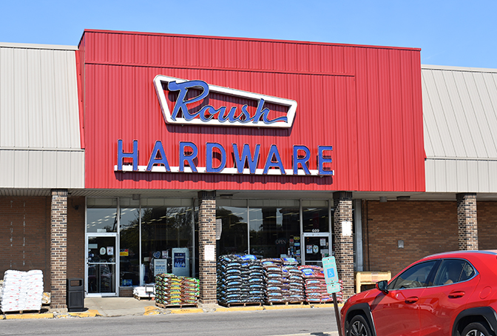
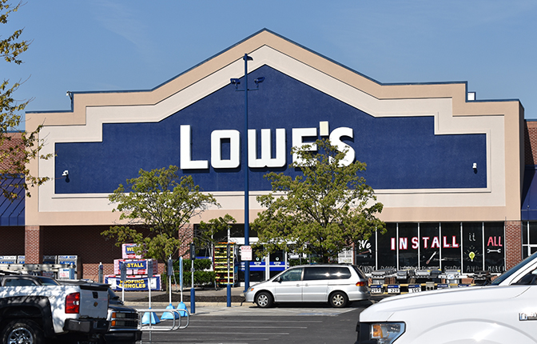
Hardware store industry
Fewer small stores
Domination by “big-box” stores
Is this fair? Ethical?
Should the government step in?
Notes:
The Gray Zone
Not so long ago, the hardware store industry was populated by many small, privately owned businesses.
Every small town had at least one local hardware store, and larger cities had several of them.
In almost every case, each store was owned by a different individual or small company.
Today, though, the industry is dominated by a few corporate giants, including Lowe’s, Home Depot, and Menards.
These “big-box,” do-it-yourself stores, as they are sometimes called, entered the hardware store industry with a vengeance.
They have all but wiped out the small, privately owned hardware stores.
Why has that happened?
How did chains like Lowe’s drive the small stores out of business?
Is that fair?
Is that ethical?
Was it right for the government to let so many small, privately owned businesses disappear?
Should the government step in and stop the big-name hardware store chains from getting even bigger?
DISCUSSION #16: Ask students to discuss other industries in which small, privately owned stores are being replaced by big-name corporations. Ask the students to also discuss why such shifts in ownership are taking place.

Slide 16
Acknowledgments
Original Developers:
Christopher C. Burke, Kerry Winfrey, and Dylan Sams MBA Research
Version 3.0
Copyright © 2021
MBA Research and Curriculum Center

Slide 17
Digital-Based Photography Sources
ThinkStock Photos
Various images used in this presentation are ©2021 ThinkStock Photos. All rights reserved www.ThinkStockPhotos.com
Getty Images
Various images used in this presentation are ©2021 Getty Images Photos. All rights reserved www.gettyimages.com

Slide 18
Copyright
All photographic digital images in this PowerPoint are owned by the aforementioned photographic resources or their licensors and are protected by the United States copyright laws, international treaty provisions, and applicable laws. No title to or intellectual property rights to the images in this PowerPoint are transferred to you. These sources retain all rights and are not to be used, digitally copied, transferred, or manipulated in any way. To do so is a violation of federal copyright laws.

