Slide 1
3.00 | Understand business management.
3.03 | Understand the concept of positive customer relations.
Customer Relations LAP 3

Slide 2
Customer Relations
Customer relations— all the activities a business engages in to interact with its customers
Used interchangeably with “customer service”
Notes:
What it means to have positive customer relations:
Everyone has a horror story about an experience they’ve had with a business.
It could involve:
A faulty product
Poor after-sale service
A rude employee
DISCUSSION #1: Ask students to relate their own “customer relations nightmares.” How many times have they related it to family, friends, or acquaintances? You may be just one customer, but your actions can have a big impact on a business. That’s why it’s so important for businesses to take customer relations seriously.
You may be just one customer, but your actions can have a big impact on a business.
That’s why it’s so important for businesses to take customer relations seriously.
Customer relations is a term that refers to all the activities a business engages in to interact with its customers.
It is often used interchangeably with the term customer service.

Slide 3
Positive Customer Relations
Customers:
Are happy
Are more than just satisfied — needs/wants have been exceeded
Feel important
Feel connected to the business
Customer service: Activities and benefits provided by a business to its customers to create goodwill and customer satisfaction
Notes:
Having positive customer relations means having happy customers.
A business with positive customer relations has customers who are more than just satisfied.
As a matter of fact, studies have shown that satisfied customers are not necessarily loyal customers.
A successful business knows that it is not enough to just meet customer needs and wants—it must exceed them.
DISCUSSION #2: Ask students to think of a time when a business went “above and beyond” to solve their problem or to make them feel valued. How did this business exceed their expectations?
Positive customer relations makes customers feel important.
They know that they are more than just a business transaction or a “means to an end” for the business to make money.
The business listens to their feedback and takes their needs seriously.
A relationship is present—they feel connected to the business.
DISCUSSION #3: Ask students if there is a business with which they feel this type of connection. What has the business done to make them feel this way?

Slide 4
Positive Customer Relations
The business:
Is proactive:
Takes initiative to build relationships
Stays ahead of issues and complaints
Integrates customer relations into each aspect of the organization
Notes:
To build positive customer relations, businesses must be proactive.
Reacting to questions, complaints, and problems as they occur is not enough.
Businesses must stay ahead of these issues, striving to:
Keep problems from happening in the first place
Provide positive customer experiences with every interaction
A business can succeed at this task only when it:
Makes customer relations a top priority
Integrates customer relations principles and practices throughout the entire organization
ON THE WEB: Read more about proactive customer service in Kristen Hicks’ article “Six Tips To Shift From Reactive to Proactive Customer Service” at http://csi.softwareadvice.com/6-tips-to-shift-from-reactive-to-proactive-customer-service-0411/.
Every business depends on its customers to survive.
Examples:
A restaurant needs diners.
A doctor needs patients.
A college needs students.
A wholesaler needs retailers.
Keeping customers happy is an important ingredient of business success.

Slide 5
Importance of Positive Customer Relations
Tough-to-please customers
Fierce competition
Value of customer loyalty - The customer’s preference for a business; usually expressed in regular purchases from the business
Notes:
There are many more reasons businesses should work hard to keep customer relations positive:
Customers are tough to please.
Today’s customers are more demanding than ever.
Studies show that customers who stop doing business with certain companies often do so because of poor customer relations experiences.
Customers know how they want to be treated—and they will take their business elsewhere if your organization fails to meet their expectations.
ON THE WEB: To learn more about today’s challenging customers, check out “The Way Customers Use Products Have Changed—but Brands Haven’t Kept Up” at https://hbr.org/2018/05/the-ways-customers-use-products-have-changed-but-brands-havent-kept-up.
Competition is fierce.
Modern customers are knowledgeable, and they spend their money wisely.
In the past, “shopping around” was more difficult for customers to do, but today’s economy is wired and global.
If the company down the street doesn’t satisfy a customer, s/he may be able to hop online and find a better customer experience with the click of a button.
Customer relations often makes the difference in a customer’s choice between two businesses offering the same product at the same price.
Building positive customer relations is one of the least expensive ways for a business to compete.
A smile, a “thank you,” and a helpful attitude are free.
Even the smallest businesses with the most limited funds can afford to provide them.
Not every company can pay to create a large-scale marketing campaign, but every company can build positive customer relations.
Loyalty is valuable.
Positive customer relations encourages repeat business and customer loyalty.
When customers feel that a business has taken the time and effort to build relationships with them, they are much less likely to switch over to a competitor, even if the competitor lowers its prices.
Over time, these long-term customers can spend a lot of money with the business, making its customer relations efforts pay off for years to come.
Retaining current customers also costs a business less money than reaching brand-new customers.
Courteously answering a current customer’s question about a product is much less expensive than paying a salesperson to bring in a new account.
DISCUSSION #4: Ask students to name some businesses they are loyal to. How closely does customer relations relate to this loyalty?

Slide 6
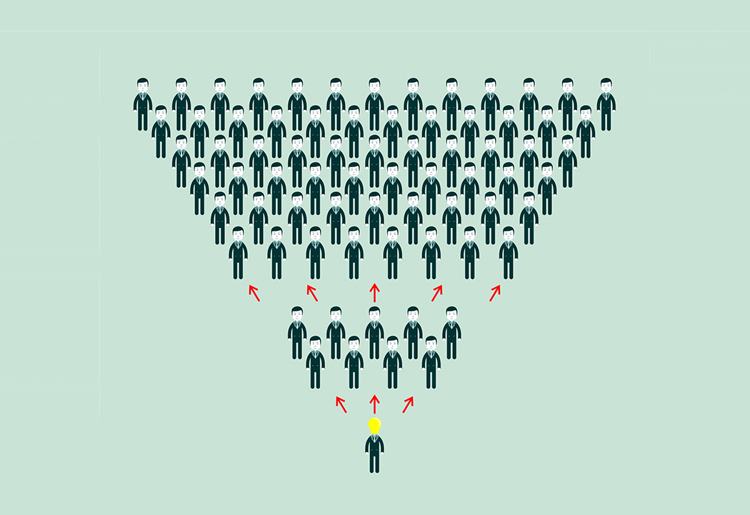
Importance of Positive Customer Relations
Value of word-of-mouth promotion - Promotion for a business provided by customers who tell others of their satisfaction with the business
Increased productivity - The amount and the value of goods and services produced (outputs) from set amounts of resources (inputs)
Inclusion of employees
Notes:
Word-of-mouth promotion is priceless.
When customers are happy with a business, they are likely to tell their friends, family, coworkers, and acquaintances about it.
This is known as word-of-mouth promotion, and it is truly priceless to a business—since it can’t be bought!
Potential customers tend to take word-of-mouth promotion more seriously than they do a business’s marketing communications, since it comes from sources they personally know and trust.
Word-of-mouth information is very powerful; however, businesses must keep in mind that this information can also be negative.
Unfortunately, customers are even more likely to relate their negative experiences to others than they are to relate their positive experiences.
When businesses make positive customer relations a priority, they are allowing this “free promotion” to work in their favor.
Productivity matters.
To boost profits, a business wants to keep costs low and productivity high.
Believe it or not, spending the extra time and effort to build positive customer relations can actually increase productivity.
Example:
A customer ordered a piece of manufacturing equipment, but the business selling it hasn’t taken the time to follow up and make sure it’s been delivered on schedule.
A shipping error occurs, the equipment doesn’t arrive on time, and an employee must spend several hours tracking it down.
Not only did the business irritate its customer, it decreased its own productivity by wasting time and resources to resolve the problem.
This situation could have been avoided if the business had made customer relations a priority in the first place.
Employees are key.
A corporate culture that values customer relations tends to create a positive working environment for its employees as well.
Smart business owners realize that positive customer relations depends on employees putting the right principles and practices into action, so they strive to keep employee relations positive.
Satisfied employees help create satisfied customers and contribute to overall business success.
ON THE WEB: To learn more about the importance of quality customer relations, read Rick Suttle’s article “What Does Excellent Customer Service Mean?” for the Houston Chronicle: https://smallbusiness.chron.com/excellent-customer-service-mean-2085.html.
DISCUSSION #5: Ask students how customer relations efforts at their places of work affect their satisfaction as employees.

Slide 7
Factors Affecting Customer Relations
Business processes
Building customer relations into every aspect of the business
Relating to specific target market
Approaching daily tasks with customers in mind
Notes:
Many factors affect a business’s customer relations, including:
Business processes
All of a business’s processes and activities should be approached with customers in mind.
Customer relations should be a priority that is built into the overall organizational plan.
No business can be all things to all people; therefore, it’s important for businesses to:
Identify their target markets.
Focus on building positive relations with those customers specifically.
Customer needs and wants should be continuously evaluated. After all, it’s pointless to work on customer relations if you aren’t offering a good or a service that people want to buy.
As an employee, you may have little to no control over your business’s organizational planning decisions.
However, you can still approach your daily job tasks with customers in mind.
You can make them your priority each and every day, helping your business build positive customer relations.
You can also contribute to your business’s customer relations efforts by being attentive to the feedback you get from customers.
What contributes to their satisfaction?
What bothers them?
How could your business “go the extra mile” to make them happier?
Use this information to perform your job better, and pass it along to your managers and supervisors.
ON THE WEB: Learn more about how businesses can build a positive customer service culture in Alyssa Gregory’s article “9 Tips for Providing Excellent Customer Service.” You can find it here: https://www.thebalancesmb.com/providing-excellent-customer-service-2951744.
DISCUSSION #6: Ask students to think of more ways they can help build positive customer relations in their current jobs.

Slide 8
Factors Affecting Customer Relations
Business environment
Tangible— physical environment
Intangible— corporate culture
The values and ideals that an organization encourages among its employees
Notes:
Business environment
A business’s environment is both tangible and intangible.
In the tangible sense, a business is a building with offices, desks, chairs, manufacturing equipment, etc.
This physical environment can affect customer relations in many ways.
A service business, such as an oil-change shop or a dentist’s office, may have a reception area or a waiting room for customers.
This environment can greatly influence how customers feel about the business.
Comfortable chairs, a good selection of magazines, and coffee or snacks can certainly go a long way toward making customers happy and helping them feel positively toward the business.
DISCUSSION #7: Ask students to give more examples of how a business’s tangible environment can affect customer relations.
In the intangible sense, a business’s environment is the way employees and customers feel when they interact with the organization.
For employees, this is known as corporate culture.
A business that promotes a culture of teamwork, respect, and professionalism among its employees has built a strong foundation for building positive customer relations.
Example:
A customer service representative needs the help of a salesperson to address a customer’s problem.
If the business has created an environment of teamwork, these employees should be able to work together effectively to solve the problem and satisfy the customer.

Slide 9
Factors Affecting Customer Relations
Technology
Allows customer greater access to the business
Allows business to track customer information more effectively/efficiently
People (employees)
Internal customers: The people (i.e., employees) who work cooperatively together to achieve business goals
Notes:
Technology
Technological advances offer two main advantages for businesses when it comes to building positive customer relations.
First, technology allows customers greater access to the business.
They can visit the business’s website to:
Get answers to FAQs (Frequently Asked Questions)
View product photos and information
Place orders
Track shipping
They can call the business’s toll-free number to receive technical support or to provide feedback.
Today’s customers value convenience.
When a business uses technology effectively to create convenient experiences for its customers, it can improve customer relations.
ON THE WEB: Check out Megan Totka’s article “Four Ways To Improve Customer Service Through Technology” to learn more: https://smallbiztrends.com/2017/05/improve-customer-service-through-technology.html.
DISCUSSION #8: Ask students how technology has improved their experiences as customers.
Second, technology allows a business to track and organize customer information more effectively and efficiently.
By doing so, the business can serve its customers better and offer them more personalized attention.
For example, if a business tracks a customer’s ordering history, it can use that information to recommend new products the customer might like.
Not only does this benefit the customer, it can create more sales for the business.
Businesses can also use customer information to identify valuable customers and create targeted marketing campaigns to reach them.
People
The most important factor in a business’s customer relations is its people.
Employees make or break a business’s efforts to build positive relations with customers.
That’s why it’s so important for businesses to hire the right people.
Skills and traits that are useful in customer relations (problem-solving skills, decision-making skills, friendliness, etc.) should be key skills companies look for when recruiting and hiring employees.
Customer relations skills should also be stressed during employee training and should play an important role in decisions regarding bonuses and promotions.

Slide 10
Techniques for Building Positive Customer Relations
Be “customer-centric” - Focused on customer needs and wants
Pay attention to internal customers.
Communicate.
Notes:
Techniques businesses can use to build positive customer relations:
Be customer-centric.
You already know that the customer comes first, but the importance of this perspective cannot be overstated.
It’s not just an idea or a philosophy. It should be the “rule” that you put into practice during every single customer interaction.
This applies even when a customer is being difficult or demanding.
In this case, the customer may not be right, but you can still treat him/her with courtesy and respect.
DISCUSSION #9: Ask students how their current places of employment are customer-centric. In what ways could they improve?
Pay attention to internal customers.
Building positive customer relations depends on a business’s employees.
They are the “face” of the company to the public, and their attitudes and actions greatly impact how customers feel about the business.
Attitude is often contagious; therefore, unhappy employees have difficulty creating and maintaining positive customer relations.
That’s why it’s important for an organization to maintain good relations with its employees as well.
Communicate.
Positive customer relations are impossible without good communication.
Businesses have a lot to tell customers about themselves and their products and services, but their best form of communication is to listen respectfully.
Customers have a great deal of valuable information to give your business if you will listen:
They will tell you about their wants and needs.
They will let you know what you’re doing well and what you can improve.
They will explain how you’re stacking up to the competition.
Many businesses make the mistake of making communication too difficult for their customers.
Automated systems answer customers’ phone calls, websites don’t offer contact information, or employees are too busy to give attention in the store.
This is poor customer relations.
Not only should businesses make communication easy for customers, they should find ways to encourage it.
Incentives such as coupons or free samples may capture customers’ attention and motivate them to give feedback (such as filling out a survey).
DISCUSSION #10: Ask students to think of more ways that businesses can encourage customer feedback.

Slide 11
Techniques for Building Positive Customer Relations
Resolve complaints in a quick, satisfactory manner.
Be thankful.
Patronage: Loyalty to a particular business
Display courtesy, friendliness, and professionalism at all times.
Notes:
Resolve complaints in a quick, satisfactory manner.
Addressing customers’ problems and complaints is a key part of customer relations.
No business wants to hear complaints; however, a smart business views them as opportunities rather than annoyances.
Customers often have better relationships with businesses that have successfully resolved their complaints than they do with businesses where no problem has occurred at all.
The experience stands out in their minds; they remember it.
Complaints give your business a golden opportunity to build positive customer relations, but only if you handle them correctly.
They should be addressed quickly and resolved to the customer’s satisfaction.
Not only should you fix the problem, you should do so courteously and apologize for the mistake.
A simple statement, such as, “I’m sorry you received the wrong product, Ms. Anderson. I’ll ship the correct one to you today, free of charge,” can go a long way toward building positive customer relations.
Be thankful.
Keep in mind that business success depends on customers and their loyalty.
They appreciate it when businesses show them gratitude for their patronage.
Saying “thanks” is often simple and free.
Example:
At the end of a recent Southwest Airlines flight, the pilot was overheard thanking passengers for choosing his airline and allowing him to make a living doing what he loves.
He certainly didn’t need to say this, but the passengers appreciated it and related it to their friends and family.
It gave them a very positive impression of the pilot and the airline.
Sometimes, a business can show its gratitude by offering customers special benefits or perks, such as frequent-buyer discounts or special-occasion gift certificates.
DISCUSSION #11: Ask students to think of more ways businesses can show gratitude to their customers.
Display courtesy, friendliness, and professionalism at all times.
It’s amazing how many times employees behave rudely toward customers.
DISCUSSION #12: Ask students if they can think of a time an employee treated them rudely. How did it affect their opinion of the business?
In a successful business, this type of unprofessional behavior is unacceptable.
Customers should always be treated with courtesy and respect.
However, not being rude is still not enough.
Employees should display friendliness toward customers by smiling, offering handshakes, using the customers’ names, etc.
Customers don’t want to deal with businesses that don’t understand the basic rules of etiquette and courtesy.

Slide 12
Techniques for Building Positive Customer Relations
Keep promises.
Be helpful.
Remember touchpoints (interactions) - All the opportunities that businesses have to connect with customers and reinforce their brand value
Notes:
Keep your promises.
A customer will always remember a company’s broken promise.
Broken promises equal poor customer relations—you should avoid them at all costs.
It’s better to under-promise and over-deliver than it is to break a promise.
Example:
If a customer is looking for a hard-to-find or out-of-stock product (perhaps a discontinued nail polish color), you might promise her you’ll locate at least five units, knowing you can probably find more.
Isn’t it better to promise five and deliver 10 than to promise 10 and only deliver six?
It’s OK to make promises, but you must always be certain that you can keep them.
Be helpful.
You might not be a manager or a supervisor, but you should know how to handle customers’ basic questions and problems.
A server, for instance, should know the soup of the day.
A sales associate should know how much an item costs or when the sale will end.
If you don’t know an answer or don’t have the authority to address a complicated inquiry or complaint, you should know exactly who to contact to make sure the customer gets prompt, appropriate attention.
Remember your touchpoints.
Companies must remember that customer relations doesn’t occur only when a customer visits the business in person.
Touchpoints (interactions) can happen over the phone, online, through the mail, and through marketing communications as well.
DISCUSSION #13: Ask students if they can think of any more touchpoints a business has with its customers.
It’s important for businesses to pay attention to each interaction and make sure it’s a positive experience for every customer, every time.
ON THE WEB: Watch this video about a great experience at a restaurant to see why customer service is important: https://www.youtube.com/watch?v=IUVan7QyD28.

