Slide 1
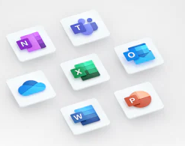
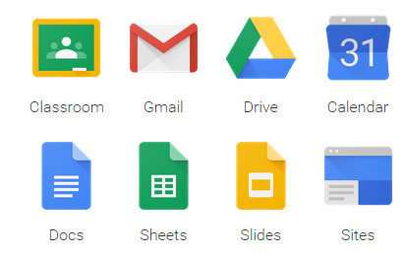
5.00 Understand business technology.
5.03 Understand the usage of basic office organization skills and usage of general office application software.

Slide 2
web-search Tools
World wide web (WWW): a collection of websites or web pages stored in web servers and connected to local computers through the internet.
Search engines: a software program on the Internet that allows you to search documents and files for keywords and returns files that match.
Uniform resource locator (URL): used to identify it and link to a web page.
Browsers: software programs that allow you to view webpages, such as Internet Explorer, Safari, Firefox, or Google Chrome.
Keywords: ideas and topics that define what your content is about.
Viruses: a piece of code which is capable of copying itself and typically has a detrimental effect, such as corrupting the system or destroying data.

Slide 3
basic e-mail functions
Address book: store your contacts, which makes it easy to correspond and share contact information with others.
Distribution lists: help you email multiple people at once.
Attachments: files included with emails.

Slide 4
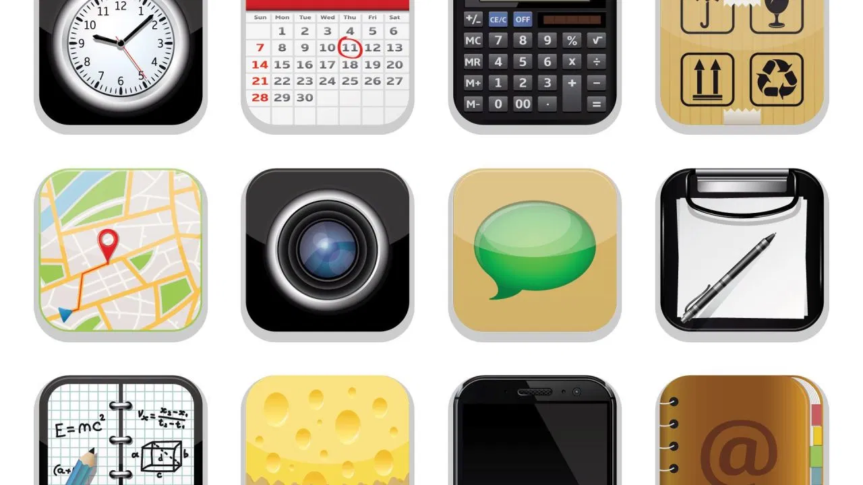
personal information management/productivity applications
There are multiple capabilities of personal information management/productivity applications.
These include Microsoft Outlook’s Calendar feature, Google Calendar, or a smartphone Calendar app.
These applications can be used with an address book application, the calculator application, the notes application, the scheduler application, and the to-do application.

Slide 5
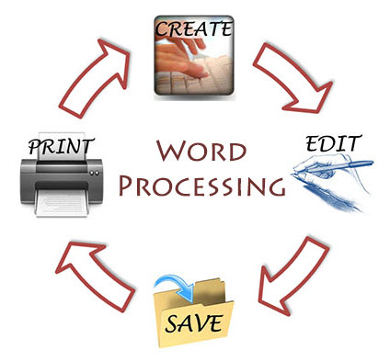
basic word processing
Word processor: enable users to enter and store written work into many types of documents.
Documents can be used to enter and store text in a word-processing software program; to search for and replace text in a document; to retrieve, edit, and print a document; and to cut and paste information from one text document into another in a word-processing software program.

Slide 6
basic presentation applications
Presentation Software: software used to create a sequence of text and graphics, and often audio and video, to accompany a speech or public presentation.

Slide 7
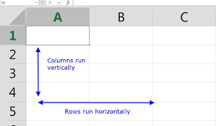
basic spreadsheet applications
Spreadsheet: file made of rows and columns that help sort, organize, and arrange data efficiently, and calculate numerical data.
Cells: a rectangular area formed by the intersection of a column and a row.
Columns: contain definitions of each field.
Formulas: an equation that makes calculations based on the data in your spreadsheet.

Slide 8
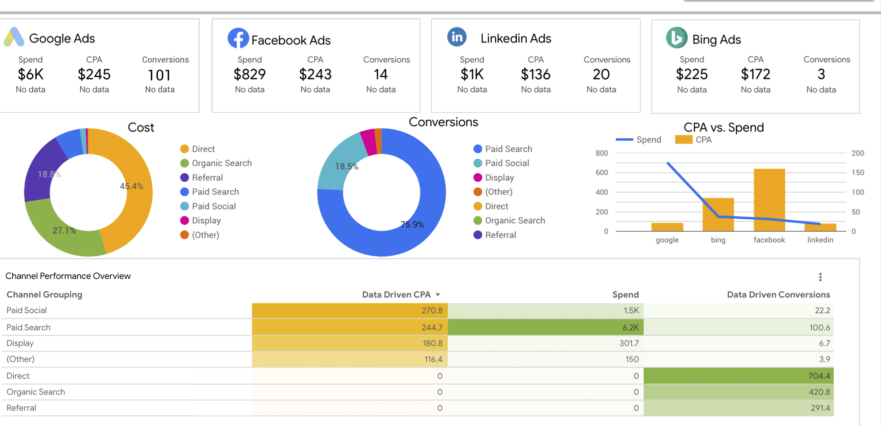
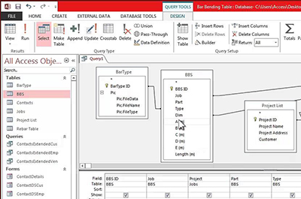
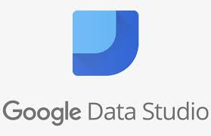
basic database applications
Database: designed to create databases and to store, manage, search, and extract the information contained within them.
Queries: requests for data.

