Slide 1
5.00 Understand business technology.
5.01 Understand the role of information systems.

Slide 2
Information System vs. Information Technology
Information system: set of coordinated network of components, which act together towards producing, distributing and/or processing information.
Information systems help a company make adequate use of its data, reduce workload and assist with compliance with various mandatory regulations.
Information technology: integration of computer with telecommunication equipment for storing, retrieving, manipulating and storage of data.
Information technology is a subset of information systems.

Slide 3
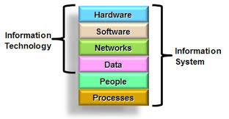
Information What?
Information Technology:
Hardware: The physical components of a computer system (e.g., the central processing unit, hard drive, modem)
Software: Programs that instruct computers to perform specific operations
Data: Facts and figures.

Slide 4
Information Systems Only
Hardware, Software, and…
Data:
Database: Computerized storage for information and facts
Data processing: Handling information, especially facts. Converting facts and figures into useful information. Analyzing collected facts and figures and putting them into formats useful to a business.
Data migration: the process of transferring data between storage types, formats, or computer system

Slide 5
Information Systems “How To’s”
Intranet: An internal network similar to the Internet that is accessible only by authorized personnel; used to access information and communicate with others within an organization. A computer network that is restricted to the organization it serves; an internal Internet.
Cloud storage: Online storage that enables users to upload, store, and access their files via the Internet; users’ files are maintained by a third-party at a remote database storage facility.
Cookies: Text files that are put on a website visitor’s hard disk and then later retrieved during subsequent visits to the site in order to track internet behavior. Mechanisms used by websites to track users’ browsing histories.

