Slide 1
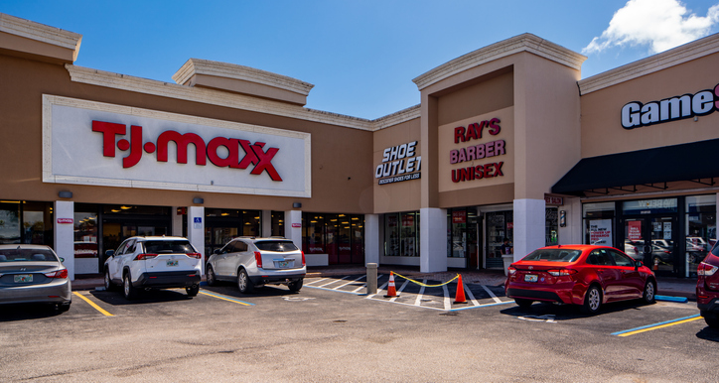
2.00 | Understand the business environment.
2.02 Part 1 | Understand fundamental economic concepts.
Economic Goods and Services
Economics LAP 902

Slide 2
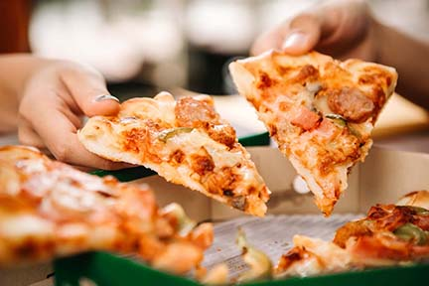
Wants
Wants—desires for things that may or may not actually be required
Craving
Wish
Need: Something required or essential that is lacking
Unlimited
Vary from person to person
Competing
Notes:
We all have wants—desires for things that we may or may not actually require.
A want can be:
A craving—maybe for a deep-dish pepperoni pizza
A wish—perhaps to see your best friend who lives in another state
A need—a warm place to sleep at night
Think of five things that you want right now.
For most people, this is an easy task because they want many things.
In fact, people want so many things that their wants are considered unlimited—when one want is satisfied, there is at least one other want waiting to take its place.
Example:
Consider your want for that pepperoni pizza.
After you get the pizza and your want is satisfied, another want will certainly appear in your mind—you might decide you want to play video games with your friends, take a nap, or get some dessert.
While we all have wants, those wants vary from person to person.
What you want may be quite different from what your parents want, what your siblings want, or even what your friends want.
Wants tend to vary from age group to age group.
What a 2-year-old wants will be quite different from what is wanted by a 16-year-old, a 30-year-old, or a 60-year-old.
DISCUSSION #2: Ask students to give examples of wants that are common to their own age group.
Our wants can also be considered competing.
In other words, we may want more than one thing at the same time.
Example:
You might want to go to a concert, but the concert takes place at the same time as a football game you also want to attend.
These two wants conflict with each other, and you’re faced with a decision about which want you will fulfill.

Slide 3
Economic & Noneconomic Wants
Economic wants —require you to spend money to satisfy them
Noneconomic wants —can be satisfied without spending money
Notes:
There is a difference between economic wants and noneconomic wants.
Think back to your list of five wants.
To obtain the things on your list, would you need to spend money?
If you need to spend money to satisfy a want, it is considered an economic want.
Desires for such things as sports equipment, cars, haircuts, manicures, jewelry, and furniture are economic wants because people will need to spend money to satisfy them.
DISCUSSION #3: Ask students to list some more examples of economic wants.
You don’t have to spend money for everything that you want, though.
For example, you won’t have to pay anything if you want to spend time sitting and talking to a friend or if you want to lie on the grass and watch the sunset.
Wants that can be satisfied without spending money are known as noneconomic wants.
DISCUSSION #4: Ask students to list some more examples of noneconomic wants.
Although noneconomic wants are important, here we are concerned with how people satisfy their economic wants.

Slide 4
Economic Goods
Economic goods must be:
Physical (tangible)
Useful
Scarce (limited)
Transferable
Notes:
The “things” that people buy to satisfy their economic wants are called economic goods and services.
Goods and services are not the same.
For something to be called an economic good, it must have the following characteristics:
It must be a physical (tangible) object.
In other words, you must be able to feel, smell, taste, see, or hear it.
Books, perfume, food, clothes, and cars are examples of physical objects.
It must be useful.
An economic good must be able to satisfy human wants.
Example:
Many people want to plant flowers in their yards; therefore, flowers are useful.
However, no one wants weeds in the yard; therefore, weeds are not considered useful and would not be classified as economic goods.
It must be scarce.
When something is scarce, that means that there is not enough of it for anyone and everyone to freely have as much as they want.
The result is that people are willing to pay money to get it.
Example:
You don’t have to pay to breathe the air.
Air is not scarce; it is abundant.
However, if you want warm air when the weather is cold or cool air when the weather is hot, you must pay because processed air is scarce.
It must be transferable.
Although some goods are tangible, useful, and scarce, they are not considered economic goods, because they cannot be easily obtained.
Example:
There are many oil reserves that exist under the ocean floor.
In many cases, the oil is too costly to obtain; thus, ownership of the oil cannot be transferred from one person or business to another.
The oil, therefore, would not be considered an economic good.

Slide 5
Economic Services
Productive acts that useful, scarce, and transferable and which satisfy economic wants
Same characteristics as economic goods, except they are intangible
“What Are Producers, Consumers, Goods, and Services?”—https://www.youtube.com/watch?v=6B2wUpJPTu0\
Notes:
In addition to buying economic goods, people also buy economic services—productive acts that satisfy economic wants.
Economic services include such acts as health care, lawn care, and dry cleaning.
In each case, someone is paid to perform a service.
The major characteristics of economic services are very similar to those of economic goods.
They must be useful, scarce, and transferable.
However, services are not physical objects.
Instead, they are intangible activities performed by other people for a certain amount of money.
ON THE WEB: To learn more about goods and services, watch this video from Miacademy Learning Channel: https://www.youtube.com/watch?v=6B2wUpJPTu0\.

Slide 6
Relationship of Consumers and Producers to the Economy
Consumers
Limited resources to purchase products
Communicate wants by purchasing or not purchasing
Producers
Limited resources to make products
Must make sure they produce what consumers want
Notes:
It takes money to obtain and to produce goods and services.
Most consumers, people who use goods and services, simply do not have enough money to buy everything that they want.
Likewise, producers have limited money and materials with which to make choices about what they will produce.
This is why decision-making is the heart of economics.
Consumers communicate their wants to producers as they purchase or fail to purchase goods and services.
In this way, consumers are casting dollar, or economic, “votes” to let producers know their wants.
They are voting for the product that they decide to buy and against the others.
Through their buying or not buying, they can control what goods and services will be produced and even how much will be charged for them.
ON THE WEB: Apple discontinued the use of a “home” button in iPhones because people wanted a bigger phone screen and because the buttons wore down over time due to repeated use. You can read about Apple’s evolving iPhone products in this article by Chaim Gartenberg, “Apple’s Now-Defunct Home Button Is a Reminder That Even the Best Buttons Can Fail,” at https://www.theverge.com/circuitbreaker/2019/2/28/18244645/apple-home-button-user-interface-iphone-7-fake.
DISCUSSION #5: Ask students if they can think of some other products that are no longer produced because consumers don’t want to purchase them anymore.
As you can see, the money that consumers spend on goods and services spins the wheels of the economy.
Producers must keep in mind that people buy goods and services to satisfy their wants.
Companies devote a great deal of time and money to finding out exactly what consumers want—this is called market research.
They know that their success depends on keeping a careful eye on what sells and what doesn’t sell so that they can focus their limited resources on satisfying consumers’ economic wants.
If consumers do not want a certain product, its production will be cut back or stopped.
On the other hand, if a product is very popular, more producers will begin to make it.
When consumers fail to buy, the influence is ultimately felt throughout the economy.
Jobs are lost in retail and wholesale businesses.
This forces producers to lay off additional workers.
Consumers who lose their jobs are able to satisfy fewer wants because of decreased income.
Thus, the decisions of consumers to buy or not to buy play a significant role in determining the health of the economy.

Slide 7
Consumer or Industrial?
Consumer goods and services —purchased and used by the ultimate consumer (final user)
Industrial goods and services —purchased by producers:
For resale
To make other goods and services
To use in business operations
Notes:
There are two broad groups, or classifications, of economic goods and services—consumer and industrial.
Consumer goods and services
In this group, we find all the goods and services that are purchased and actually used by the ultimate consumer.
An ultimate consumer is anyone who personally uses a good or service to satisfy their own wants—the final user.
We are all ultimate consumers because we all buy and use goods and services in this manner.
Think of all the goods and services that you buy for your own personal use.
Examples might include food, gas, sunglasses, shoes, movie tickets, and so on.
DISCUSSION #6: Ask students to list some more examples of consumer goods and services.
Industrial goods and services
In this category, we find all the goods and services that are purchased by producers (the people who make or provide goods and services):
For resale
To make other goods and services
To use in operating their businesses
Almost all producers must buy certain goods and services to carry out their day-to-day activities.
They need things such as buildings, equipment, and office supplies to operate.
In addition, many producers must purchase the raw materials they need to make their finished products.
Farmers must buy seed to produce their crops.
Automobile manufacturers must buy steel, tin, plastic, rubber, and glass to produce new cars.
Businesses buy the services of advertising agencies to create ads, attorneys to handle legal arrangements, and accountants to prepare financial statements.
All of these are examples of industrial goods and services since they are used by producers rather than by ultimate consumers.
These goods are also frequently referred to as “producer” goods and services.
DISCUSSION #7: Ask students to list some more examples of industrial goods and services.
Do you think you can tell the difference between a consumer good or service and an industrial good or service?
What about a regular old ink pen?
Would that be considered a consumer good or an industrial good?
Don’t be confused!
If you bought the pen for your own personal use, it is a consumer good.
If a producer bought the pen for use in the office, it is an industrial good.
As you can see, it is simply a matter of who buys the item and for what purpose.
ON THE WEB: To further explore the difference between consumer goods and industrial goods, check out this article by Evan Tarver: https://www.investopedia.com/ask/answers/050415/how-are-industrial-goods-different-consumer-goods.asp.
DISCUSSION #8: Ask students to think of more goods and services that could be either consumer products or industrial products depending on who buys them and for what purpose. Are there any products that are either always consumer or always industrial?

Slide 8
Product Classifications for Marketing
Consumer or industrial classification:
Helps marketers plan marketing activities
Serves as guide for:
Promotion
Distribution
Selling
Notes:
It matters to marketers whether a good or service is a consumer or an industrial product.
The classification system helps them select appropriate marketing activities for a particular good or service.
The types of promotion, distribution, and selling a marketer uses are affected by a product’s classification.
Therefore, marketers use the classifications as a guide for marketing planning.
They have found it useful to divide the categories of consumer and industrial goods and services even further.

Slide 9
Classifications of Consumer Products
Convenience
Shopping
Specialty
Unsought
“Types of Consumer Products & How To Sell Them”—https://www.youtube.com/watch?v=4mqPAUvXRw0
Notes:
Classifications of consumer products
Marketers classify consumer products based on consumer buying habits.
They recognize four groups of consumer products:
Convenience products
Consumers purchase these items quickly and without much thought or effort.
If the desired good or service is not available, consumers will select a substitute item.
Convenience goods are usually low-cost items.
They may be staple items, such as bread or milk, or impulse items, such as a candy bar at the checkout counter or a quick car wash on the way home from work.
ON THE WEB: You can see more examples of staple items in this article, “What Are Consumer Staples?” from InfoBloom: https://www.infobloom.com/what-are-consumer-staples.htm.
Shopping products
When buying shopping products, consumers “shop around” to get the best quality, price, and/or service.
They tend to pay more for shopping products than for convenience products.
They usually want the advice of a salesperson.
Examples:
Furniture
Computers
Large appliances
College educations
DISCUSSION #9: Ask students to think of more examples of shopping products.
Specialty products
These are items with special or unique characteristics that consumers are willing to exert special efforts to obtain.
In many cases, the special characteristic of the item relates to its brand name.
DISCUSSION #10: Ask students if they can think of a time they were searching for a product of a specific brand. How far were they willing to go to get it?
Consumers are not willing to accept substitutes for specialty products.
They are willing to pay higher prices to get them.
Examples:
Antiques
Sports cars
Fine china
Luxury spa services
Unsought products
A common definition for unsought products is that they are bought out of adversity instead of desire.
This might include a coffin, a pair of crutches, or a life insurance policy—these are not items that consumers would like to think about needing, but circumstances might make them necessary.
Many times, these products require an explanation or demonstration from a knowledgeable salesperson.
ON THE WEB: For more information on the different consumer product classifications, watch this video from Professor Wolters: https://www.youtube.com/watch?v=4mqPAUvXRw0.

Slide 10
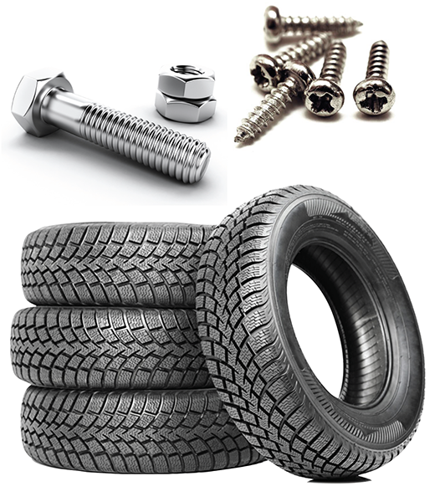
Classifications of Industrial Products
Materials
Parts
Installations
Equipment
Supplies
Notes:
Classifications of industrial products
Marketers classify industrial products according to their uses.
These classifications include:
Materials
Become part of a finished product after they have been processed
Some are considered raw materials because the producer receives them almost as they would appear in their natural state.
Examples of raw materials include wheat, trees, and gold.
Other materials have already been processed in some way when the producer receives them.
Examples of these materials include yarn that will be used to make cloth and flour that will be used to make baked goods.
Parts
Will become part of a finished product, but they do not need any additional processing
Examples:
Bolts
Screws
Tires
DISCUSSION #11: Ask students to think of more examples of parts.
Installations
High-cost, long-lasting items that are used to produce other goods and services
Affect the amount of goods and services that a producer can expect to make
Examples:
Buildings
Conveyor belts for assembly lines
Blast furnaces used to smelt iron
Equipment
Used in the operation of a business but are not used in the actual production of a good or service
Cost less and have a shorter life span than installations
Examples:
Computers
Forklifts
Phones
Supplies
Constantly being purchased and used up in the operation of a business
Usually the least costly type of industrial product
Examples:
Cash register tapes
Pencils
Stationery
Shipping materials

