Slide 1
The Price Is Right
Nature of Pricing
Pricing LAP 1

Slide 2
Objectives
Describe the pricing function.
Explain the role of pricing in marketing.

Slide 3
Describe the pricing function.

Slide 4
What Is Pricing?
A marketing function that involves the determination of an exchange price at which the buyer and seller perceive optimum value for a good or service
Important for:
Customer satisfaction
Continued success of a business
Notes:
Pricing is a marketing function that involves the determination of an exchange price at which the buyer and seller perceive optimum value for a good or service.
Effective pricing is important for:
Customer satisfaction
The continued success of a business
Pricing isn’t as simple as just placing a tag on an item that tells customers how much they owe.
It involves:
Determining an exchange price
When a good or service is sold, the buyers and sellers have agreed on a value for the product.
That initial value is usually stated as a monetary amount, such as $39.99.
At this point, the buyer has decided that s/he is willing and able to pay that amount of money to obtain the product, while the seller has decided that s/he will accept that amount as payment.
This amount of money is known as the exchange price.
Before sellers can set this exchange price, they must consider a number of factors.
Perceiving optimum value
Buyers and sellers must feel that they are receiving the most, or optimum, value from the product.
When you buy something, you want to make sure that it is the best purchase you can make for your money.
After all, when you spend your money on one product, you will no longer have it available to buy something else.
DISCUSSION #1: Ask students to relate a time when they made a purchase that didn’t turn out to be a good value for their money.
Likewise, sellers want to feel that they are selling their products at the best price—the highest price that will still attract the most buyers.
The price that the seller sets will affect the number of sales and the amount of income that the company will make.

Slide 5
Pricing
Like a tug-of-war between buyers and sellers
Buyers—want low prices
Sellers—want high prices
Must find balance
Pricing is not the same as cost.
“What Is Pricing and What Are Some Common Pricing Strategies?” by Rosemary Peavler: https://www.thebalancesmb.com/what-is-pricing-393477
Notes:
Pricing is like a tug-of-war between the buyers and the sellers.
Both are trying to get the most value from the good or service.
Naturally, buyers want low prices, while sellers want high prices.
The trick to pricing comes in balance and satisfying both groups.
Both buyers and sellers need to perceive that they are getting the best possible value they can.
If this doesn’t happen, several things might occur:
Customers will spend their money elsewhere, either on a similar product (if one is available) or on an entirely different product.
A business’s sales will decline, and it will be forced to discontinue offering the product or to change its prices.
Effective pricing, therefore, is important for both customer satisfaction and the continued success of the business.
ON THE WEB: Keep in mind that price is not the same as cost. To learn more about the difference between these terms, read Rosemary Peavler's article "What Is Pricing and What Are Some Common Pricing Strategies?" at https://www.thebalancesmb.com/what-is-pricing-393477.

Slide 6
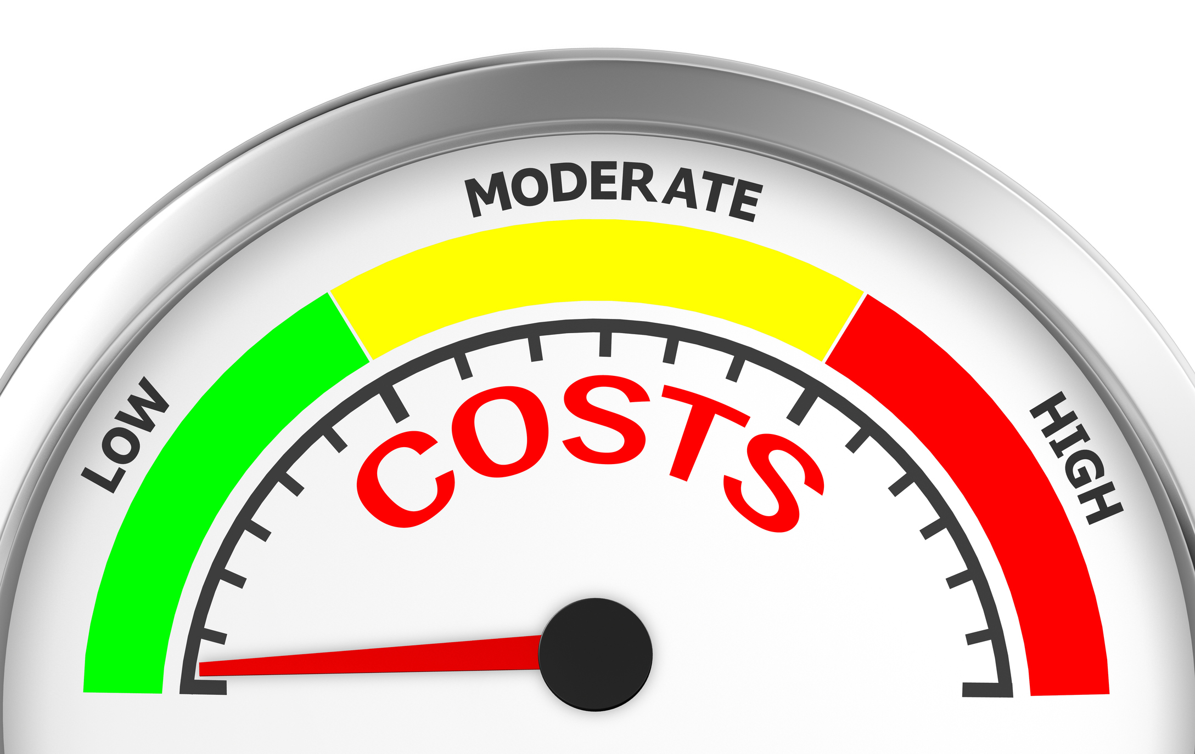
Characteristics of Effective Pricing
Realistic
Flexible
Competitive
Notes:
Characteristics of effective pricing:
No single factor makes an effective price.
Marketers must keep a number of characteristics in mind when setting effective prices.
These include:
Being realistic
Believe it or not, prices can be set too low.
Many businesses have found that if their prices are not what customers expect to pay, even if that price is lower than expected, customers will not buy.
When these businesses increased their prices, their sales actually increased as well.
Customers associate price with quality.
If the price is high, the quality is high.
If the price is low, the quality is low.
Wouldn’t you be skeptical if you found a brand new laptop that only cost $15?
Businesses must set prices that are realistic to customers—neither too high nor too low.
DISCUSSION #2: Ask students if they can recall a time they saw a product that seemed to be priced too low. What was the product? Why do they think the price was so low?
Being flexible
Marketers must understand that the prices they set are written on paper—not in stone.
Because pricing is a tug-of-war and a constant quest for balance, businesses must be willing to adjust their prices as necessary.
These adjustments may be increases or decreases, depending on the circumstances the business faces.
Example:
During bad economic times, customers are quite cautious about how they spend their money.
To attract these customers, businesses may need to lower prices.
However, when economic conditions are good, businesses might increase prices because customers are less cautious with their spending.
DISCUSSION #3: Ask students to identify goods and services that suffer poor sales and may be priced lower when economic conditions are bad.
Being competitive
Would you pay $4 for a can of Pepsi?
Under normal circumstances, probably not.
You would know that you could get the same product for a much lower price at another store.
When a similar product is offered by competitors, a business needs to be aware of the prices others are charging.
If not, the business will probably lose customers because its prices are not competitive.

Slide 7
Prices Have Many Names
Interest
Wages/Salary
Fees
Dues
Fare
Notes:
Prices are attached to anything of value for which we are willing to make a money exchange.
They are associated with such things as:
A loan from a bank (interest)
The work that you do (wages/salary)
A lawyer’s services (legal fees)
Membership in a professional organization (dues)
An airline or bus ticket (fare)

Slide 8
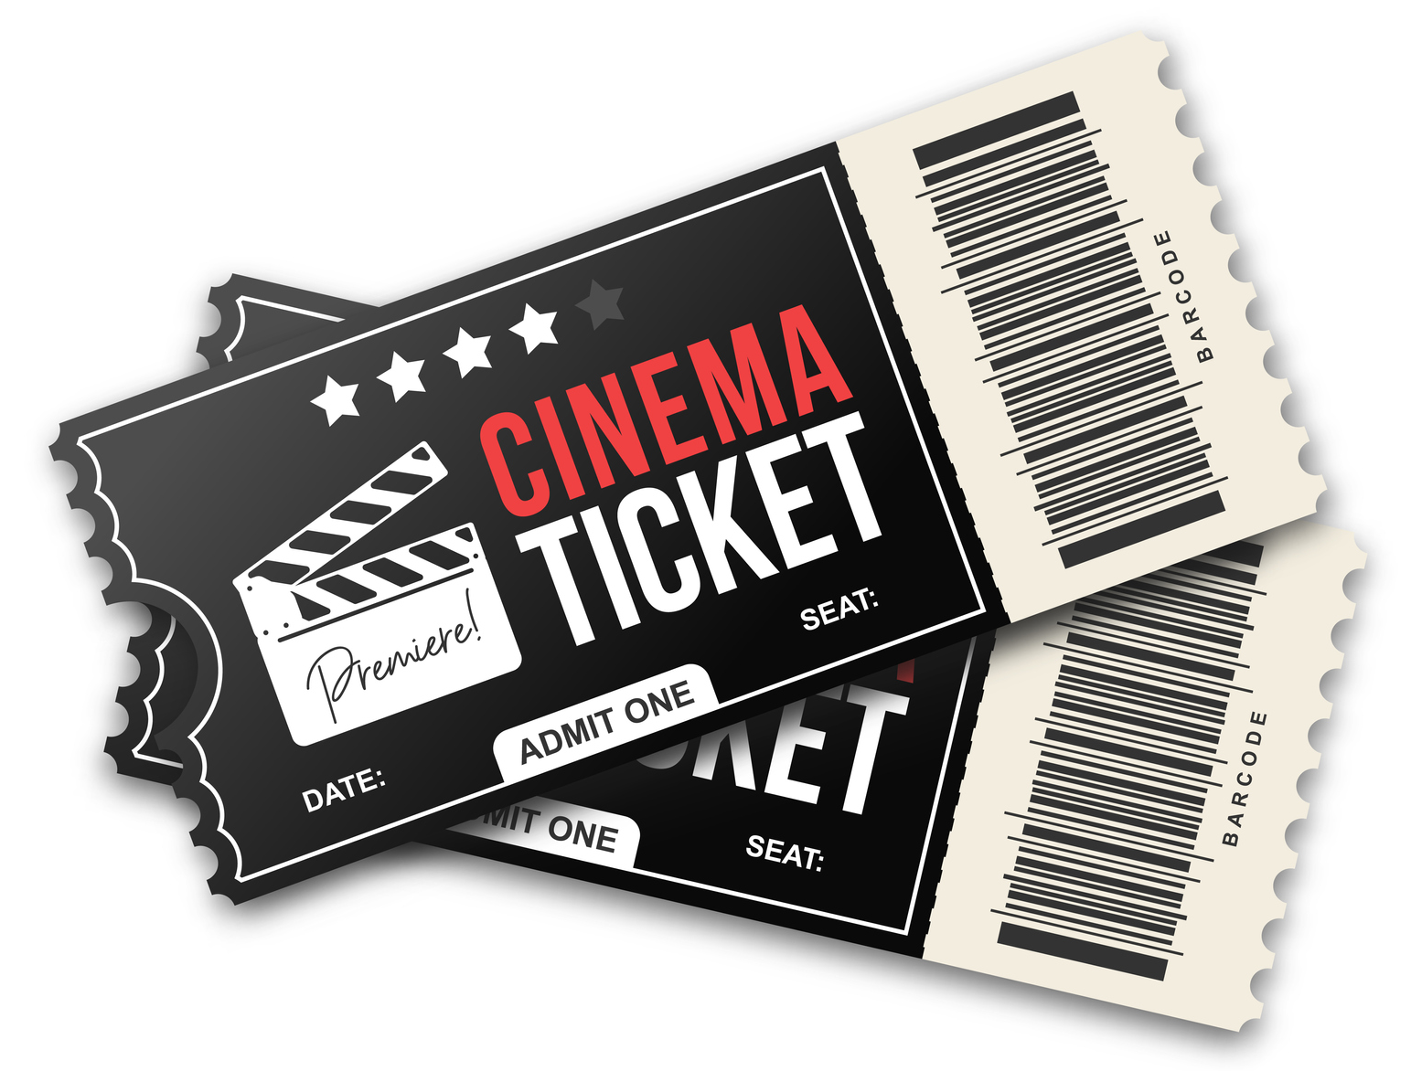
Prices Have Many Names
Admission
Service charge
Tuition
Rent
Notes:
A movie or theater ticket (admission)
Service charge for room service
Tuition
Rent
All of these are prices—they are just known by different names.
DISCUSSION #4: Ask students to identify more alternative names for prices.
What is actually being priced?
In the case of a car, it’s not just the car itself.
The price includes the car and all of the associated services—transportation and delivery charges, credit, etc.
This makes pricing more difficult because marketers must look beyond the cost of the immediate product to consider its associated services.
Who sets prices:
Depending on the size of the business, many people may be involved in establishing prices.
In a smaller business, the person most often responsible for setting prices is the manager or owner.
This person will check competitors’ prices and use the company’s own records to establish prices for the goods and services the business offers.
In larger companies, an entire department (part of marketing) is usually responsible for setting prices for the company.
The department may use more sophisticated means to determine prices for the company’s products.
It may analyze market research, conduct customer surveys, study competitors’ prices, and analyze current and past sales records and trends to help with pricing decisions.
ON THE WEB: For more information about the relationship between price, research, and the marketplace, read the article “Why Is ‘Price’ Important in the Marketplace?” at https://informationstation.org/kitchen_table_econ/why-is-price-important-in-the-marketplace/.

Slide 9
Factors Affecting Price
Costs
Supply and demand
Economic conditions
Competition
Government regulations
Channel members
Company objectives and strategies
Notes:
Many factors, both internal and external, affect the final price decision:
Costs
Supply and demand
Economic conditions
Competition
Government regulations
Channel members
Company objectives and strategies
DISCUSSION #5: Ask students if they can identify more factors that might affect the final price decision for a product.

Slide 10
Explain the role of pricing in marketing.

Slide 11
How Pricing Affects Product Decisions
Research
Materials used in production
Profit decisions
Customer decisions
Company image
Notes:
Pricing plays a key role in the marketing mix (product, price, place, and promotion).
The elements of the marketing mix are interdependent because a change in one will affect the others.
ON THE WEB: You can learn what the marketing mix is by watching this video “The 4 Ps of the Marketing Mix Simplified” by Paxton/Patterson: https://www.youtube.com/watch?v=Mco8vBAwOmA.
Product
Product decisions involve determining what goods, services, or ideas to produce or sell that will satisfy customers’ needs and wants.
Pricing affects product decisions in the following ways:
Research
Pricing affects the type of research conducted, the length of the research project, and the amount of money spent on research.
Research costs money.
If a company wants to introduce a new, low-priced laundry detergent, it cannot afford to spend millions of dollars on research.
Instead, the company will probably choose a less expensive method of research and may spend only three to six months conducting it.
Materials used in production
Which costs more—a silver ring or a platinum ring?
The quality of materials used in production is reflected in the product’s price.
Companies, therefore, must decide what materials to use in the production of their products.
If they want to charge lower prices, they may not be able to use more expensive materials.
DISCUSSION #6: Ask students if they can think of more examples of similar products with prices that vary due to the materials used.
Profit decisions
Just because a good or service looks great on paper doesn’t mean that the good or service will ever hit the market.
Companies must first determine if there is a market for the product and if there will be sufficient demand for it.
Before introducing a new product, a company must first determine if it will be profitable.
Companies must ask the following questions:
Can we make a profit by selling this product?
Can we achieve the return on investment we want?
Can we set our prices high enough to answer the first two questions with a YES?
Customer decisions
Different companies seek to attract different types of customers.
Low prices attract customers who are looking for bargains, while high prices attract customers looking for prestige and high quality.
For example, Porsche doesn’t price its cars to appeal to people on a budget—the company wants to attract customers who are seeking luxury.
A company’s pricing strategies will determine the type of customers its products attract.
Company image
What type of image does a company want to project?
Pricing will help determine that image.
Stores that have low prices are thought of as discount stores.
On the other hand, stores with very high prices usually are perceived as having more prestigious name brands and higher quality products.
Think of the discount grocery chain Aldi, known for its low prices, versus the higher priced grocery chain Whole Foods.
How are these companies perceived differently?
DISCUSSION #7: Ask students if they can think of any stores with a prestigious image in the area. How do the stores’ images relate to price?

Slide 12
How Pricing Affects Promotion Decisions
Choice of medium
Amount of money spent
Time allocated to promotion
Notes:
Promotion
Promotion involves the various types of communications that marketers use to inform, persuade, or remind customers of their products.
Pricing affects promotion decisions in the following ways:
Choice of medium
Products with very low profit margins are usually promoted in lower priced media.
Companies that have low profit margins and/or small promotional budgets often promote themselves largely on social media, which usually costs very little.
Products that have high profit margins are usually promoted in a combination of media, including:
Radio
Television
Newspapers
Magazines
Also, the bigger the advertisement, the higher its cost.
A one-page ad in your local newspaper will cost more than a two-column or a ¼-page ad.
A 10-second television commercial costs less than a 30- or 60-second commercial.
The amount of money spent
Most companies have promotional budgets.
The amount of money spent on a promotional campaign is built into the cost of the product.
The higher the promotional budget for a good or service, the higher the price of the good or service for customers.
DISCUSSION #8: Ask students to identify examples of higher priced products with big promotional budgets.
Time allocated to the promotion
Since the cost of promotion is built into the cost of the product, goods and services tend to cost more when they are promoted over a long period of time.
Products that are promoted through displays, television, and radio over a six-month period will probably be priced higher than products that are promoted for only one month.

Slide 13
How Pricing Affects Place Decisions
Choice of transportation channels
Where the product is offered
Notes:
Place
Place involves shipping, handling, and storing products and determining when and where they will be available.
Pricing affects place decisions in the following ways:
Choice of transportation channels
There are a variety of ways that companies can ship their products to their final destinations.
Trucks, planes, trains, and ships are all used to transport products across town, across the country, and across the globe.
The cost of each type of transportation varies.
Companies will choose the method that fits within their budget.
Remember that the cost of the transportation will be built into the price of the product.
For example, trucking is less expensive than flying, so an item transported by truck may be less expensive than one transported by plane (think about the cost of goods in remote areas, such as Hawaii).
Marketers must also consider time when it comes to transportation channels—one channel may be cheaper but might take longer for products to get to their destinations.
This factor will have an impact on pricing decisions.
Where the product is offered
A product’s price affects where it is sold.
Goods and services with high prices will be carried by stores that sell higher priced items.
If a product is priced inexpensively, it will sell at a different type of store.
Example:
A $100 haircut is a service you will most likely find at a fine salon or day spa.
A $10 haircut is a service you will most likely find at a discount salon.
DISCUSSION #9: Ask students if they can think of any other ways in which pricing might affect place decisions.

Slide 14
Pricing Objectives
Goals marketers have for their pricing strategies
May relate to:
Profitability
Sales
Competition
Image/Prestige
"Four Types of Pricing Objectives" by Devra Gartenstein: https://smallbusiness.chron.com/four-types-pricing-objectives-33873.html
Notes:
Each company wants or needs something unique from its pricing strategies.
These pricing objectives or goals are the guiding influences in how marketers go about making pricing decisions.
There are a number of different types of pricing objectives that companies have.
They may relate to profitability.
Making as much profit as possible
Simply covering costs
They may relate to sales.
Selling as many units as possible
Gaining a certain market share
They may relate to the competition—keeping prices competitive is very important in many industries, such as the airline industry.
They may relate to image or prestige.
Companies may set prices that will help them maintain a certain image in customers’ minds.
Think about luxury cars or jewelry.
Companies may use any combination of these pricing objectives when setting prices for goods or services.
ON THE WEB: For more information about how and why marketers make pricing decisions, read Devra Gartenstein's article "Four Types of Pricing Objectives" at https://smallbusiness.chron.com/four-types-pricing-objectives-33873.html.
DISCUSSION #10: Ask students if they can identify other examples of pricing objectives a company might set.

Slide 15
Amazon’s success
Predatory pricing
“Can Anyone Compete With Amazon?” at https://www.thenational.ae/arts-culture/comment/can-anyone-compete-with-amazon-1.948975
What do you think?
Notes:
The Gray Zone
You’re no doubt familiar with Amazon.com—perhaps you’ve even purchased something from the online retailer recently!
Amazon’s often unbelievably low prices are one of the biggest reasons for its success, but those prices are also the cause of controversy.
In fact, some people have accused Amazon of predatory pricing, the practice of selling a product at a very low price in an attempt to drive competitors out of the market.
This practice is illegal in the United States and many other countries.
Amazon and its defenders maintain that the company hasn’t done anything wrong.
They claim that in a private enterprise system, businesses should be allowed to price their products as low as they want to, regardless of how their actions impact the competition.
ON THE WEB: Read the following article “Can Anyone Compete With Amazon?” by Rhodri Marsden to learn more: https://www.thenational.ae/arts-culture/comment/can-anyone-compete-with-amazon-1.948975.
What do you think?
Are Amazon’s practices wrong, or is the company simply being competitive?

Slide 16
Acknowledgments
Original Developers:
Christopher C. Burke and Kate Terentyev, MBA Research
Version 2.0
Copyright © 2020
MBA Research and Curriculum Center

Slide 17
Digital-Based Photography Sources
ThinkStock Photos
Various images used in this presentation are ©2020 ThinkStock Photos. All rights reserved www.ThinkStockPhotos.com
Getty Images
Various images used in this presentation are ©2020 Getty Images Photos. All rights reserved www.gettyimages.com

Slide 18
Copyright
All photographic digital images in this PowerPoint are owned by the aforementioned photographic resources or their licensors and are protected by the United States copyright laws, international treaty provisions, and applicable laws. No title to or intellectual property rights to the images in this PowerPoint are transferred to you. These sources retain all rights and are not to be used, digitally copied, transferred, or manipulated in any way. To do so is a violation of federal copyright laws.

