Slide 1
The French and Indian War

Slide 2
Background
European countries were constantly fighting
European countries tried to control as much land and as much trade as possible

Slide 3
Triangle of Hatred
England
France
Spain

Slide 4
18th Century Success Secret
more land
+ more trade
+ more gold
= more wealth
& more power
Mercantilism

Slide 5
Colonial Land Grab
Colonists “bumped” into each other.
Colonists explored each others’ land.
Colonists claimed each others’ land.
Native Americans were always caught in the middle.

Slide 6
French forts in the Ohio Valley angered the English.

Slide 7
The French Irritation…
In the 1750s, France started building forts around the Great Lakes and into the Ohio River valley.
French had better trading relations with the Indians than the English did... especially the fur trade.
France controlled land from the St. Lawrence River (north) to New Orleans (south); wanted to control western PA

Slide 8
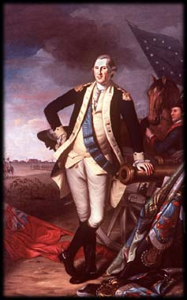
George’s First Command
VA claimed western PA too.
G. Washington was a wealthy planter and member of Virginia militia (volunteer soldiers).
VA Governor Dinwiddie sent GW and militia to PA to build a road through the mountains.
The road from VA to PA would help “claim” the land for VA.

Slide 9
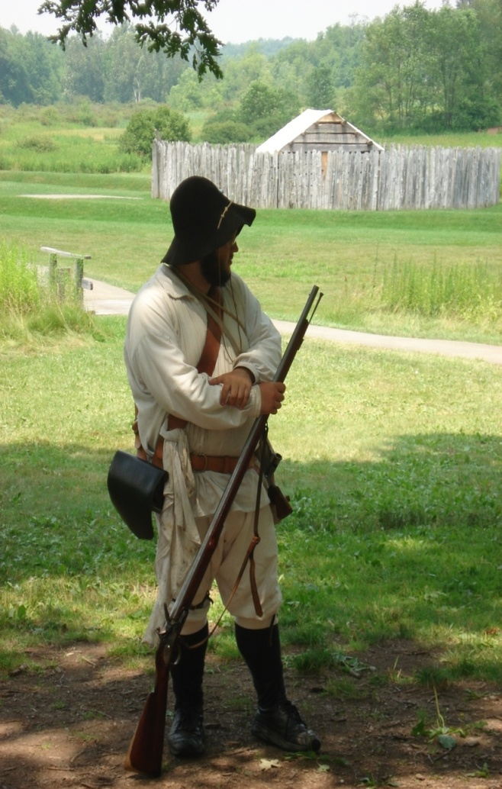
George’s First Command
Dinwiddie ordered GW to tell the French to leave (May, 1754).
VA militia killed a French “ambassador” by mistake.
French forces outnumbered GW and VA militia.
GW built Fort Necessity.
French forces captured GW and sent him home embarrassed.

Slide 10
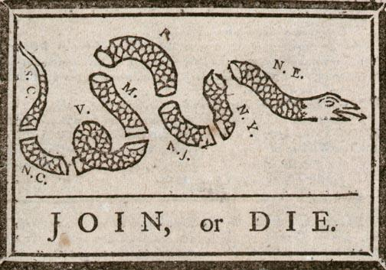
BACK TO LESSON
Albany Plan of Union
- Ben. Franklin published this cartoon in 1754 urging colonies to unite for defense.
- 7 Colonies sent representatives to Albany, NY to devise a common government
- Not one colony approved the “Albany Plan.”
Join, or Die (1754), Benjamin Franklin

Slide 11
Preparing for War
In late 1754, France sent several army regiments to defend Canadian territory.
In late 1754, Britain sent professional soldiers to America commanded by General Edward Braddock.
Both Britain and France tried to secure the help of Native Americans.
In June 1755, Braddock led nearly 2000 British soldiers and some colonial militia to the French Fort Duquesne (Do-cane), PA. (near Pittsburgh, PA)

Slide 12
Britain Declares War!
News of Braddock’s defeat reached London and Britain declared war on France, beginning the Seven Years’ War.
It was a “world war”…French, British, and Spanish forces clashed in Cuba, the West Indies, India, the Philippines…as well as in North America and Europe.
Early years of the war were disastrous for the British and the British colonies.

Slide 13
Pitt Takes Charge
British performance improved after William Pitt became Secretary of State and then Prime Minister.
Pitt wanted Britain to win the war no matter the cost; Britain went deep into debt.
Pitt sent some of Britain’s best generals, troops, and naval squadrons to the Colonies.
Overwhelming British strength won the war.

Slide 14
French and Indian War:
Cause and Effect Flow Chart
Critical Thinking: Cause and Effect
Critical Thinking: Cause and Effect
Back to Transparencies

Slide 15
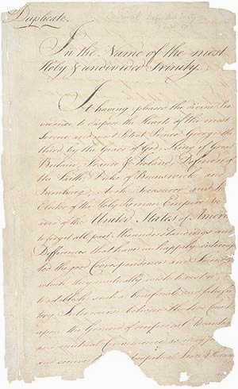
The Treaty of Paris 1763
signed in Paris, France in 1763.
France gave Canada its lands east of the Mississippi River to Great Britain.
France gave its lands west of the Mississippi River (including Louisiana Territory) to Spain.
France kept four Caribbean islands.
Spain gave Florida to Great Britain.

Slide 16
Results of the F & I War
British:
acquired more land
became a world-wide “super power”
grew resentful of colonial “blundering” and the cost of defending the colonies

Slide 17
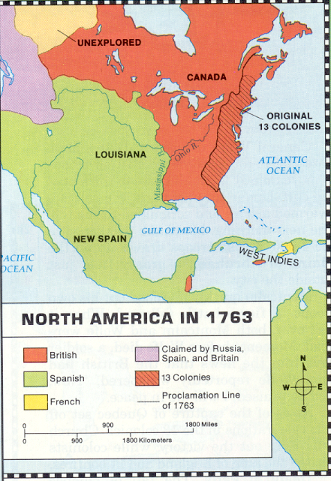
Results of the F & I War
French:
lost almost all land in North America
no longer important in American development
Native Americans:
continued to lose control over land in North America

Slide 18
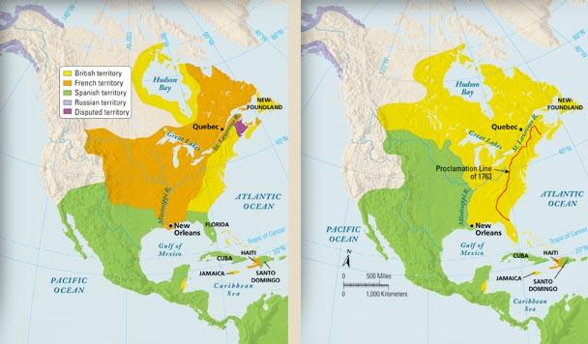
North America: Before and After
BACK TO LESSON
European Claims in North America, 1754 and 1763
Back to Maps

Slide 19
Results of the F & I War
Colonists:
acquired land to expand
gained valuable military experience
found their first “American” hero…G.Washington
learned how to cooperate
began to think of themselves as “Americans”

Slide 20
Proclamation of 1763
King George III declared that Appalachian Mountains were the western boundary for all colonies; colonists could NOT cross mountains:
to separate the colonists from the Indians
to prevent future wars and expense
Proclamation angered many colonists, especially those who owned shares in land companies, such as the Ohio Company of Virginia.

Slide 21
American colonists forbidden to cross Appalachian Mountains.

Slide 22
Proclamation of 1763
Proclamation of 1763 created tension between Britain and the colonies.
Britain placed additional taxes on the colonists to pay for defending the 13 colonies…this created more tension.
Indians traded with the British and the colonists, but regarded both as enemies.
Colonists migrated across the Appalachian Mountains anyway.

Slide 23
The French and Indian War…
…was really the beginning of the American Revolutionary War

