Slide 1
NC CTE 7.01: Understand marketing’s role and function in business to facilitate economic exchanges with customers.
Explain marketing and its importance in a global economy

Slide 2
What is marketing?
the process of planning and executing the conception, pricing, promotion, and distribution of ideas, goods, and services to create exchanges that satisfy individual and organizational objectives.
links producers to the customers who buy their goods and services

Slide 3
Marketing Activities (The 4 P’s)
Product
The goods and service combination the business offers to the market, including variety of product mix, features, designs, packaging, sizes, services, warrantees and return policies.
Ford
Goods VS Services
Notes:
Image retrieved from: http://www.sportscarcup.com/cars/ford-shelby-gt500-exterior.jpg, August 27, 2012, Image retrieved from:http://www.musclecarclub.com/other-cars/classic/ford-model-t/images/ford-model-t-1a.jpg, August 27, 2012., http://image.8-lug.com/f/27356644/0810_8l_01_%2Breaders_rides_bragging_rights%2Bcustom_ford_truck.jpg, http://upload.wikimedia.org/wikipedia/commons/4/44/Ford_Jeep_Brazil.jpghttp://www.almatractor.com/images/ford-tractor.jpg

Slide 4
Marketing Activities (The 4 P’s)
Pricing
Pricing decisions dictate how much to charge for goods and service in order to make a profit.
Pricing decisions are based on costs and on what competitors charge for the same product or service.
Must also determine how much customers are willing to pay.
Notes:
Image retrieved from: http://thesurfingpizza.com/2009/12/08/breaking-down-2009s-stocking-stuffers/, August 27, 2012, Image retrieved from: http://www.candy.com/assets/images/30137.jpg, August 27, 2012.

Slide 5
Marketing Activities (The 4 P’s)
Promoting
The effort to inform, persuade, or remind potential customers about a business’s products or services.
Examples:
Advertising—e.g., television commercials
Personal selling—e.g., door-to-door sales, professional sales
Publicity—e.g., press releases
Sales promotion—e.g., logo-imprinted giveaways, buy one get one free, sign up early, no registration fee.
Notes:
Image retrieved from: http://www.neighborhoodnewspapers.com/Extra.gif, August 27, 2012, Image retrieved from: https://www.google.com/search?hl=en&sugexp=les%3B&tok=Stffts61nzLam2FXgziaLQ&cp=10&gs_id=7&xhr=t&q=website+advertising&qscrl=1&rlz=1T4SKPT_enUS408US412&bav=on.2,or.r_gc.r_pw.r_qf.&biw=1680&bih=798&ion=1&wrapid=tljp134612699871802&um=1&ie=UTF-8&tbm=isch&source=og&sa=N&tab=wi&ei=b0Q8UK_NOpSG9QSzvYCIBw, August 27, 2012, Image retrieved from: http://www.cepro.com/article/how_vivint_sells_200k_security_automation_systems_in_a_summer/, August 27, 2012.

Slide 6
Marketing Activities (The 4 P’s)
Place/Distribution
Deciding how to get goods into customers hands.
Physically moving and storing goods.
Main methods are truck, rail, ship, or air.
Download it via Internet?
Medical equipment/supplies
Vehicle from Germany
Timber
Coal

Slide 7
Items that are marketed
Broad categories
Goods
Durable – e.g., DVD player
Nondurable – e.g., gasoline
Services – e.g., Pest Control
Organizations – e.g., Humane Society
Places – e.g., New Zealand
Ideas – e.g., “Stand” against smoking
People – e.g., “Shaq Attaq” (Shaquille O’Neal)
Almost anything can be marketed.
Notes:
Image retrieved from: http://cdn3.blogs.babble.com/strollerderby/files/2012/03/Picture-5.png, August 29, 2012. Image retrieved from: http://cdn.humanesociety.org/images/hsus_logo.gif, august 28, 2012.

Slide 8
Where does Marketing Occur?
Everyday by people, in places, with communication
Marketing occurs wherever customers are

Slide 9
Marketing Concept
The idea that a business should strive to satisfy consumer wants and needs while achieving company goals.
Notes:
Image retrieved from: http://www.fishbowlinventory.com/images/Happy-customer.jpg, August 28, 2012.Image retrieved from: http://www.blackenterprise.com/career/7-ways-to-maximize-your-companys-profits/attachment/happy-customers/, August 29, 2012. Image retrieved from: http://img.ehowcdn.com/article-new/ehow/images/a06/b9/io/calculate-company-profit-800x800.jpg, August 29, 2012. Image retrieved from: http://www.inthesetimes.com/images/working/apple_workers.jpg, August 29, 2012.

Slide 10
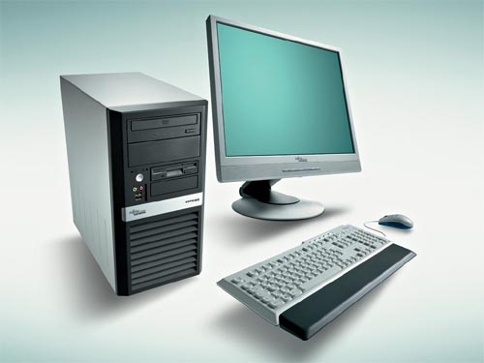
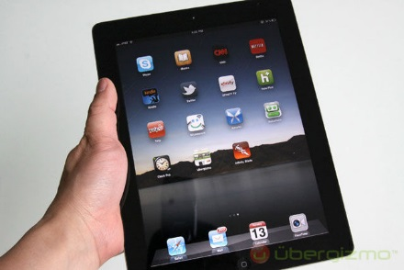
Elements of the Marketing Concept
Customer orientation: Do it their way.
Finding out what customers want and producing those products the way they want them
Company commitment: Do it better.
Make/price the product better than the competition’s model.
Company goals: Do it with success in mind.
Maintain your firm’s purpose while you apply the marketing concept.
Notes:
Image retrieved from: https://internetdevices.files.wordpress.com/2012/05/desktop-computer-accessories.jpg, August 29, 2012. Image retrieved from: http://asset3.cbsistatic.com/cnwk.1d/sc/35330106-2-460-0.gif, August 29, 2012. Image retrieved from: http://www.ubergizmo.com/wp-content/uploads/2011/03/ipad-2-review-07.jpg, August 29, 2012. Image retrieved from: http://4.bp.blogspot.com/_LgF7ePXTRlA/TTXd1ntyXnI/AAAAAAAAAEo/udQAjNr4gNs/s1600/Apple-Logo.gif, August 28, 2012. Image retrieved from: http://bionicbong.com/wp-content/uploads/2010/03/dell-logo.jpg, August 28, 2012.

Slide 11
What is Marketing’s Role in a Private Enterprise System?
Marketing fits into every facet of our lives, whether on a global scale or right in our own neighborhoods.
Provides benefits that make our lives better, promoting using natural resources more wisely, and encourage international trade.
Without marketing, we would all have to be self-sufficient.
Notes:
Image retrieved from: http://www.coolhunt.net/wp-content/uploads/2008/11/organicfarm_02.jpg, August 30, 2012.

Slide 12
How would consumers and businesses be affected if marketing did not exist?
Our nation would have difficulty linking producers to consumers
Chiquita bananas are grown in Costa Rica,
Guatemala, Honduras, and Panama
Our own routines would be different because marketing shapes everything we do.
Ex: Out of milk? Go to the store.
Notes:
Image retrieved from: http://www.jacksonvilledivorceattorneyblog.com/baby_hands.jpg, August 29, 2012. Image retrieved from: http://www.nikdaum.com/news/mai266.jpg, August 29, 2012.Image retrieved from: http://www.avanceon.com/Portals/31626/images/C--Users-sschlegel-Pictures-Question-Mark-Man.jpg, August 29, 2012.

Slide 13
How Does Marketing Benefit Our Society?
Marketing visibly benefits our lives, our natural surroundings, and our global trade.
Makes our lives better
Because problem solving is at the heart of marketing, each year we add
some new products to our home, often at lower prices.
Promotes using the earth’s resources more wisely
If available resources are used sensibly, benefits can extend well into the
future for the marketer, the nation, and the entire world.
Encourages trade between nations
Because resources are valuable to marketers, it doesn’t take them long to
pinpoint where a particular resource can be found in abundance.
If our nation lacks a resource, we can usually trade something to get it.

Slide 14
The Six Functions of Marketing
1. Channel management (a.k.a. Distribution): identifying, selecting, monitoring, and evaluating sales channels.
Main goal is to move products from the producer to the consumer.
2. Marketing-information management: gathering, accessing, synthesizing, evaluating, and disseminating information to aid in business decisions.
Provides data about customer satisfaction, customer loyalty, needs, and wants, habits, attitudes. (questionnaire about service at a restaurant?)
3. Pricing: Pricing decisions dictate how much to charge for goods and service in order to make a profit and are based on costs and on what competitors charge for the same product or service.

Slide 15
The Six Functions of Marketing
4. Product/Service management: obtaining, developing, maintaining, and improving a product or service mix in response to market opportunities.
Helps to determine which products a business will offer and in what quantities.
Decisions based on a product’s life cycle
5. Promotion: communicate information about goods, services, images, and or ideas to achieve a desired outcome.
Reminds
Informs
Persuades
6. Selling: determining client needs and wants and responding through planned, personalized communication that influences purchase decisions and enhances future business opportunities.
Completes the exchange transaction
Provides services for customers

