Slide 1
Principles of business
Objective 1.02: Record information to maintain and present a report of business activity.

Slide 2
Objective Content
Utilize note-taking strategies
Organize information
Select and use appropriate graphic aids.

Slide 3
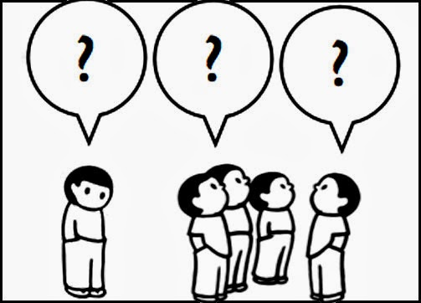
Select and Use Appropriate Graphic Aids
Reasons to use graphic aids.
When time is limited.
Overcoming language barriers.
To retain information.
Information overload.
Information processing.
Notes:
Limited time – A picture is still worth 1,000 words; thus, visual aids save time in conveying ideas.
Language barriers are a common communication barrier, especially as the workplace becomes more diverse. If someone in your target audience doesn’t speak the same language as you, visual aids can maybe help them use deductive reasoning to grasp your main ideas.
Information retention - If you are standing in front of a group presenting information for 30 minutes, the likelihood of them retaining the information is slim, especially if the audience has a hard time concentrating or is uninterested in your information. Using visual aids, along with verbal or written forms of communication, can help the audience retain the information.
Information overload - A common communication barrier employers and employees face when presenting or receiving information is that too much information is presented at once. When this happens, it's hard to determine which information is most important and relevant to their tasks and responsibilities. Visual aids, such as graphs and flow charts, can condense large chunks of information into the most important portions.
Information processing - Since people process and digest information differently, combining visual aids with a presentation or document can present the audience with various ways to receive the information. As a result, you increase your chances of having the audience understand what is being communicated. Some people understand things better orally; others prefer the written word, while others prefer a graph or table.

Slide 4
Commonly Used Graphic Aids
Tables
Bar graphs
Line graphs
Pie charts
Pictures
Diagrams

Slide 5
Commonly Used Graphic Aids
Tables work best when the data presented:
Is used to look up or compare individual values.
Requires precise values.
Values involve multiple units of measurement.
Student | 1st 6 Weeks Average | 2nd 6 Weeks Average
Ben | 82% | 90%
Kara | 98% | 95%
Sean | 75% | 85%
Amanda | 87% | 93%

Slide 6
Commonly Used Graphic Aids
Bar graphs
Used to compare things between different groups or to track changes over time.
When trying to measure changes over time, bar graphs are best when the changes are larger.
Notes:
Bar graphs are used to compare things between different groups or to track changes over time. However, when trying to measure change over time, bar graphs are best when the changes are larger

Slide 7
Commonly Used Graphic Aids
Line graphs
Used to track changes over short and long periods of time.
When smaller changes exist, line graphs are better to use than bar graphs.
Notes:
Line graphs are used to track changes over short and long periods of time. When smaller changes exist, line graphs are better to use than bar graphs. Line graphs can also be used to compare changes over the same period of time for more than one group

Slide 8
Commonly Used Graphic Aids
Pie charts
Best to use when you are trying to compare parts of a whole.
Does not show changes over time.
Notes:
Pie charts are best to use when you are trying to compare parts of a whole. They do not show changes over time

Slide 9
Commonly Used Graphic Aids
Pictures
A realistic visual representation that allows you to see exactly what is being described.
Notes:
Trying to describe this sunset to someone would hardly do it justice. Often times, pictures can lead to better understanding.

Slide 10
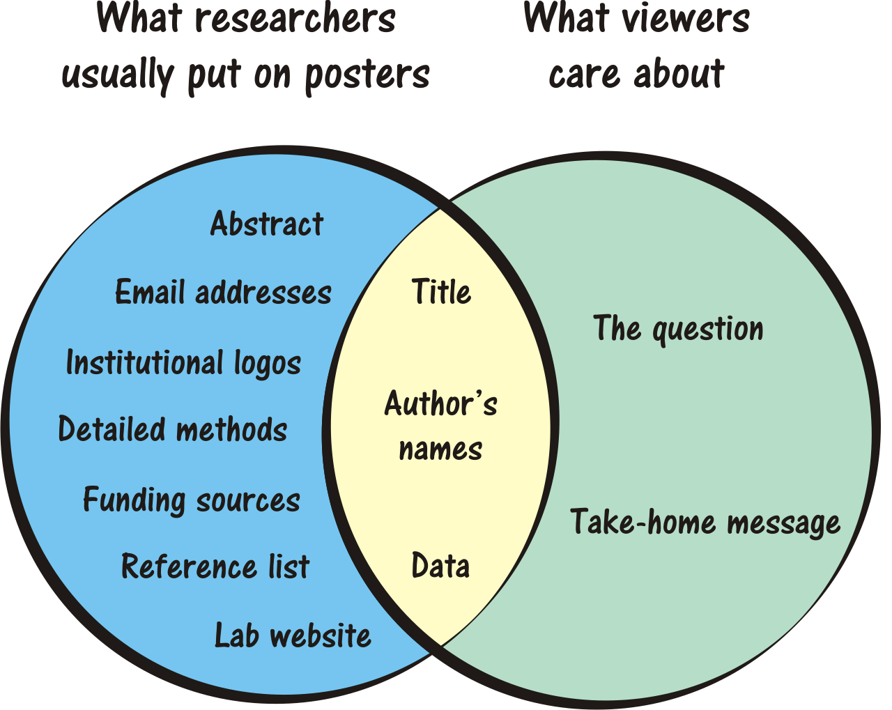
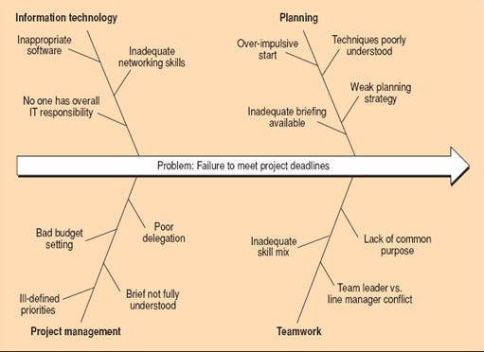
Commonly Used Graphic Aids
Diagrams
Visual representations of thinking.
Allow people to literally see the relationship between all parts of the topic.
Examples
Venn diagram
Fish bone diagram
Notes:
Venn diagrams allow you to compare and contrast two things or ideas.
Fish bone diagram is a cause and effect map used to show the interaction of a complex event.

