Slide 1
POB 2.01 and 2.02

Slide 2
Vocabulary

Slide 3
2.01-2.02 vocabulary
Industries
Statistics
Periodicals
Dissertation
Primary Information
Secondary Information
Biography
Autobiography
Pamphlet
Opinions
Commentary
Subjective
Reliable
Truncated
Cross Reference
Validity
Reliability
Accuracy
Bias
References
Credentials
Source
Impartial
Storyboard
Proposal
Quoting (Prices)
Audit
Liability
Obsolescence
Analysis
Hard Copy
Byte
Evaluation
Disseminating
Prioritize

Slide 4
2.03 Vocabulary
Computer Network
Internet
Intranet
Artificial Intelligence
Expert System
Computer Aided Design
E-Commerce
Management Information System
Inventory
Budget
Database
Spreadsheet
Confidentiality
Hacking
Outsource
Robotics
Automated
Telecommuting
Computer Virus
Piracy
White Collar Crime
Carpal Tunnel

Slide 5
Accuracy | the quality or state of being correct or precise.
Analysis | detailed examination of the elements or structure of something
Audit | an official inspection of an individual's or organization's accounts. Ex. the IRS does Audits on taxes.
Autobiography | an account of a person’s life written by that person
Bias | prejudice in favor of or against one thing, person, or group compared with another, usually in a way considered to be unfair.
Biography | an account of somebody’s life and work written by another person
Byte | a unit of memory size on a computer.

Slide 6
Commentary | remarks about a book, a problem, a sporting event, etc.
Credentials | a document or certificate proving a person's identity or qualifications.
Cross Reference | a note in a book (such as a dictionary) that tells you where to look for more information.
Disseminating | spread or disperse information widely.
Dissertation | a written account of research
Evaluation | making a judgment about the amount, number, or value of something.

Slide 7
Hard Copy | a printed version on paper of data held in a computer.
Impartial | treating everyone everything equally.
Industries | The manufacturing or technically productive enterprises in a particular field
Liability | being responsible for something.
Obsolescence | when an object, service, or practice is no longer wanted needed even though it may still be in good working order.
Opinions | what someone thinks about something.

Slide 8
Pamphlet | a small booklet giving information about something.
Periodicals | something published at regular intervals (weekly or monthly)
Primary Information | the original document from which information is extracted
Prioritize | determine the order for dealing with items, tasks, etc. according to their relative importance.
Proposal | a written plan or suggestion, put forward for consideration or discussion by others.

Slide 9
Quoting | give someone the estimated price of a job or service.
References | testimony to someone's ability or reliability.
Reliability | extent to which an experiment, test, or measuring procedure yields the same results on repeated trials.
Reliable | consistently good in quality or performance; able to be trusted.
Secondary Information | information which has already been compiled and is therefore found through desk research
Source | place, person, or thing from which something comes or can be obtained.

Slide 10
Statistics | collection, classification, analysis, and interpretation of numerical facts
Storyboard | a sequence of drawings, typically with some directions and dialogue, representing the shots planned for a movie or television production.
Subjective | based on or influenced by personal feelings, tastes, or opinions
Truncated | shorten (something) by cutting off the top or the end.
Validity | the quality of being logically or factually sound.

Slide 11
Objective 2.01: Use information literacy skills to increase workplace efficiency and effectiveness.

Slide 12

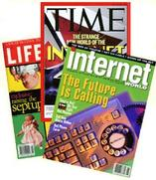
Types and Sources of Information
  Formality of information- Is it written as a paper, book, blog on the internet, or newspaper article
  Based on Specific Disciplines (Industries or Topics)
    Examples
      Background Information that helps you understand what you are researching
      Statistics related to your topic- (Ex. Statistics related to restaurants- Restaurant Failure Rates)
      Scholarly and Technical Magazines
        New England Journal of Medicine, Harvard Business Review, Journal of Popular Culture
      Popular Magazines
        Fortune, Scientific American, Psychology Today, Time Magazine
      Dissertations written by doctors about specific topics
  Current (Recent) vs. Historical (Older)
    Periodicals (Newspapers, Magazines, Journals)

Slide 13


Types and Sources of Information
  Primary Information- First Hand Accounts
    Interviews and Autobiographies of experts and scholars
    Historical Documents- The Declaration of Independence
  Secondary Information- Second Hand Accounts
    Biographies and Books
      Broad or detailed overviews
  Factual information
    reference materials (general and subject encyclopedias)
    Pamphlets
  Criticism of information and Personal Opinions
    News Articles
      Analysis of information
      Commentary based on Objective or Subjective Opinions

Slide 14
Primary and Secondary Sources
https://www.youtube.com/watch?v=cqXHO7bTPnw

Slide 15


  You can obtain information electronically or by using information that has been printed.
    Find print material in the libraries and bookstores
    Find electronic material on the internet, in databases of articles or information online.
    ***Make sure that you are using reliable sources***
        Why is Wikipedia NOT a reliable source?

Slide 16

Obtaining information Online
Advantages
Speed- You can search multiple databases in a matter of seconds.
Flexibility- You can link words or search terms in a way that can never be done in print, often with better search results.
Variability- Truncating (shortening) terms allow you to search for all the variations of a term.
  For example, using the truncated term "college*" will retrieve "college," "colleges," "collegial," and "collegiate."
More resources- Online searching provides access to many more resources than are available in any one library.
Currency- Online databases are updated more frequently than printed sources.

Slide 17

Obtaining information Online
Disadvantages
Volume- You tend to get back an enormous number of search results, particularly if you are searching the Internet.
False hits- Any search in an electronic database will frequently result in a number of false matches of your keyword search terms. For example, a search for information on "AIDS" may easily turn up false hits such as "study aids" or "visual aids.”
Cross-references- Lack of cross-references that take the researcher from a poor choice of keywords to terms that will result in a higher rate of success. This is particularly true if you make a typographical error or spell a word wrong.
Older sources- Since many online databases only index articles published after 1980, you will need to use print indexes to locate older articles. If you plan to do research in the humanities or in history you will most likely need to consult information published prior to 1980.

Slide 18


  Factors that should be evaluated when assessing information’s quality
Validity- Is that information valid, does the information truly relate to what you are researching?
Reliability- Is it from a trustworthy and reputable source?
Accuracy- Is the information based in facts and data that is true?
Timeliness- Is the information recent? Is the information from the correct time period?
Bias- Does the source have any reason to be for, or against, the information in some way?

Slide 19

  Procedures for evaluating the quality and source of information
When evaluating information you should determine the following, and ask the following questions:
1. Authority:
Is it from a government agency? Is the source self-published?
What is the purpose of the publication?
Does the information appear to be valid and well-researched, or is it questionable and unsupported by evidence?
Is there a list of references or works cited?
What are the author's credentials (educational background, past writing, experience) in this area? Is the content a first-hand account or is it being retold?

Slide 20
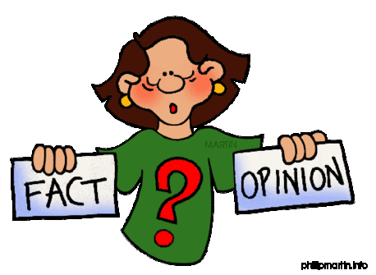
  Procedures for evaluating the quality and source of information
2. Currency:
When was the source published?
Is the source current or out of date for your topic?
3. Purpose:
What is the author’s intention?
Is the information fact, opinion, or propaganda?
Is the author's point of view objective and impartial?
Is the language free of emotion-rousing words or bias?

Slide 21
  Ways to organize information to support the purpose and format needed for a task
  Outlines- Use an outline to ensure information is laid out in a logical sequence.
  Drafts- Use a draft to get all of your information on paper. Later your draft can be used to write a paper or project.
  Storyboards- Useful in the development process of a commercial or movie.
  Proposals- Use this document to inform people about your project and gain approval/assistance. Can be long or short.
  Summaries- Use to describe your research briefly along with any relevant details.

Slide 22
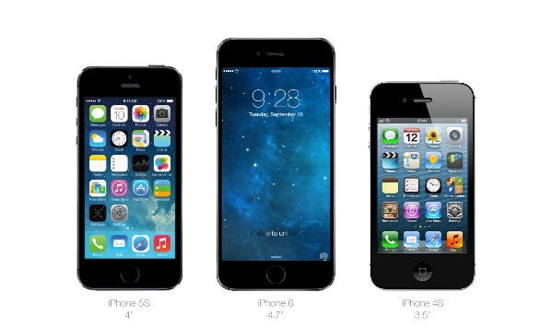
  Ways to integrate existing information, data, or images into a new product or performance
    Quoting- Use information gathered to determine what your product will cost you to make and what others are willing to pay for similar products. You can then give a potential customer a quote, or estimate, of what the product will cost.
    Summarizing- Briefly summarize your product for your customer. For example, create an advertisement, pamphlet, or even a book to inform your customer of your product(s).
    Copying- Use similar product features that you know consumers are attracted to.
    Manipulating- Change several features of a product to update it.
      Car Companies
      Phones (iPhone 5 vs. iPhone 6)

Slide 23

Store information for future use
  Advantages of storing/recording information
    Documentation- If held liable, or holding someone else liable, for any reason a company has proof of their ownership of information.
    Audit trail- If a company is audited it is able to show proof of what money has been used for.
    Personal files- Includes things like papers, photographs, movies, etc. that someone may want to use in the future.
    Heritage preservation- Companies, along with individuals, like to look back on “where they came from”. Keeping files, documents, pictures, etc. will ensure they are able to look back and see progression.

Slide 24
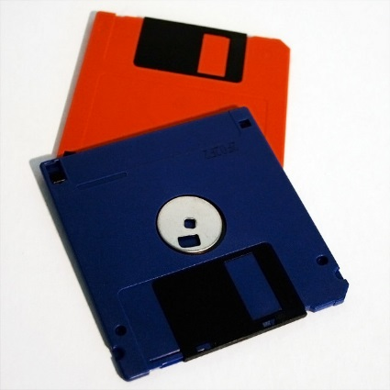
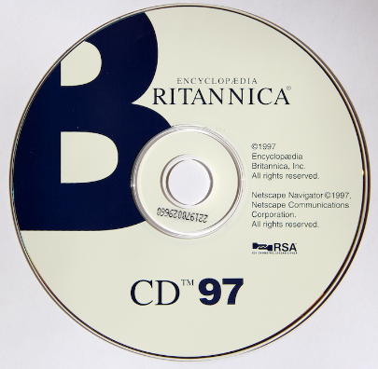
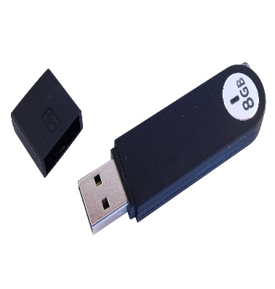
Store information for future use
  Negative results of storing/recording information
    Obsolescence of format or medium- For example if your information is held on a floppy disk you will no longer be able to access this information because computers no longer have floppy disk drives, instead they have CD/DVD Drives or USB Ports.
    Security of information- When information is stored there is always a threat of that information being stolen.

Slide 25
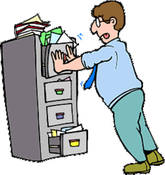
Store information for future use
  Challenges of storing/recording information
    Recordkeeping- Determining who will keep the records, and when they will be kept.
    Storage space- Whether information is digital or hard copy it takes up space.
      Digital information takes up space in Bytes- Ex. Megabytes (MB), Gigabytes (GB)
      Hard Copy information takes up physical space in files, file cabinets, store rooms, etc.
    Filing systems-
      Alphabetical, Numerical, Color, or Special Combination Systems
      Which software to use (Ex. Microsoft Excel/Access)
    Employer analysis- How will the information be analyzed in a way that is relevant and timely?

Slide 26
Summary
Information evolves through discussion and research
  Someone comes up with an idea and lets others know about it
  Other people discuss the idea and come up with related ideas to research
  Other people discuss those ideas and come up with still more related ideas
Existing information can be combined to create new information
Mash ups
https://www.youtube.com/watch?v=EmnSm_d2ll4

Slide 27
Criteria that can be used to make information decisions and choices
Validity
Reliability
Accuracy
Timeliness
Bias

Slide 28
The need to evaluate the cost and benefits associated with obtaining information
It costs time and effort to obtain information
Obtaining the perfect amount of information may not be possible
You need to know when obtaining MORE information may not be worth the effort

Slide 29
Investigative methods/techniques that can be used to obtain or retrieve information
Literature search/internet search
Interviews
Focus groups
Surveys
Advantages and disadvantages of these techniques

Slide 30
Objective 2.02: Acquire a foundational knowledge of information management to understand its nature and scope.

Slide 31
information management
  Business Information management: The process of accessing, processing, maintaining, evaluating, and disseminating knowledge, facts, or data for the purpose of assisting business decision making. Effectiveness of information management activities.
    Make sure information is retrievable, accurate, accessible, up-to-date, complete and usable.
    Set and follow organization information management practices.
    Prioritize information management needs according to business needs.
    Integrate information management though out the entire organization.
    Assign responsibility for information management (Delegate)

Slide 32
when you can't get your hands on the information you need, or when the information you have isn't protected appropriately, you:
can miss opportunities
decisions can be compromised
performance drops
customers suffer
and you can lose a competitive advantage.

Slide 33
Information Management Risks Worksheet

Slide 34
Objective 2.03- Utilize information-technology tools to management and perform work responsibilities.

Slide 35
2.03 Vocabulary

Slide 36
Artificial Intelligence | computer systems able to perform tasks that normally require human intelligence.
Automated | to run or operate (something, such as a factory or system) by using machines or computers, instead of people to do the work.
Budget | an estimate of income and expenditure for a set period of time.
Carpal Tunnel | Chronic pain, numbness, or tingling in the hand. Can be caused by repetitive bending and extension of the wrist, as in keyboarding.
Computer Aided Design (CAD) | software is used by architects, engineers, drafters, artists, and others to create precision drawings or technical illustrations.
Computer Network | a set of computers connected together for the purpose of sharing resources.
Computer Virus | a piece of code that typically has a detrimental effect to a computer, such as corrupting the system or destroying data.
Confidentiality | set of rules or a promise that limits access or places restrictions on certain types of information.

Slide 37
Database | collection of information that is organized so that it can easily be accessed, managed, and updated.
E-Commerce | buying and selling of goods and services, or the transmitting of funds or data, over an electronic network, such as the Internet.
Expert System | software systems that use databases of expert knowledge to offer advice or make decisions in such areas as medical diagnosis and trading on the stock exchange.
Hacking | using a computer to gain unauthorized access to data in a system.
Internet | The global communication network that allows almost all computers worldwide to connect and exchange information.
Intranet | a local or restricted (private) communications network.
Inventory | list of items such as property, goods in stock, or the contents of a building.

Slide 38
Management Information System (MIS) | hardware and software systems within an business that provide the information that management needs to run the business.
Outsourcing | obtaining (goods or a service) from an outside supplier.
Piracy | the unauthorized use or reproduction of another's work.
Robots | machines capable of carrying out a complex or repetitious series of actions automatically.
Spreadsheet | an electronic document in which data is arranged in the rows and columns of a grid and can be manipulated and used in calculations.
Telecommuting | work from home through the use of the Internet, e-mail, and the telephone.
White Collar Crime | “Lying, Cheating, Stealing”- financially motivated nonviolent crime committed by business and government professionals.

Slide 39
Business use of technology
Notes:
Read p. 274 and 280 Focus on Real Life
Ask these two questions:
1. Will someone describe any technology he/she used outside of class, and why the technology was used?
2. Will someone describe how the technology he/she saw can be used in Business?
**Pass out Graphic organizer 147-149 to complete while working through slides.

Slide 40
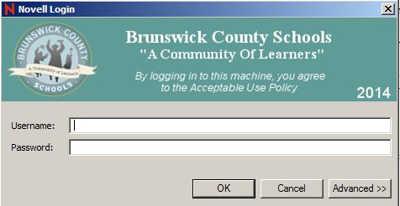
Applications of Technology by Businesses
What are computer networks?
  Computer networks are computers linked in a school or business so users can share hardware, software, and data.
Examples of computer networks:
  Internet- Public network used most often for:
    Emailing
    Accessing the World Wide Web (WWW)
  Intranet- Private network, primarily used to share information
    Ex. Brunswick County Schools uses Novell

Slide 41
Applications of Technology by Businesses continued
What is artificial intelligence (AI)?
  It is software that enables computers to reason learn and make decisions.
    Example: voice recognition software
How do expert systems help people?
  Expert systems are computer programs that help people solve technical problems including medical services, financial planning, and legal matters.
    Example: Automotive parts electronic catalogue

Slide 42
Applications of Technology by Businesses continued
Why is Computer-aided design (CAD) used?
  It is used to create product styles and designs.
    Example:
  Property Brothers- Design/Redesign Homes
  American Choppers- Design Bikes
  Car Companies- Design Cars

Slide 43
Applications of Technology by Businesses continued
What is involved in E-commerce?
  E-commerce is conducting business transactions using the Internet or other technology.
Most common activities of E-Commerce:
  Providing product information
  Promoting a company
  Selling online
  Conducting market research
  Making payments
  Obtaining parts and supplies
  Tracking shipments

Slide 44
Applications of Technology by Businesses continued
Four basic models for E-commerce:
  B2C: Business-to-Consumer
    Example: Lands’ End.com selling swimwear to a customer.
  B2B: Business-to-Business
    Example: Staples.com ships office supplies to local hospitals
  C2B: Consumer-to-Business
    Example: Customers completing on-line surveys in order to provide feedback to Dunkin’ Donuts
  C2C: Consumer-to-Consumer
    Example: Customer buying electronics from other customers through eBay.com

Slide 45
Applications of Technology by Businesses continued
What is a Management Information System (MIS)?
  MIS is an ordered system for processing and reporting information in an organization.
    Computer systems and software are an essential part of MIS
    Managers use the information provided from MIS to make essential business decisions

Slide 46
Applications of Technology by Businesses continued
Categories of information obtained (Gathered) from MIS:
  Financial Information
    Including budgets, sales reports, and financial statements.
  Production and Inventory Information
    Including production summaries, lists of tools and supplies, WIP (Work in Progress) and finished goods reports.
  Marketing and Sales Information
    Including data on customer needs, current economic conditions, and actions of competitors.
  Human Resources Information
    Including salaries, employee benefit data, and employee evaluations.

Slide 47
Applications of Technology by Businesses continued
Four main components of a MIS:
  Gathering data
  Analyzing data
  Storing data
  Reporting results

Slide 48
Gathering Information
Information can be obtained through
  Point of sale systems
    Includes scanners, iPads, computers
  Scanning Barcodes to track inventory
  Surveying customers and employees
  Researching competitors

Slide 49
Analyzing Information
Information and Data can be analyzed using spreadsheets, databases, and graphs.
  Microsoft Excel and Access
  Payroll
    QuickBooks
    Peach Tree

Slide 50
Storing Data
Data can be stored in a variety of locations from hard copy files in a file cabinet to “The cloud”.
  Safety and Security of information.
    In case of emergency, tax audits, etc.
  Privacy and confidentiality.
    Hacking and stealing of information

Slide 51
Reporting Results
Companies use data from sales, customer surveys, and industry ratings to determine what course of action will be best for the company in the future.
  Should they:
    Create more products
    Increase/Decrease Prices
    Merge/Buy/Outsource

Slide 52
Applications of Technology by Businesses continued
What is involved in robotics activities?
  It involves mechanical devices programmed to do routine tasks, such as those seen on an assembly line in factories.
  Robots are also used in dangerous situations where it is not safe for people to go.
    Example: Assembly line work that requires repeated tasks.
  You will find the use of robotics at:
    Automated checkout clerks
    Airline Tickets agents
    Gorilla Carwash ( clerk and wash system)
    Are Robots Hurting Job Growth

Slide 53
Applications of Technology by Businesses continued
What happens during telecommuting activities?
    This involves the activities of a worker using a computer at home to do a job.
    Telecommuting saves time and money!
      Less traffic, less pollution, noise reduction
      Telecommuting is common for:
        Writers, researchers, editors, sales reps, website designers.
Notes:
Every morning more than 20 million Americans travel to their offices for work, but they never leave home. How do they do that?????

Slide 54
Concerns of using technology

Slide 55
Concerns of Using Technology
Employment Trends
Many people feel that their jobs are being taken away by computers
  What is actually occurring is a shift in the type of worker that is needed
  More workers skilled in programming, operating, or repairing computer systems are needed
Companies have to retrain displaced workers.
  Workers must get additional training so that they can adapt to the changing job environment
Computer literacy is vital.
  The ability to use computers to process information or solve problems.

Slide 56
Concerns of Using Technology continued
Computer Crimes
A computer virus is a hidden program code in a system that can do damage to software or stored data.
  How many people have encountered a computer virus?
  Will someone tell how they removed the virus?
  https://www.fbi.gov/about-us/investigate/cyber

Slide 57
Concerns of Using Technology continued
Piracy is stealing or illegally copying software packages or information.
  Companies that develop software may lose more than half of their profits to information pirates who violate the law.
  In some countries, between 1/3 and ½ of the software used is obtained illegally.
White-collar crime is an illegal act carried out by office or professional workers while at work including stealing money, information, or computer time through improper use of computer systems.

Slide 58
Concerns of Using Technology continued
Health Concerns
While very little danger can come from the use of a computer and other technological devices there are some issues people are experiencing
  Eyestrain and vision problems
  Muscle tension and nerve damage
  Carpal tunnel syndrome

Slide 59
Concerns of Using Technology continued
Privacy Concerns
  One of the greatest challenges facing computer users is the need to guarantee privacy.
  Dishonest people have access to customer records at some companies and this poses great concern.
  Companies have changed which employees as well as other people that have access to customer records.
  Companies are also changing almost all of their programs to be password protected.
    Some programs even require the user to change their password combination several times a day!
    Each day more than 1,000 people have their identities stolen in the US

