Slide 1
5.00 Understand Economics
NC CTE 5.02: Understand economic systems to be able to recognize the environments in which businesses function.

Slide 2
Types of economic systems
Economic System - The organized way in which a country handles its economic decisions and solves its economic problems.
Traditional Economic System - An economic system in which people produce only what they must have in order to exist; all economic decisions are based on habit and tradition.
Command Economic System - An economic system in which all or many of the means of production and distribution are owned and controlled by the government.
Communism - A command economic system in which the government controls the economic system and does not allow private ownership of the means of production and distribution
Socialism - A modified command economic system in which government owns the basic means of production and allows private ownership of businesses as well

Slide 3
Types of economic systems
Describe the characteristics, strengths and weaknesses of
Traditional Economic Systems - Economic decisions are based on custom and historical precedent (example/pattern/practice)
People often perform the same type of work as their parents and grandparents regardless of ability or potential
Communism - Central ownership (usually the government) of property/resources. All property and resources are collectively owned by a classless society and not individual citizens
Workers control the means of production; therefore, all share equally in the benefit of success or the consequences of failure.
Lack of consumer choice
Government determines which goods and services are produced and how they are distributed. Example: Former Soviet Union
Socialism - Government ownership of productive resources. A planned economy
Redistribution of income
Social welfare characterizes a socialist’s society’s goals
Peaceful and gradual extension of government ownership (revolution by ballot rather than bullet)
Market Economic System - Private ownership of property/resources. Profit motive (chance to make money)
Competition
Consumer sovereignty (individuals determine through purchases what will be produced)
Individual choice
Minimal government involvement

Slide 4
Types of economic systems
As we have said, all nations must answer the question of scarcity. All nations and societies must allocate their resources in order to meet their needs. This is where the essential dilemma between unlimited wants and limited needs comes into play.
We have also noted that all nations must make choices. This is a matter of resource allocation. When we allocate limited resources we make choices. The cost of these choices is known as opportunity cost. When making these choices and dealing with scarcity, resource allocation and opportunity cost nations are answering what we have previously referred to as the three basic economic questions.
These are the questions all nations must ask when dealing with scarcity and efficiently allocating their resources. The three economic questions are:
What to produce?
How to produce?
For whom to produce?

Slide 5
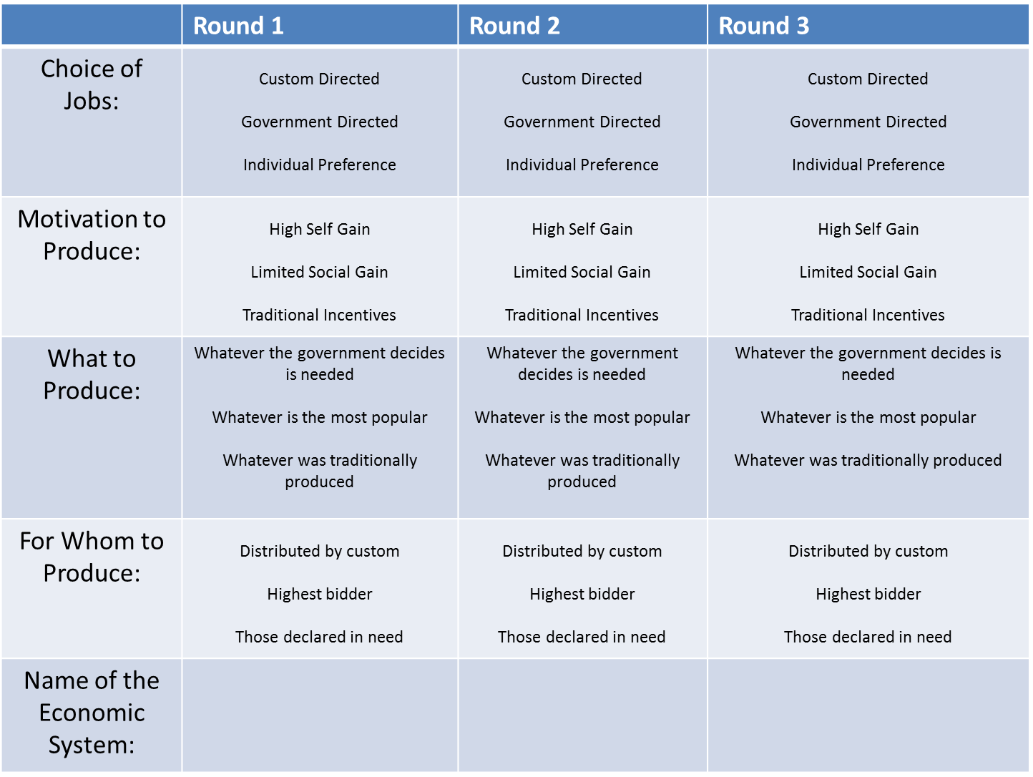

Slide 6
Private enterprise
Private Enterprise System - An economic system in which individuals and groups, rather than government, own or control the means of production–the human and natural resources and capital goods used to produce goods and services. Also known as free market economy, private profit system, market system, capitalistic system, or free enterprise system.
Describe the characteristics, advantages and disadvantages of a private enterprise system
Advantages
competition promotes high quality and low prices.
wide selection of goods and services available to consumers.
the pursuit of profit leads to efficient use of resources.
technological change and innovation take place rapidly.
consumers influence production of goods through consumer sovereignty.
the economy is flexible and can respond quickly to changing consumer demand.
Disadvantages
income and wealth are unevenly distributed. there may be great differences between right and poor.
economic periods of boom and bust.
unemployment and underemployment may occur.
consumers may be manipulated through advertising.
producers can influence prices through the creation of cartels.
not all resources are used efficiently.

Slide 7
Factors affecting a business’s profit
Profit - Monetary reward a business owner receives for taking the risk involved in investing in a business; income left once all expenses are paid.
Profit Motive - The desire to make a profit which moves people to invest in business
Income - The money received by resource owners and by producers for supplying goods and services to customers
Expenses - Money spent or cost incurred in an organization's efforts to generate revenue, representing the cost of doing business.
Cost Of Goods - The amount of money a business pays for the products it sells or for the raw materials from which it produces goods to sell; the amount of money a business pays for the products (or for any part of the products) it sells.
Operating Expenses - All of the expenses involved in running a business
Gross Profit - This is the difference between sales income and the direct costs of making those products. Gross profit is used as a performance indicator to help the business make decisions over its pricing policies and use of materials.
Net Profit - Net profit represents gross profit less all expenses associated with the normal running of the business. Net profit shows how well the business performs under its normal trading circumstances.

Slide 8
Factors affecting a business’s profit
Profit
Profit is the difference between the income of the business (Revenues) and all its costs/expenses.
Calculation: Revenues-Expenses = Profit
Importance of profit
It is a reward to the owners of the business. They have taken risks with their money and time. If there was no profit, then there would be little point in starting up or putting more money into the business, they might as well put the money into a bank or building society
Profits are an important source of investment funds. Profit can be used to buy more stock, improve technology or expand the premises
A business than does not make a profit will fail, potentially affecting employees, suppliers and the local community

Slide 9
Business risk
Risk: The possibility of a financial loss.
Risk Management - The process of managing a business’s exposure to risk in order to achieve business objectives.
Business Risk - The possibility of loss (failure) or gain (success) inherent in conducting business
Pure Risks - The possibility of loss to a business without any possibility of gain. Such as:
Economic Risks - Risks that result from changes in overall business conditions. Examples: Competition, Inflation, Government regulation, Recession
Natural Risks - Perils resulting from environmental causes. Examples: Floods, Earthquakes, Tornadoes, Hurricanes, Fires
Human Risks - Perils caused by human errors as well as the unpredictability of customers, employees, or the work environment. Examples: Shoplifting, Employee theft
Speculative Risks - Chances of loss that may result in loss, no change, or gain. Examples: buying new machinery, constructing new buildings.
Guarantees - A promise made to the consumer that a product’s purchase price will be refunded if the product is not satisfactory
Warranties - A promise made by the seller to the customer that the seller will repair or replace a product that does not perform as expected. A promise to the purchaser that a product will be repaired or replaced if it proves to be defective

Slide 10
Business risk
Methods of dealing with business risk
Risk Reduction:
Design work areas to reduce the chance of accident or fire.
Educate employees on safe use of equipment
Check and service safety equipment on a regular basis.
Stress the limits of your company’s products.
Implement ways to reduce shoplifting.
Control employee theft.
Implement ways to reduce robbery.
Control Risks – a risk that cannot be avoided can be prevented or controlled. When businesses identify a risk they face, they often take measures to prevent or reduce that risk. Examples: Safety, Security, Employee incompetence, Product selection, Credit, Changes, Weather extremes
Retain Risks - Self-insurance against business loss. The business must set aside money each month to help cover the costs should a loss occur.
In some instances, businesses may keep, or retain, the risk involved in doing business. A business may do nothing to reduce or eliminate a risk because the business:
Involves not doing anything about the risk because the business:
Is unaware of the risk
Underestimates the risk
Feels that the risk is small
Believes there’s a chance of return

Slide 11
Business risk
Methods of dealing with business risk
Transfer Risks - Certain risks may be reduced or eliminated by transferring (or shifting) those risks to another person or business. This option enables businesses to move forward with their decisions without bearing the risks involved. Examples: Contractual agreements, Guarantees/Warranties, Surety bonds, Rental/Lease agreements
Property insurance: Covers the loss of physical property (cash, inventory, vehicles, buildings).
Real property: Buildings, land, and fixtures.
Personal property: Vehicles, clothing, furniture, jewelry.
Business interruption insurance: Makes up for lost income if a business is shut down for repairs or rebuilding.
Casualty insurance: Protects a business from lawsuits.
Errors-and-omissions insurance: Protects businesses from lawsuits resulting from mistakes in advertising.
Product liability insurance: Protects manufacturers from claims for injuries that result from using their products.
Fidelity bonds: Protect companies from employee theft.
Performance bonds: Protect a business if work is not finished on time or as agreed.
Workers’ Compensation: A government-regulated program government-regulated program that provides medical benefits and income to employees who are injured on the job.
Emergency planning - Businesses must have procedures in place before a crisis occurs. Businesses must create emergency response plans to handle emergency situations.
Avoid Risks - Sometimes, the best way to handle a risk is to simply avoid it. This is the first and best way for a business to stay out of trouble. Example: Avoid flying to eliminate the risk of a plane crash, staying away from things altogether, assurance of nothing happening by eliminating all possibilities of a risk
If business owners avoid all risks, they would not:
Open a new store
Introduce new products
Expand overseas

Slide 12
Competition
Competition - The rivalry among two or more businesses to attract scarce customer dollars
Direct Competition - Rivalry between or among businesses that offer similar types of goods or services.
Indirect Competition - Rivalry between or among businesses that offer dissimilar goods or services.
Oligopoly - A market structure in which there are relatively few sellers, and industry leaders usually determine prices.
Oligopoly exits where few large firms producing a homogeneous or differentiated product dominate a market. Examples are automobile and gasoline industries.
Characteristics
Few large firms: each must consider its rivals’ reactions in response to its decisions about prices, output, and advertising.
Standardized or differentiated products.
Entry is hard: economies of scale, huge capital investment may be the barriers to enter.
Demand Curve - Facing competition or in tacit collusion, oligopolies believe that rivals will match any price cuts and not follow their price rise. Firms view their demands as inelastic for price cuts, and elastic for price rise. Firms face kinked demand curves. This analysis explains the fact that prices tend to be inflexible in some oligopolistic industries.

Slide 13
Competition
Monopoly - A type of market structure in which a market is controlled by one supplier, and there are no substitute goods or services readily available.
Pure monopoly exists when a single firm is the sole producer of a product for which there are no close substitutes. Examples are public utilities and professional sports leagues.
Monopolistic competition refers to a market situation with a relatively large number of sellers offering similar but not identical products. Examples are fast food restaurants and clothing stores.
Characteristics
A lot of firms: each has a small percentage of the total market.
Differentiated products: variety of the product makes this model different from pure competition model. Product differentiated in style, brand name, location, advertisement, packaging, pricing strategies, etc.
Easy entry or exit.
Demand Curve - The firm’s demand curve is highly elastic, but not perfectly elastic. It is more elastic than the monopoly’s demand curve because the seller has many rivals producing close substitutes; it is less elastic than pure competition, because the seller’s product is differentiated from its rivals.
Characteristics
A single seller: the firm and industry are synonymous.
Unique product: no close substitutes for the firm’s product.
The firm is the price maker: the firm has considerable control over the price because it can control the quantity supplied.
Entry or exit is blocked.

Slide 14
Competition
Regulated Monopolies - Monopoly that the government allows to exist legally.
Perfect Competition - A market structure in which there are many businesses selling a lot of identical products for about the same price to many buyers; also known as pure competition.
Pure or perfect competition is rare in the real world, but the model is important because it helps analyze industries with characteristics similar to pure competition.
This model provides a context in which to apply revenue and cost concepts developed in the previous lecture.
Examples of this model are stock market and agricultural industries
Characteristics
Many sellers: there are enough so that a single seller’s decision has no impact on market price.
Homogenous or standardized products: each seller’s product is identical to its competitors’.
Firms are price takers: individual firms must accept the market price and can exert no influence on price.
Free entry and exit: no significant barriers prevent firms from entering or leaving the industry.

Slide 15
Competition
Price Competition - A type of rivalry between or among businesses that focuses on the use of price to attract scarce customer dollars.
Non Price Competition - A type of rivalry between or among businesses that involves factors other than price (e.g., customer services, modern facilities, trained personnel, and variety of products)
Price discrimination - is selling a good or service at a number of different prices, and the price differences is not justified by the cost differences. In order to price discriminate, a monopoly must be able to
be able to segregate the market
make sure that buyers cannot resell the original product or services.
Perfect price discrimination is a price discrimination that extracts the entire consumer surplus by charging the highest price that consumer are willing to pay for each unit.
As a result, the demand curve becomes the MR curve for a perfect price discriminator. Firms capture the entire consumer surplus and maximize economic profit.

Slide 16
Competition
Government legislation affecting competition
Competition – Three common Antitrust Laws:
The Sherman Act outlaws "every contract, combination, or conspiracy in restraint of trade," and any "monopolization, attempted monopolization, or conspiracy or combination to monopolize."
The Clayton Act addresses specific practices such as mergers and interlocking directorates (that is, the same person making business decisions for competing companies). The Clayton Act prohibits mergers and acquisitions where the effect "may be substantially to lessen competition, or to tend to create a monopoly."
The Federal Trade Commission Act bans "unfair methods of competition" and "unfair or deceptive acts or practices."
Freedom of Choice - The key ingredients of economic freedom are personal choice, voluntary exchange, freedom to compete in markets, and protection of person and property. Institutions and policies are consistent with economic freedom when they allow voluntary exchange and protect individuals and their property.
Private Property - is the exclusive authority to determine how a resource is used, whether that resource is owned by government or by individuals.
Profit - Taxation policy affects business costs. For example, a rise in corporation tax (on business profits) has the same effect as an increase in costs. Businesses can pass some of this tax on to consumers in higher prices, but it will also affect the bottom line.

