Slide 1
NC CTE 3.02: Utilize critical-thinking skills to determine best options/outcomes.
Explain the need for innovation skills

Slide 2
Learning Objectives
Define the term innovation.
Explain how innovation contributes to a company’s well-being.
Identify skills, attitudes, and behaviors that characterize innovation.
Describe ways that businesses achieve innovation.
Describe types of innovation (i.e., product, process, position, and paradigm).
Distinguish between invention and innovation.
Explain the relationship between creative ideas and innovation.

Slide 3
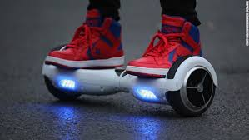
Something new, such as a new product, strategy, or process
Source: Money.cnn.com
Source: inhabitat.com

Slide 4
Innovation contributes to a company's well-being
Profit/Margins increase
Improve productivity and efficiency
New/Improved products & services
Satisfying consumer needs
Use of new business opportunities
Personalized services
Increase of competitive advantage
Encourages collaboration among team

Slide 5
Business process to achieve innovation
Develop a regular process to solicit and record new ideas.
Identify the Problems that Need Clever Solutions
Gather a team to decide which ideas are worth pursuing.
Prototype the strongest ideas, and try them out in the real world.

Slide 6
Types of Innovation
Paradigm
Involves a significant change in thinking
Position
Occurs when the purpose of a product is changed
Process
Occurs when a business changes how something is done
Product
Occurs when a business either creates or improves a product

Slide 7
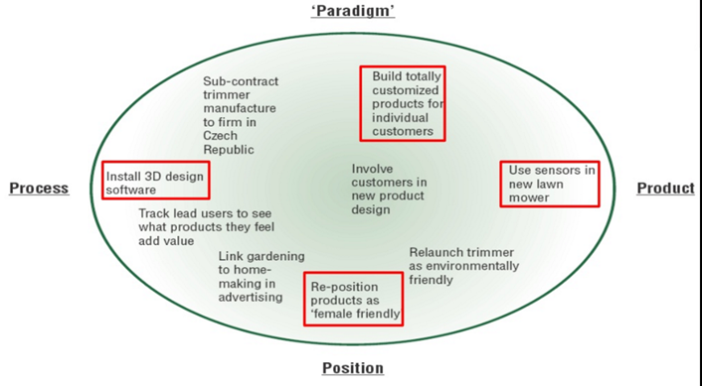
Image source: http://www.slideshare.net/MAO_Osman/innovation-mangement-mao-final

Slide 8
Innovation or Invention? What's the difference?
Innovation
Invention
Introduction of new product service or process into marketplace
Result into commercialization
Succeeds/follows invention
Innovation=Invention + Commercial exploitation
Creation of a new product, service or process
May not be commercialized
Precedes innovation
Invention=Innovation-Commercial exploitation
Source: http://www.slideshare.net/VijayKrKhurana/innovation-process-models

Slide 9
Source: http://www.slideshare.net/speedkings/idea1generationppt

Slide 10
The BIG Picture...
Source: http://www.slideshare.net/joanvijetha/innovation-46553709

