Slide 1
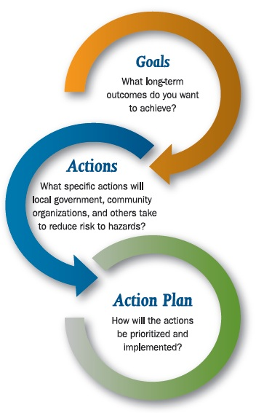
3.01- Acquire self-development skills to enhance relationships and improve efficiency in the work environment

Slide 2

Goals: An observable and measurable end result having one or more objectives to be achieved within a more or less fixed timeframe.
Goals give you a roadmap to your future.

Slide 3
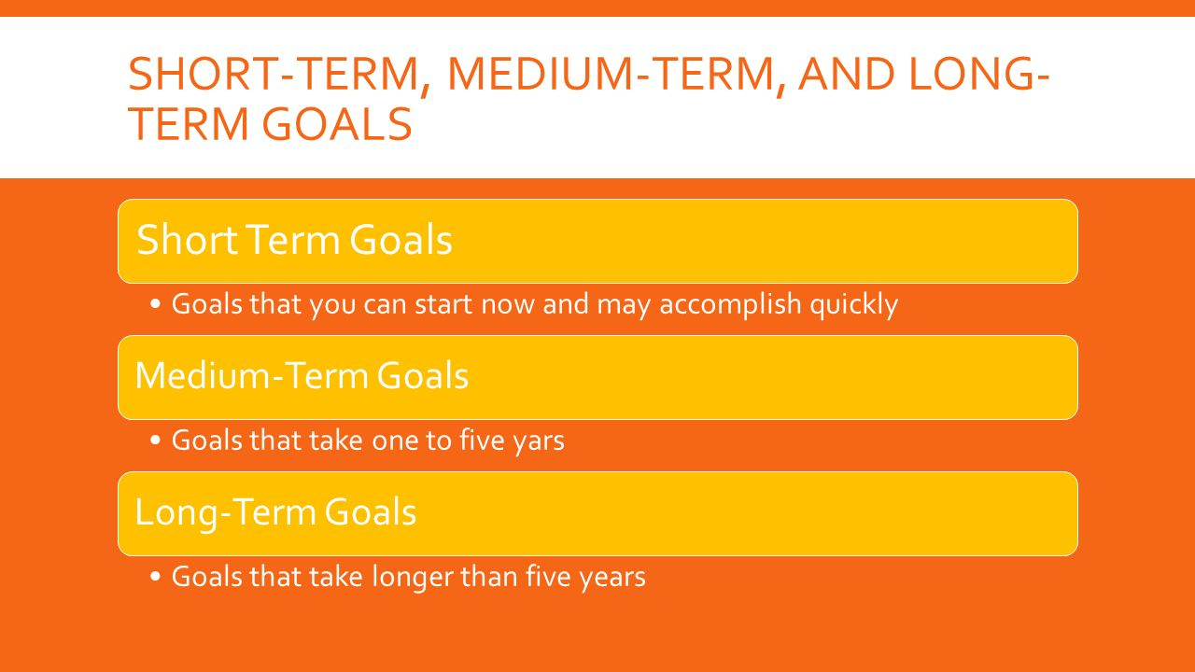

Slide 4





Steps for setting goals
    Identify your goal by writing it down.
    Set a deadline for the achievement.
    List the obstacles to overcome in accomplishing your goal.
    List the skills and knowledge required to reach your goal.
    Develop a plan of action to reach your goal.

Slide 5
Setting SMART Goals
If goals aren’t reachable, they aren’t worth making. All you have to do to set realistic goals is follow the SMART goals guidelines.

Slide 6
SPECIFIC
What details do you want to accomplish?
“I want to do better in history”
“I want to increase my history grade from an 85% to a 90%.

Slide 7
MEASURABLE
All goals should have a way to evaluate whether or not they were accomplished.
“I want to run the mile better.”
“I want to improve my mile time by 30 seconds.”

Slide 8
ATTAINABLE
Goals must be something you are capable of reaching.
Which one would be a better goal for Tom Brady?
“I will help my team to win the 2009 Super Bowl”
“I will rehabilitate my knee so that I can play football again next season.

Slide 9
RELEVANT
Make goals that are important to you and your lifestyle.
Which goal is better for a teacher?
“My goal is to discover a cure for cancer”
“My goal is to inspire at least one student to become a doctor to research a cure for cancer”

Slide 10
TIME - BOUND
Make sure that you have a time set as a “dead line” so your goal is not unending.
“My goal is to be able to run a half marathon.”
My goal is to run in a half marathon by May of 2009.

Slide 11
Final tips to Goal Setting:
Write down your goals and look at them often!
If you achieved your goals too easily, make your next goals harder.
Failure to meet goals only matters if you don’t learn something from your mistakes.
Goal setting is an important method of:
  Deciding what’s important for you to achieve.
  Motivating yourself.
  Building self-confidence.

Slide 12

Apply your knowledge!
Complete the 3.01 Seven Steps for Setting Goals activity
Source

