Slide 1
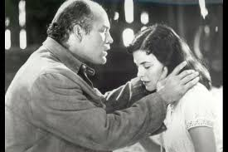
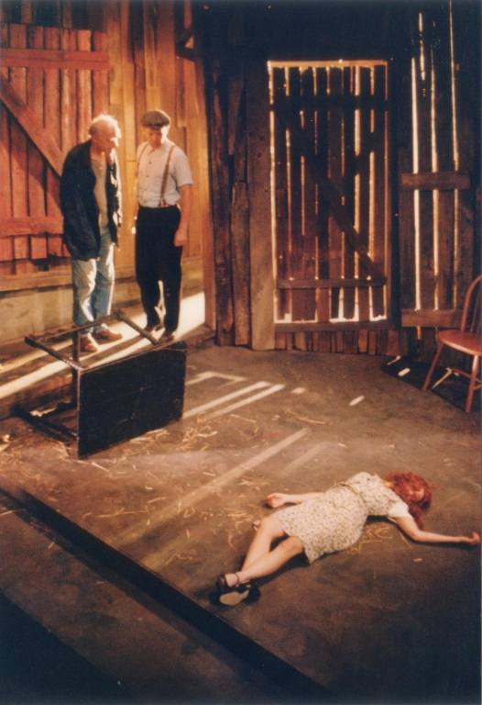
Of Mice and Men Chapter 5
Noun
-- a state of despair or distress, typically one which results in rash or extreme behavior
“Then- it’s all off? Candy asked sulkily” (95).
Desperation
“Having lost all hope”
George: “I think I knowed from the very first. I think I know’d we’d never do her. He usta like to hear about it so much I got to thinking maybe we would” (94).
Desperation is clearly conveyed in this chapter…
Curley’s wife shares her deepest feelings of loneliness & disappointment only to be killed
Lennie kills Curley’s wife and realizes that “he has done a bad thing” and must flee
Candy begs George to still go through with their plans even without Lennie
George recognizes the dream is dead and steals Carlson’s luger from the bunkhouse

