Slide 1
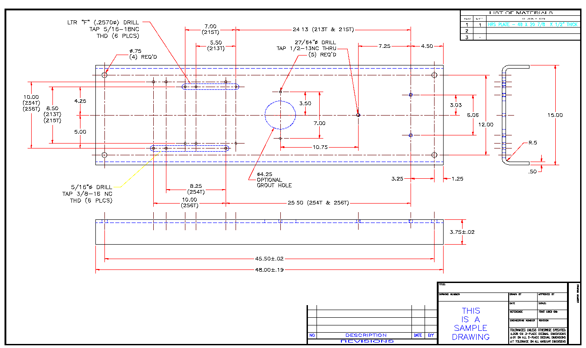
006.00
Demonstrate basic dimensioning techniques
Career & Technical
Education
1

Slide 2
To describe an object completely, a drafter needs to define both the shape and the size of the object.
2

Slide 3
After all, a machinist cannot build a part, a carpenter cannot build a house, unless all the sizes on the drawing are accurate and complete.
3

Slide 4
Another name for size description is Dimensioning.
4

Slide 5
Standards for dimensioning technique, dimension placement, and general rules for dimensioning are published in Dimensioning and Tolerancing, ASME Y14.5M-1994.
4

Slide 6
Dimensioning
Techniques
1

Slide 7
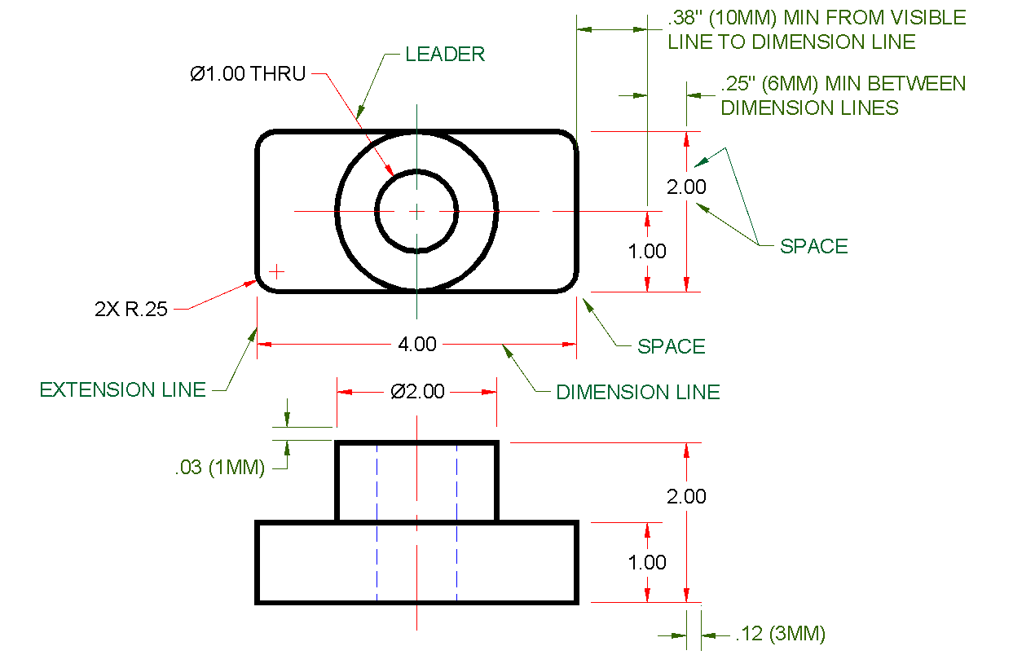
DIMENSIONING INCLUDES MEASUREMENTS, NOTES AND SYMBOLS
6

Slide 8
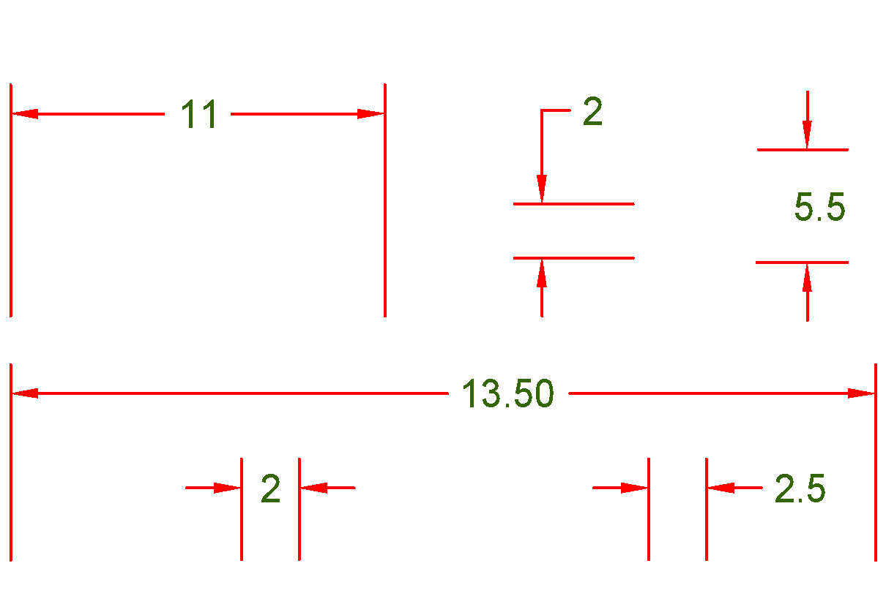
PLACEMENT OF DIMENSIONS
7

Slide 9
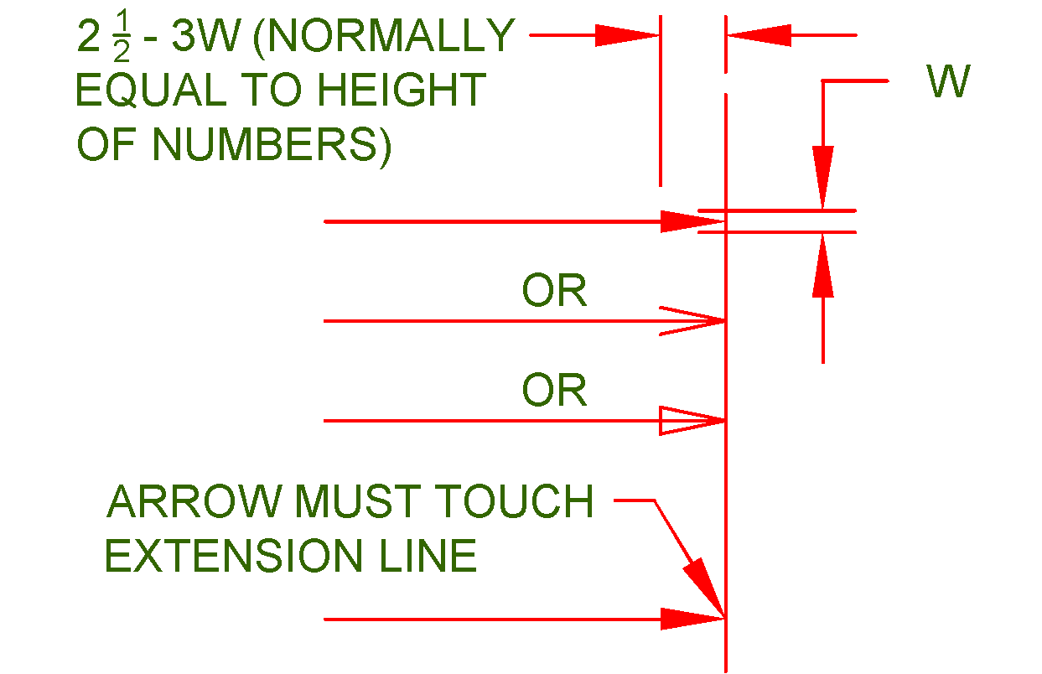
ARROWHEADS SIZE AND STYLES
8

Slide 10
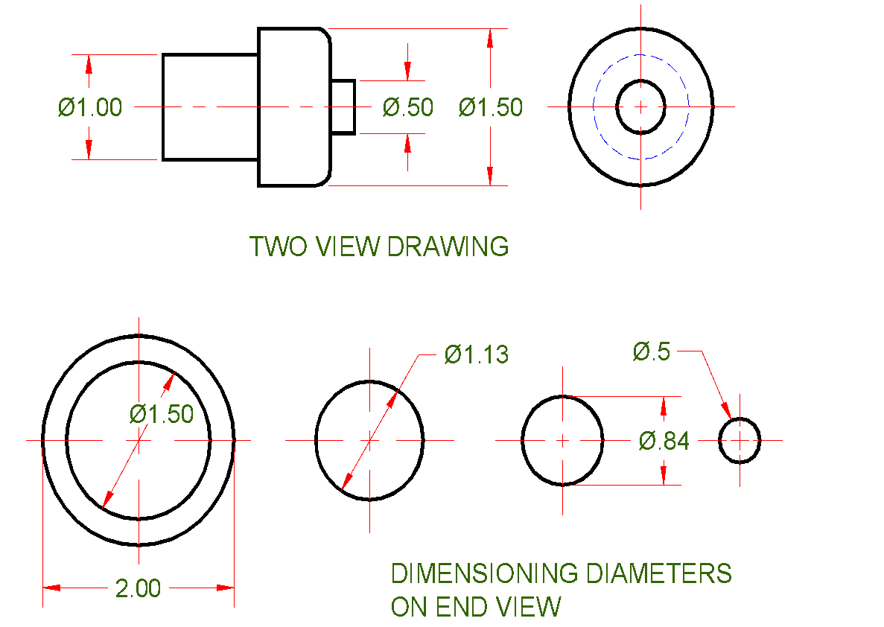
DIMENSIONING DIAMETERS
9

Slide 11
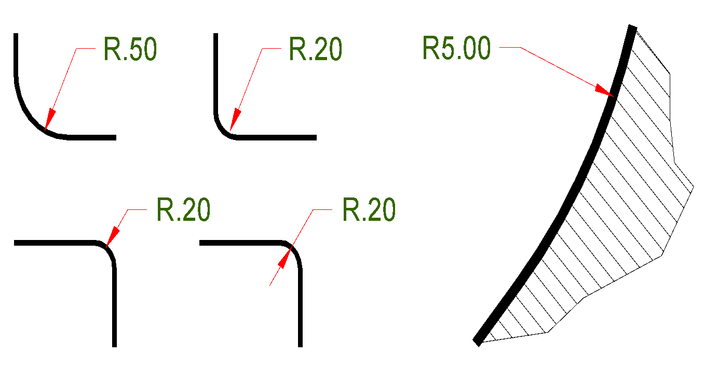
DIMENSIONING RADII which do not need their centers located
10

Slide 12
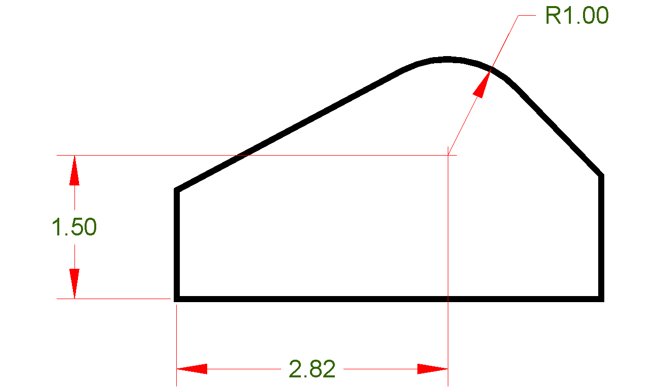
DIMENSIONING RADII when locating the radius center.
11

Slide 13
Decimal Inch
Decimals are the ANSI standard.
Decimals are easier to add, subtract, multiply and divide than fractions.
Preferably, decimals should be rounded to two decimal places (Unless more precision is required).

Slide 14
Metric
Where linear measurement are less than 10,000 millimeters, the millimeter is the standard unit of measure.
The abbreviation for millimeters (mm) is usually omitted when all dimensions are in millimeters.
The period is used as a decimal point only in English speaking countries, others use a comma.

Slide 15
Leading and Trailing Zeros
Inches
Millimeters
Show trailing zeros Omit leading zeros
.250 .500 .875
Show leading zeros Omit trailing zeros
0.25 0.5 0.875
Values less than one unit
Show trailing zeros
1.000 1.500 1.875
Omit trailing zeros
1 1.5 15
Values greater than or equal to one unit

Slide 16
The following are 12 basic rules that summarize what might well be a list of hundreds of very specific rules that apply to dimensioning. Review the list carefully. Make each of these items a part of your dimensioning practices.
12

Slide 17
The “Number One” rule of dimensioning is that the dimensions should be clear.
Place dimensions where the shape is best shown.
Shortest Dimensions are placed closest to the object
Group and align dimensions when possible.
Avoid duplicate and/or unnecessary dimensions.
Do not place a dimension to coincide with a line of a drawing.
Try to avoid placing dimensions inside a view.
Avoid crowding dimensions.
Avoid dimensioning to hidden features.
Place dimensions between the views to which they relate.
Lines should be thin and contrast noticeably with visible lines.
Dimensions should be included that describe both size and location of features.
13

