Slide 1
Objective 8.03 Apply Animation and Graphic Methods in a Windows Form (4%)
Computer Programming I

Slide 2
Objective/Essential Standard
Essential Standard 8.00 Apply procedures to develop graphics applications
Indicator 8.03 Apply Animation and Graphic Methods in a Windows Form (4%)

Slide 3
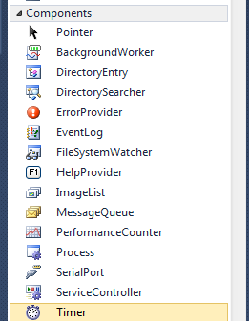
The Timer Control
You can add a Timer control to your module and use it to “animate” your picture.
A timer generates recurring events.
Code inside the timer event will recur until the timer is stopped.
The Timer is located in the Components area of your Toolbox.
Click on it, then click on your form.
The Timer will display in your Component Tray.

Slide 4
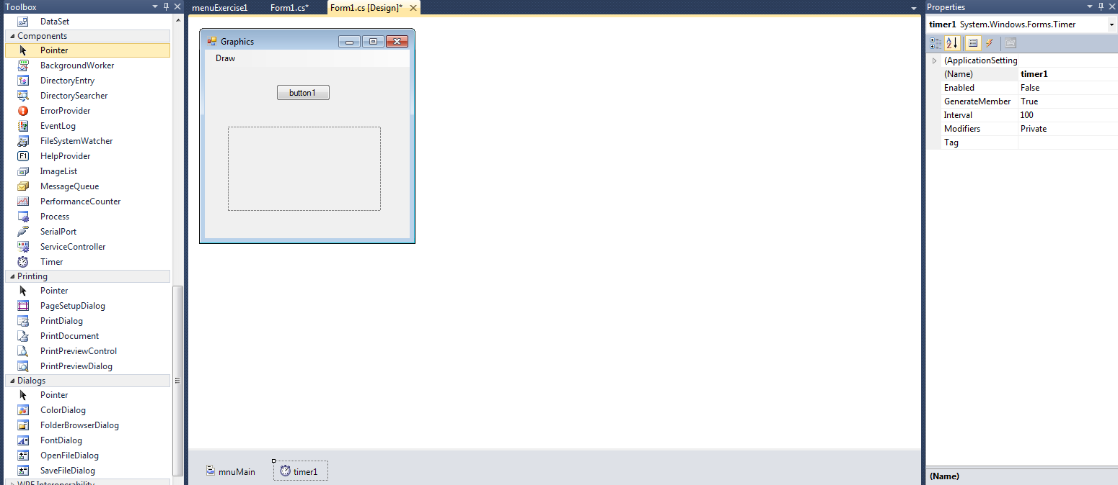
Using the Timer Control
Timer Properties
Timer1 in the Component Tray

Slide 5
Timer Control
Timer Properties | Description
(Name) | The name of a timer should start with tmr
Enabled | True if the timer can respond to user interaction, otherwise false (default)
Interval | The interval sets the time in milliseconds between elapsed events. 1000 = 1 second
Timer Event | Description
Start | Starts by raising the Elapsed event by setting Enabled to True
Stop | Stops by raising the Elapsed event by setting Enabled to False

Slide 6
Using the Timer Control
To set the timer interval at runtime. tmrName.Interval = number in milliseconds
Example: tmr2Secs.Interval = 2000
To enable/disable the timer at runtime. tmrName.Enabled = True/False
Example tmr2Secs.Enabled = True

Slide 7
Using the Timer Control
To create an event for the timer, create a Tick event.
Double Click on the Timer control
Type the code
The code that is to repeat goes in the timer tick event.
To start the timer timer1.Start()
To stop the timer timer1.Stop()

Slide 8
PictureBox & Timer Example
Private Sub tmrChange_Tick(ByVal sender As Object, ByVal e As _ System.EventArgs) Handles tmrChangeTick
Const MAX_IMAGES As Integer = 3
Static ImageNum as Integer = 0 ‘use Static to hold the value.
Select Case ImageNum
Case 0
Me.picImage.Image = My.Resources.fish
Case 1
Me.picImage.Image = My.Resources.star
Case 2
Me.picImage.Image = My.Resources.moon
ImageNum = (ImageNum + 1) Mod intMAXIMAGES 'determine next image number
End Sub

Slide 9
The Graphics Class
The Graphics class can be used to draw shapes.
This class contains methods for creating circles, lines, rectangles and other shapes on a drawing surface.
The drawing surface can be the surface of a form, a button or almost any other control object.
The drawing surface is define by assigning an object’s surface to a Graphics object.

Slide 10
The CreateGraphics Control
CreateGraphics control
A control class method
Encases a specific object surface area
Available with most control objects

Slide 11
The CreateGraphics Control
The drawing surface can be the surface of a form, a button or almost any other object.
Syntax
Dim SurfaceName As Graphic = controlObject.CreateCraphics
Examples to declare the drawing surface
Using the Form itself as a surface Dim FormSurface As Graphic = Me.CreateGraphics
Using a Button as a surface Dim ButtonSurface As Graphic = btnOn.CreateGraphics

Slide 12
Drawing on the Graphics Surface
Defining a Drawing Pen
Drawing on a surface requires a Pen object
The pen, pen color and line thickness are declared in the same statement.
Creating a Drawing Pen
The keyword New declares a new object.
Syntax Dim PenName As New Pen(Color.whatever, size)
Size must be an integer
Example: Dim ThinAquaPen As New Pen(Color.Aqua, 2)
Why create a pen?
You can use this penin multiple places, then if you want to change the color, you only have to change it in the declaration

Slide 13
Drawing on the Graphics Surface
After defining a surface and a pen, Graphics class methods are used to draw on the surface.
Drawing Surface
A grid consisting of a set of points with x values and y values.
Each point is a pixel.
0,0 is the upper-left corner.
Size Property of an object stores both a height an width and can be used to determine the point in the lower-right-hand of an object.

Slide 14
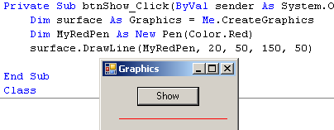
Graphics Methods
Require a pen along with the shape position and size.
DrawLine(pen, x1, y1, x2, y2)
Draws a line that extends from x1, y1 to x2, y2
Example surface.DrawLine(MyRedPen, 20, 50, 150, 50)

Slide 15
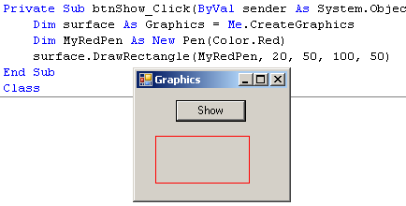
Graphics Methods
DrawRectangle(pen, x1, y1, width, height)
Draws a rectangle with the upper-left corner at coordinates x1, y1 on a graphics object and is width wide and height high
Example surface.DrawRectangle(MyRedPen, 50, 50, 100, 50)

Slide 16
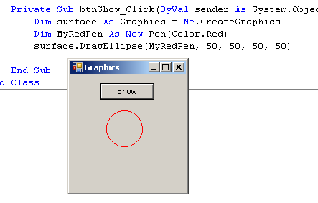
Drawing on the Graphics Surface
DrawEllipse(pen, x1,y1,width, height)
Draws an ellipse within a rectangular area that has its upper-left corner at coordinates x1, y1 on a graphics object and is width wide and height high
Example surface.DrawEllipse (MyRedPen, 50, 50, 50, 50)

Slide 17
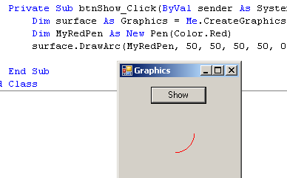
Drawing on the Graphics Surface
DrawArc(pen, x1,y1,width, height, startAngle, sweepAngle)
Draws an arc that starts at angle startAngle and continues clockwise sweepAngle degrees.
The arc is within a rectangular are that has its upper-left corner at coordinates x1, y1 on a graphics object and is width wide and height high
Example surface.DrawArc(MyRedPen, 50, 50, 50, 50, 0, 180)

Slide 18
Drawing on the Graphics Surface
Clear(color)
Clears the drawing surface with color
Example
surface.Clear(me.Backcolor)
‘Wipes the surface with the color of the form

Slide 19
The Pen
The Pen class contains the DashStyle property for defining pen style.
DashStyle Options
Solid, Dash, Dot, DashDot, DashDotDot, Custom
Example of Declaring a Pen Object myPen.DashStyle = Drawing2D.DashStyle.DashDotDot

Slide 20
Drawing Solid Shapes
The Graphics class also includes methods for creating solid (filled) shapes
Example of Declaring a SolidBrush Object
Dim PurpleBrush As New SolidBrush(Color.BlueViolet)
Why create a brush?
You can use this brush in multiple places, then if you want to change the color, you only have to change it in the declaration.

Slide 21
Drawing Solid Shapes
The Graphics class methods that fill shapes require a brush along with the shape position and size.
FillRectangle(brush, x1, y1, width, height)
Surface.FillRectangle(blackBrush, 0, 0, 200, 200)
FillEllipse (brush, x1, y1, width, height)
Surface.FillEllipse(GreenBrush, 0, 0, 200, 200)
FillPie(brush, x1, y1, width, height, startAngle, sweepAngle)
Surface.FillPie(violetBrush, 0, 210, 50, 50, 0, 180) 'half circle

Slide 22
The Point Structure
A point has an x-coordinate and a y-coordinate that together indicates a specific location
Example of declaring a point:
Dim MinPoint as Point MinPoint.X = 0
MinPoint.Y = 0

Slide 23
The Point Structure
You can declare a point with the X and Y values included when the keyword New is used
Example:
Dim MinPoint As New Point(0,0)
You can overload a Graphics method to accept Point variables in place of coordinates.

Slide 24
The Point Structure
Using the size property of an object, you can set a maximum point that can be updated if the object is resized.
Example of declaring a point:
Dim MaxPoint as New Point (Me.btnDrawHere.Size.Width, Me.btnDrawHere.Size.Height)

Slide 25
Using the Graphics Class for Polygons & Curves
The Graphics class also includes methods for creating polygons and curves on a drawing surface.
The number of points that define a curve or polygon vary depending upon the specific shape.
A set of points in an array is required by these methods.
Creating a Points array Dim CurvePoints() As Point = {New Point(10, 30), New Point(35, 35), New Point(75, 80), New Point(120, 20)}

Slide 26
Polygons & Curves Using a Points Array
DrawCurve(pen, points)
Creates a curve on a Graphics object using the points in the points array
Each point will represent where the line drawn will curve.
DrawClosedCurve(pen, points)
Creates a closed curve on a Graphics object using the points in the points array
Each point will represent where the line drawn will curve.
The curve is automatically continued from the last point to the first point to close the curve.

Slide 27
Polygons & Curves Using a Points Array
FillClosedCurve(brush, points)
Creates a filled, closed curve on a Graphics object using the points in the points array.
Each point will represent where the line drawn will curve.
The curve is automatically continued from the last point to the first point to close the curve.
DrawPolygon(pen, points)
Creates a closed polygon on a Graphics object using the points in the points array.
Each point will represent where the line drawn will change.
A line is automatically created form the last point to the first to close the polygon

Slide 28
Polygons & Curves Using a Points Array
FillPolygon(brush, points)
Creates a filled, closed polygon on a Graphics object using the points in the points array.
Each point will represent where the line drawn will change.
A line is automatically created form the last point to the first to close the polygon

Slide 29
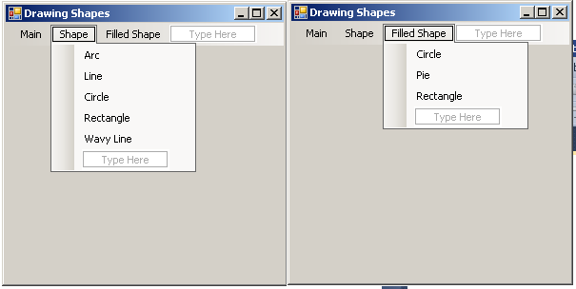
Drawing Shapes Examples
Create a program that will draw an example of each of the Draw and Fill methods learned.

Slide 30
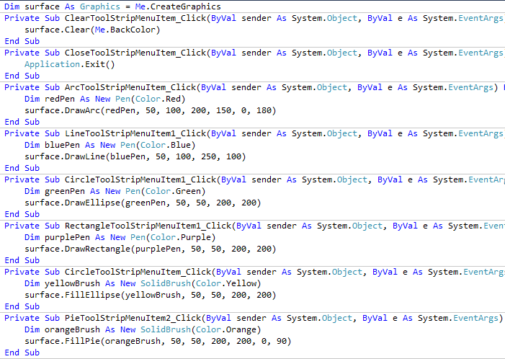
Drawing Shapes Examples

Slide 31
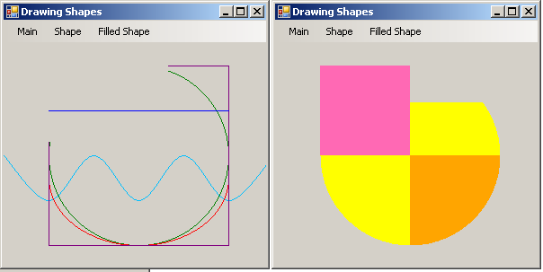
Drawing Shapes Examples
Sample output.
Note that the graphics are drawing over each other.

Slide 32
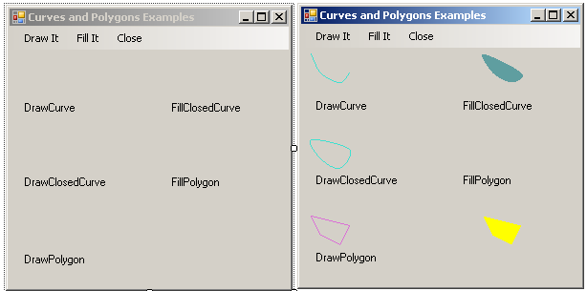
Curves & Polygons Examples
Create a program that will draw an example of each of the Draw and Fill methods learned that use the Points array.

Slide 33
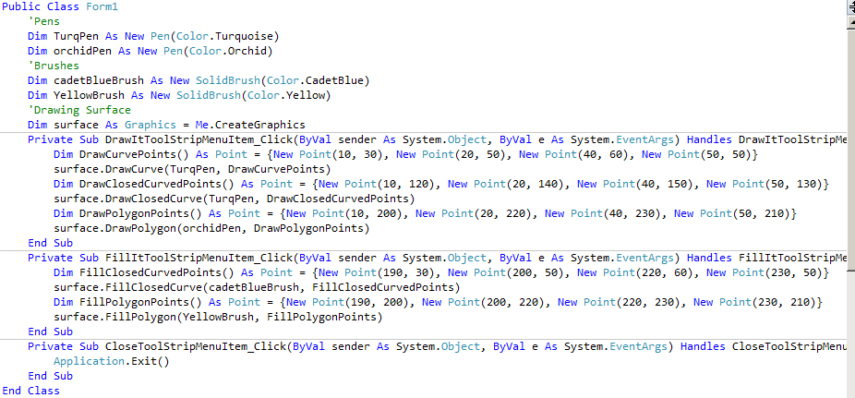
Curves & Polygons Examples

Slide 34
Conclusion
This PowerPoint provided an overview of the Graphics Class in Visual Studio.
For more information on timers:
http://msdn.microsoft.com/en-us/library/5b4t5f7s.aspx
For more information on graphics
http://msdn.microsoft.com/en-us/library/ac148eb3.aspx

