Slide 1
Single Dimensional Arrays
Computer Programming I
Notes:
Some slides will contain teacher notes- especially if a specific example given will not work in both VB and C#.

Slide 2
Objective/Essential Standard
Essential Standard: 7.00 Apply Advanced Logic
Indicator: 7.02 Apply One-Dimensional Arrays (7%)

Slide 3
Arrays
What is an array?
An array is a “container” that holds more than one value.
Each value is called an element.
Each element of the array must be the same data type.

Slide 4
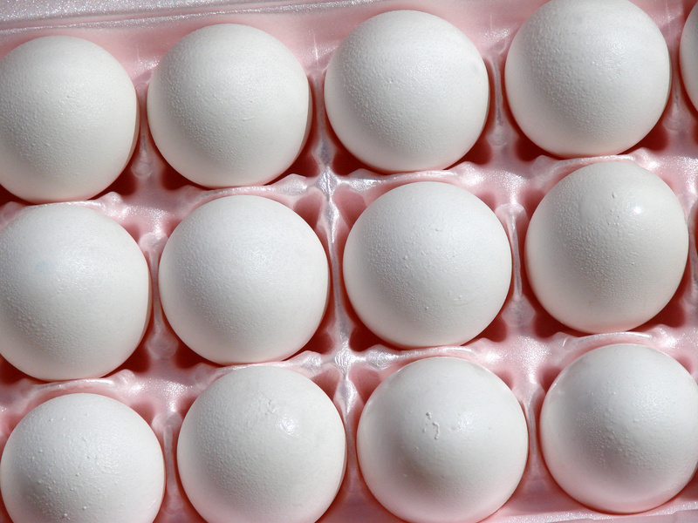
Arrays
Picture a carton of eggs. The “carton” is the container for the eggs. Each “egg” is an element in the container.

Slide 5
Declaring an Array
An array like all variables must be declared before it can be used.
Dim arrayName(intLastIndex) As DataType
Dim intArray(5) as Integer 0 1 2 3 4 5
The first element is always be located at the index position of zero
The index position points to the location of a value in an array.
In VB this array will have six elements.
Notes:
In VB the number of elements in the array is one greater than the number given in the declaring statement. This is not the case in C#. So in VB the elements would be 0-5. In C# the above statement would create elements 0-4.

Slide 6
Declaring an Array
Using our egg/egg carton analogy, each position would be numbered, starting at 0.
3
0
1
2
7
4
5
6
10
11
9
8

Slide 7
Populating an Array
In the previous slide we declared an array but did not give the elements any values.
Since the data type was integer all elements have a value of zero.
Unless given values, the array will be initialized as follows
Numeric Values → 0
String Value → Nothing
Notes:
If the data type was string all elements would be null. Notice the difference in VB and C#. VB uses () and C# uses []. Using the wrong symbols will generate weird syntax errors.

Slide 8
Populating an Array
However, we can modify our statement:
Dim intArray() As Integer = {1, 2, 3, 4, 5}
This declaration has an initializer list that will set all of the values of the array.
No integer is within the ()’s.
intArray with Values
1 | 2 | 3 | 4 | 5
Index Positions
0
1
2
3
4
Notes:
If the data type was string all elements would be null. Notice the difference in VB and C#. VB uses () and C# uses []. Using the wrong symbols will generate weird syntax errors.

Slide 9
Populating an Array
We can also add values individually like this: intArray(0) = 1 intArray(1) = 2
We can also use a loop if we are putting successive values in the array. For i as Integer = 0 to 5 intArray(i) = InputBox (“Enter a Value”, “Fill Array”) Next i
Notes:
Notice the difference in VB and C#. VB uses () and C# uses []. Using the wrong symbols will generate weird syntax errors.

Slide 10
Populating an Array Using a Loop
2 | 4 | 6 | 8 | 10
Dim intArray(4) As Integer
Dim i As Integer= 2
Dim j As Integer= 0
Do While i <= 10
intArray(j) = i
i+=2 ‘increases i
j+=1 ‘increases index j
Loop
i | j | intArray(j)
2 | 0
 |  | 2
4 | 1
 |  | 4
6 | 2
 |  | 6
8 | 3
 |  | 8
10 | 4
 |  | 10
12 | 6
Notes:
This will give the five elements of the array an value. Starting with 2 and ending with 10 counting by 2s.

Slide 11
Pulling Data from An Array
Now your array has data in it! How do you display it to the user? Use a loop of course!
Length is a property that will give the length (number of elements) of any declared array.
Note the Length will be 1 more than the index number of the last element in the array. intArray(4) has a Length of 5
Notes:
Is it not required in VB to convert the data type to string to display in the message box, but it is good programming practice.

Slide 12
Pulling Data from An Array
Consider the following example:
Do While x < intArray.Length MessageBox.Show(intArray(x)) x += 1
Loop
You can also use a For Loop For i As Integer = 0 To ArrayName.Length -1

Slide 13
Potential Problem with Arrays
You will get a runtime error if you try to assign a value or pull a value from an array using an incorrect runtime error.
Example Dim strName (3) As String strName (4) = “Jane”
There is not a 4th index position.

Slide 14
Wait… There is an Easier Way
There is a special type of loop just for arrays! Use For Each.
This special loop’s main use is pulling data from arrays.
Syntax For Each var As DataType In ArrayName
‘Statements Next var
Example
For Each intNum As Integer In intArray MessageBox.Show(intNum) ‘shows the value of intArray(intNum) Next i
Notes:
For Each i (counter) in intArray show that element and loop until all elements are displayed. If the variable being used has already been declared omit the data type in the for each statement.

Slide 15
Sorting An Array
Sorting data in an array is quite simple:
Array.Sort(NameOfArray)
Array.Sort(intArray)
This will sort the array from smallest to largest.
A string array would be sorted A-Z.

Slide 16
Sorting a String Array
Dim strArray() As String = {"apple", "orange", "banana", "pineapple", "pear"}
Array.Sort(strArray)
For Each x In strArray
lstFruit.Items.Add(x)
Next x
Sample output is shown above.
Notes:
Listboxes are covered in Standard 8- one is used here because it is the simplest way to display data pulled from an array.

Slide 17
Changing the Order of an Array
We can flip the array (last element becomes the first) using the Reverse method.
Array.Reverse(strArray)
Using our string array- the new output is shown above.
Notes:
Notice- this is also a “trick” way to quickly sort an array in descending order. Sort it using the sort method then reverse it.

Slide 18
Searching an Array
You can search an array by using a loop with an if statement.
In many cases, it is more efficient to search an array if it is sorted first.
Syntax
For Each variable As DataType In ArrayName If variable = searchForVar Then Statements (Whatever should happen) End If Next variable

Slide 19
Parallel Arrays
You can use multiple arrays where their elements are related by their position in the array.
Example:
Array | Student Name Array
StdNameArr(0) | John Doe
StdNameArr(1) | Jane Smith
StdNameArr(2) | Peter Thomas
Student Grade Array | Array
10 | StdGrdArr(0)
10 | StdGrdArr(1)
11 | StdGrdArr(2)

Slide 20
Re-Declaring an Array
If you find you need a larger array, you will need to re-declare the array as arrays are not dynamic.
Once you set the size of an array, you cannot change it.
Use the ReDim statement to re-declare the array.
Syntax: ReDim arrayName(newSize)
Re-declaring an array this way will delete all existing values in the array.

Slide 21
Re-Declaring an Array
To re-declare the array AND hold the values, add the Preserve keyword.
Syntax ReDim Preserve arrayName(newSize)

Slide 22
Sample Program
Write a program that accepts three numbers and shows them to the user smallest to largest.
Use textboxes for input and output.

Slide 23
Sample VB Code
Private Sub btnSort_Click(ByVal sender As System.Object, ByVal e As System.EventArgs) Handles Button1.Click
Dim numarray(2) As Integer Try
numarray(0) = Convert.toInt16(txtNum1.Text)
numarray(1) = Convert.toInt16(txtNum2.Text)
numarray(2) = Convert.toInt16(txtNum3.Text)
Catch ex As Exception
MessageBox.Show(“Enter numeric values”)
End Try
Array.Sort(numarray)
txtNum1.Text = numarray(0)
txtNum2.Text = numarray(1)
txtNum3.Text = numarray(2)
End Sub
Notes:
Exit is a keyword that can exit the current block of code (like a try) or an entire sub. The program continues to the next block or sub (if there is one). In this case it allows the user to correct their errors without the program continuing to run.

Slide 24
Sample Program 2
Write a program that takes in grades from a user.
The user will in a textbox tell the program how many grades to be entered.
Display the grades in a listbox sorted smallest to largest.
In a label provide the average of the grades.

Slide 25
Sample VB Code
'while counter is less than number of grades entered run loop
‘Assume i = 0 and intNumOfGrade is > 0 and has been entered to set the number of ‘Grades to be entered.
Do While i < intNumOfGrade
strInputGrade = InputBox("Please input a grade:", "Grade Input") 'get grade
Try
intArray(i) = Convert.ToInt32(strInputGrade) 'make sure it’s a number and adds it to the array
Catch ex As Exception
MessageBox.Show("That grade is not a number please try again.") 'error
End Try
intGradeTotal = intGradeTotal + intArray(i) 'add to total for average
i += 1 'increment counter
Loop
Notes:
Private Sub btnStart_Click(ByVal sender As System.Object, ByVal e As System.EventArgs) Handles btnStart.Click
Dim intGradeNum As Integer
Try
intGradeNum = Convert.ToInt32(txtGrade.Text)
Catch ex As Exception
MessageBox.Show("Numbers only!")
Exit Sub
End Try
Dim intArray(intGradeNum - 1) As Integer
Dim i As Integer = 0
Dim j As Integer = 0
Dim intGrade As Integer = 0
Dim intGradeTotal As Integer
Dim decAverage As Decimal = 0
Dim strInputGrade As String = ""
Do While i < intGradeNum
strInputGrade = InputBox("Please input a grade:", "Grade Input")
Try
intArray(i) = Convert.ToInt32(strInputGrade)
Catch ex As Exception
MessageBox.Show("That grade is not a number please try again.")
End Try
intGradeTotal = intGradeTotal + intArray(i)
i += 1
Loop
Array.Sort(intArray)
For Each j In intArray
lstGrades.Items.Add(j)
Next j
decAverage = intGradeTotal / intGradeNum
lblAverage.Text = Format(decAverage, "##.00")
End Sub

Slide 26
Sample VB Code
Array.Sort(intArray) 'smallest to largest
For Each grade In intArray 'pull data from array
lstGrades.Items.Add(grade)
Next grade
decAverage = intGradeTotal / intGradeNum
'find average
lblAverage.Text = decAverage.ToString("##.0") 'display with 1 decimal place

Slide 27
Passing An Array to a Sub
You can pass an array to a sub either ByVal or ByRef.
Syntax for the Sub header Private Sub addNums (ByVal NumArr() As Integer)
Note: No number between the ()’s
Syntax for Call statement addNums(NumArr)
Note: NO ()’s

Slide 28
Passing An Array to a Sub
You can also pass one element from an array.
Syntax for the Sub header Private Sub addNums (ByVal intNum As Integer)
Note: It is only pass a single data value
Syntax for Call statement addNums(NumArr(i))
Passes the single value

Slide 29
Vocabulary
Array
Element
Index Position
Length
ReDim
Preserve
Dynamic Array

Slide 30
Code
Dim arrayName(intNum) As DataType
ArrayName(position) = value
Dim ArrayName As DataType() = {value,..., value}
ArrayName.Length
For Each var As DataType In ArrayName Next var
Array.Sort(ArrayName)
Array.Reverse(ArrayName)
For Each variable As DataType In ArrayName If variable = searchForVar Then Statements (Whatever should happen) End If Next variable
ReDim Preserve arrayName(newSize)
Listboxname.Items.Add(what to add)

Slide 31
Wrap It Up
In this presentation you learned about single-dimension arrays.
Arrays are powerful tools that can be used to simplify programs.
More sample programs are provided in the unpacked content.

