Slide 1
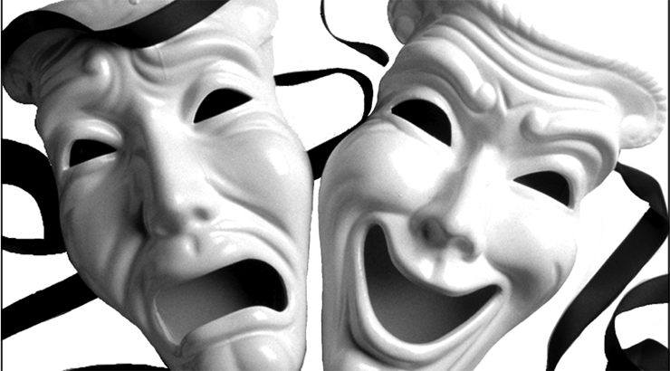
Shakespearean Poetry & Dramas

Slide 2
Poetry Terms
Sonnet- poem of 14 lines written and rhymed in iambic pentameter. Each sonnet ends with a couplet.
(note: most sonnets are written this way, but not all)
In a Shakespearean sonnet the rhyme scheme is:
ABAB CDCD EFEF GG

Slide 3
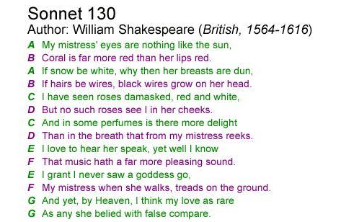

Slide 4
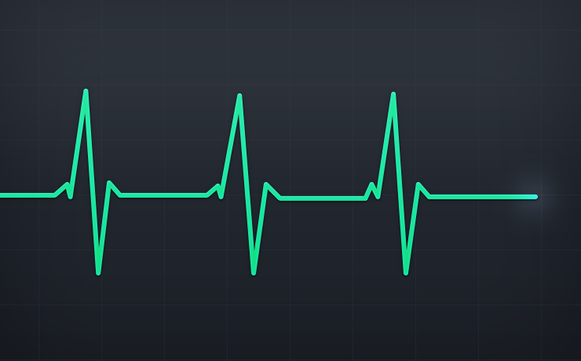
Poetry Terms
Iambic Pentameter: unrhymed verse in which each line has five stressed syllables and five unstressed syllables; the iam is the name for the combination of syllables

Slide 5
Poetry Terms
Iam = unstressed syllable followed by stressed syllable
Ex. comPLETE, → think of a heartbeat
Pentameter = a poetic line with five “feet”
**Best thing to remember→ a typical sonnet has 14 lines with 10 syllables per line

Slide 6
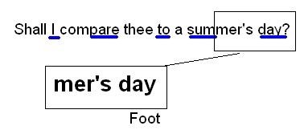
Da-Duh
Da-Duh
Da-Duh
Da-Duh
Da-Duh

Slide 7
Poetry Terms
Couplet- two consecutive lines that rhyme.
“Good night, good night. Parting is such sweet sorrow
That I shall say good night till it be morrow.”

Slide 8
Additional terms
Prose: ordinary form of language (paragraphs)
Verse: a line of poetry
Blank verse: unrhymed iambic pentameter

Slide 9
DRAMA

Slide 10
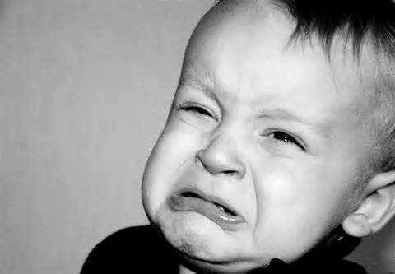
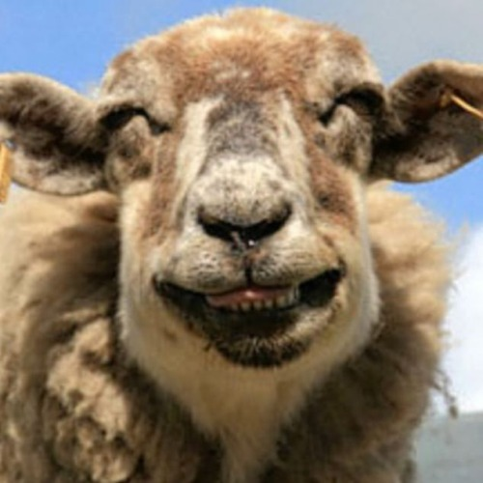
Types of Dramas
Tragedy
Comedy

Slide 11
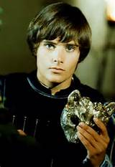
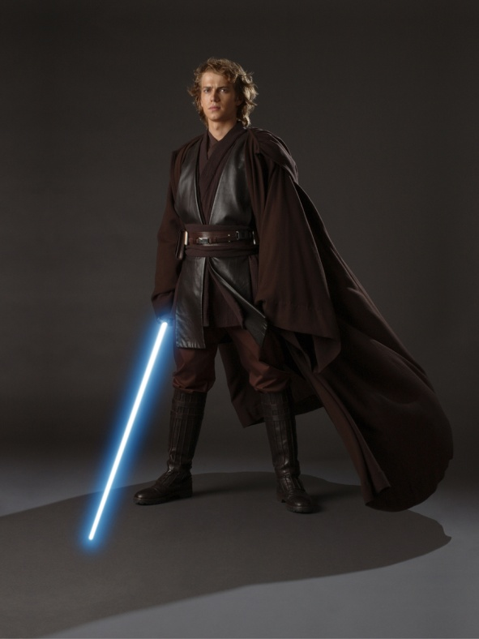
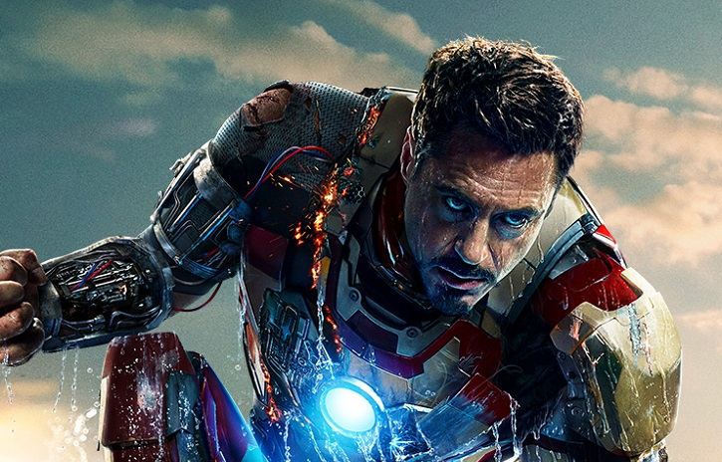
1. Tragedy
  A play with an unhappy ending
  Themes:
  right v. wrong
  justice v. injustice
  life v. death
  Humans struggle against larger forces of destiny
  Tragic Hero: noble but flawed

Slide 12
Comedy v. Tragedy
Romeo and Juliet begins as a comedy but ends as a tragedy.
Comedy
Tragedy
A struggle of young lovers to overcome difficulty that is often presented by elders
Separation and unification
Heightened tensions, often within a family
Must have a tragic hero/heroine
Ends in the death of many of the main characters
The shift from comedy to tragedy is what sets Romeo and Juliet apart from the rest of Shakespeare’s plays.

Slide 13

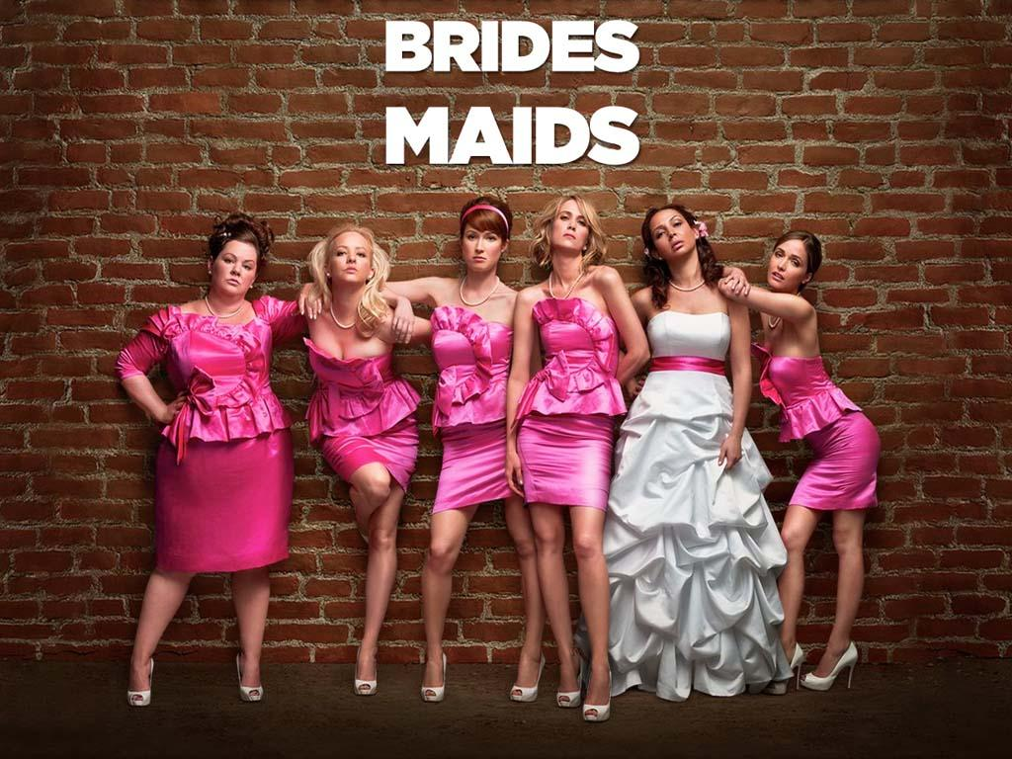
2. Comedy
  a play with a happy ending (usually)
  Usually centers around a romantic conflict

Slide 14

Drama Terms
Act: a major section of the play (most Shakespearean plays have five acts)
Scene: a subdivision of an act consisting of continuous action taking place at a single time in a single location

Slide 15
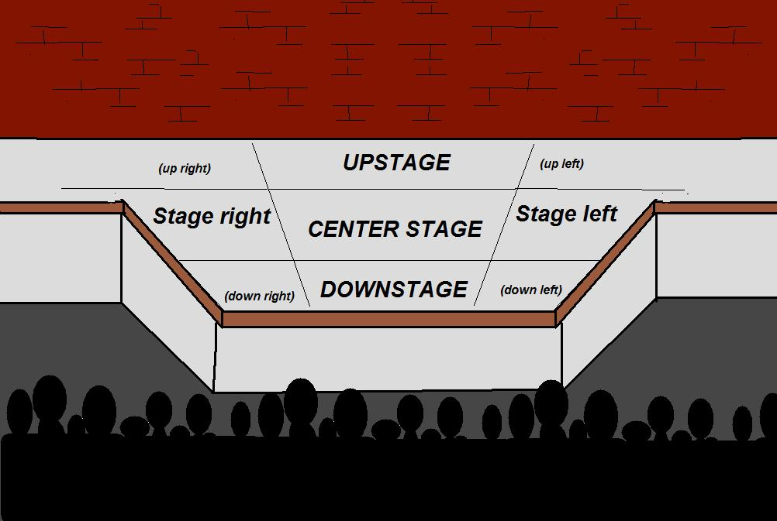
Drama Terms
Lines: the words spoken by the actor
  When citing lines from a play, use the act number, the scene number and the lines….ex) …..(1.2.35-4).
Stage Direction: description of setting and characters (ex. “crying softly” or “standing on the balcony”)

Slide 16
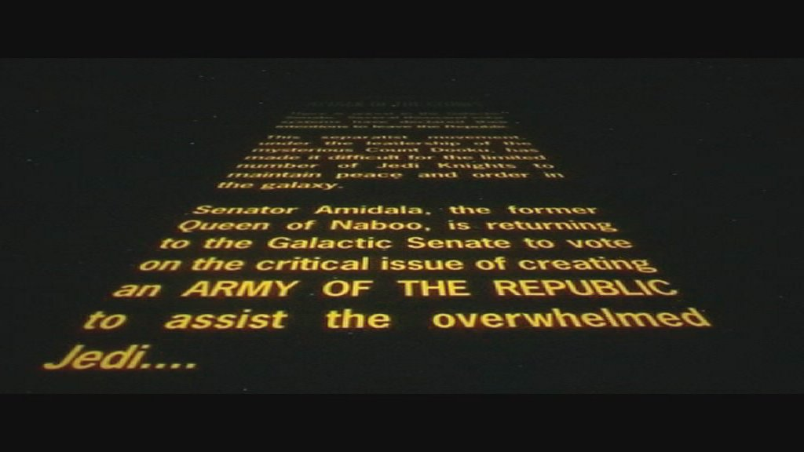
Drama Terms
Performance: the delivery of the play to the audience
Prologue: introduction of play
Epilogue: a concluding speech following the action of the play

Slide 17
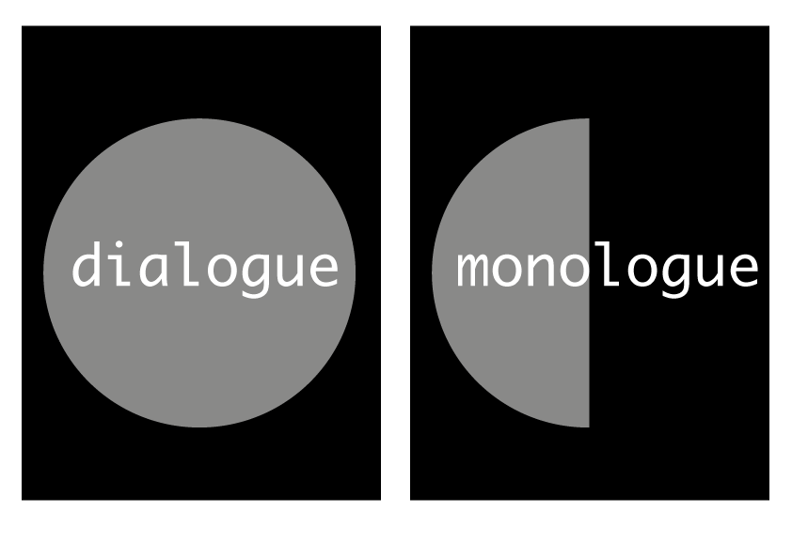
Drama Terms
Dialogue: a conversation between multiple characters on stage
Monologue: long speech given by one character to other characters on stage

Slide 18
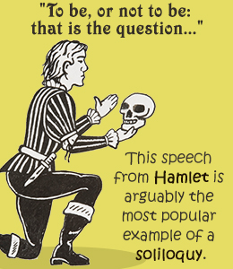
Drama Terms
Soliloquy: long speech delivered by one character alone on stage; meant for him/herself and the audience to hear
Aside: remarks made to audience or other character; not meant for everyone to hear

Slide 19
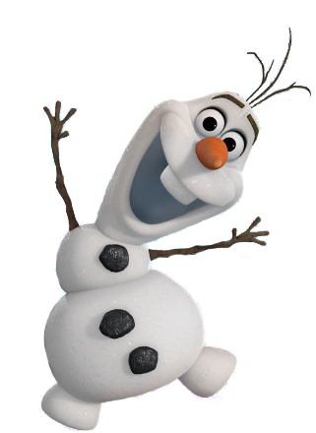
Drama/Literary Terms
Comic Relief: a bit of humor injected into a serious play to balance tragic events
Pun: a play on words
  “Dreamers often lie…”
  Why is this a pun?

Slide 20
Drama/Literary Terms
Oxymoron: a figure of speech in which apparently contradictory terms appear in conjunction
Examples:
  Deafening silence
  Seriously funny
  Act naturally

Slide 21
Drama/Literary Terms
Satire: a type of writing that ridicules something– a person, a group of people, humanity at large, an attitude or failing, a social institution– in order to reveal a weakness
Examples: Sketches on Saturday Night Live, The Simpsons, Family Guy; various scenes from movies like Shrek

