Slide 1
Objective 8.02 Apply Procedures to Create Picture Boxes using Images. (5%)
Computer Programming I
Summer 2011

Slide 2
Objective/Essential Standard
Essential Standard 8.00 Apply procedures to develop graphics applications
Indicator 8.02 Apply Procedures to Create Picture Boxes Using Images. (5%)

Slide 3
Adding Images
Computer programming 1

Slide 4
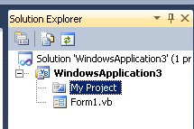
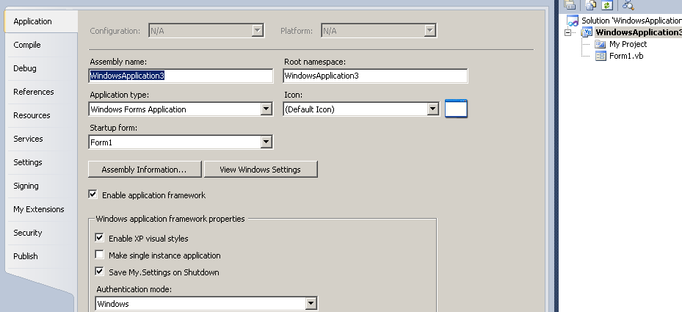
Adding Images to Your Project
In the Solution Explorer, double-click My Project
The following is displayed.

Slide 5
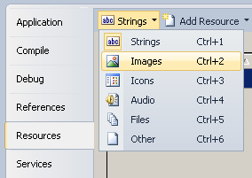
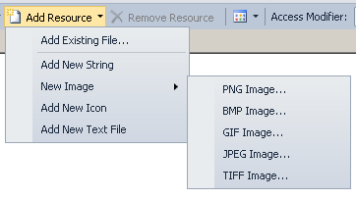
Adding Images to Your Project
Select the Resources tab.
Go to the Strings tab
click the drop-down arrow.
Select Images
Go to the Add Resource tab
click the drop-down arrow.
To add an existing image, select Add Existing. To create and add an image, select New Image, then the image type.

Slide 6
The PictureBox Control
Computer programming 1

Slide 7
PictureBox Control
The PictureBox control displays an image.
The image can be one of the following formats.
Bitmap
GIF
JPEG
Best use
Enhanced Metafile
Icon

Slide 8
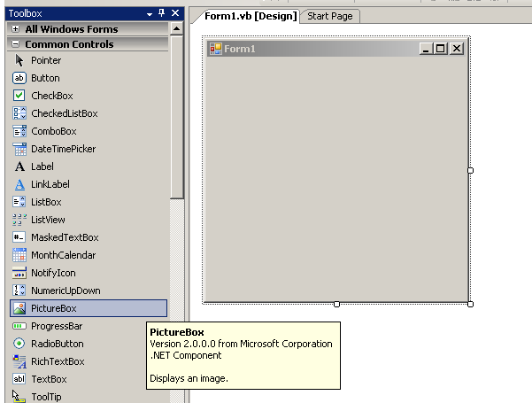
Adding A PictureBox Control
Click the PictureBox control in the ToolBox.
Draw the rectangular picture box on your form.
Set the Properties.

Slide 9
PictureBox Control
PictureBox Properties | Description
(Name) | The name of a PictureBox should start with pic
Image | Sets the image to display in the PictureBox
SizeMode Normal (Default) StretchImage AutoSize CenterImage Zoom | Controls the image sizing and position places in the top-left corner of the Picture Box resizes the image to fit the PictureBox resizes the PictureBox to fit the image puts the image in the middle of the PictureBox resizes the image to fit the PictureBox but maintains the original ratio
PictureBox Event | Description
Click | Occurs when the user clicks the PictureBox

Slide 10
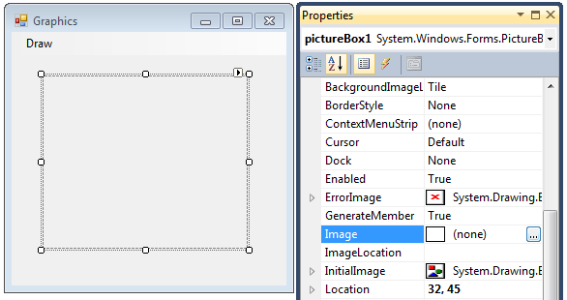
Adding Images to the PictureBox Control
Select the PictureBox
Click in the Image property area
The Ellipsis displays.
The Select Resource dialog displays

Slide 11
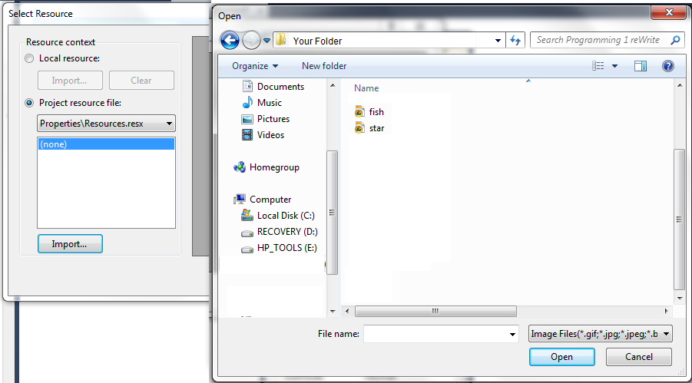
Adding Images to the PictureBox Control
Click on Import
Browse to your folder
Select the Image
Click Open

Slide 12
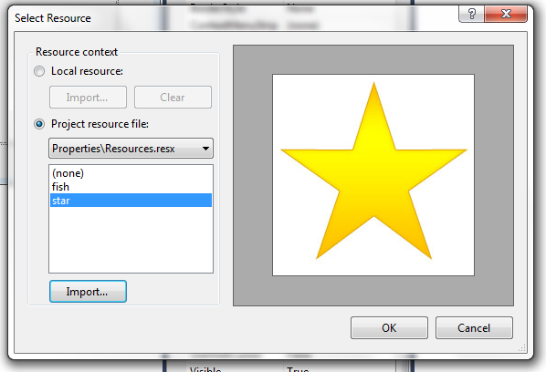
Adding Images to the PictureBox Control
Your image will be added to the list.

Slide 13
Using the PictureBox
You can set the Image property during runtime Me.PictureBox.Image = My.Resources.ImgName
Example

Slide 14
Changing How the Image Displays
Remember the SizeMode property of the PictureBox will change how the image is displayed.
To change how the image is displayed at runtime, you can change the SizeMode property. Me.PictureBox.SizeMode = PictureBoxSizeMode.SizeModeValue
Where the SizeModeValue is one of the choices given: Normal (Default), StretchImage , AutoSize, CenterImage, Zoom

Slide 15
Conclusion
This PowerPoint provided an overview of the PictureBox control in Visual Basic.
For more information: http://msdn.microsoft.com/en-us/library/5b4t5f7s.aspx

