Slide 1
Objective 8.01 Understand coordinate systems. (3%)
Computer Programming I
Summer 2011

Slide 2
Objective/Essential Standard
Essential Standard 8.00 Apply procedures to develop graphics applications
Indicator 8.01 Understand coordinate systems. (3%)

Slide 3
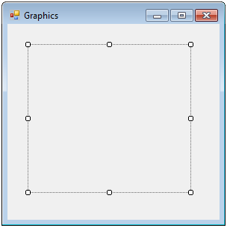
Coordinate Systems
With Visual Studio, any object, whether it is a form or a label uses the same coordinate system.
The top left corner, or the origin is 0, 0.
The bottom right corner is the width and height of the control (in this case, the label).
0, 0
Width, Height

Slide 4
Coordinate Systems
The default coordinate system is made up of rows and columns of pixels.
The pixels are the smallest points you can locate on the form.

Slide 5
Coordinate Systems
As you increase the x, you move across to the right.
As you increase the y, you move down.
(0, 0)
x = 50
(50, 50)
Y = 50

Slide 6
Coordinate Systems
You can also indicate the width of the object by using its Width property.
Likewise you can indicate the height of the object using its Height property.
0, 0
lblDraw.Width
lblDraw.Height

Slide 7
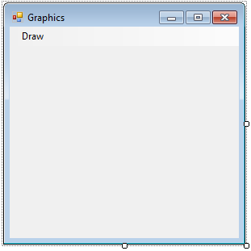
Coordinate Systems
To indicate the form’s height maxHeight = Me.Height
To indicate the form’s width maxWidth = Me.Width
You can use the Height and Width properties to set relative positions.
Form’s Width and Height

Slide 8
Summary
Vocabulary
Origin
Coordinate System
Width Property
Height Property
Code
MaxHeight = Me.Height
For a form
MaxHt = lblDraw.Heigth
For a label
MaxWidth = Me.Width
For a form
MaxWidth = lblDraw.Width
For a label

Slide 9
Conclusion
This PowerPoint provided an overview of coordinate systems in Visual Studio.

