Slide 1
Looping Practice (Std. 5.05)

Slide 2
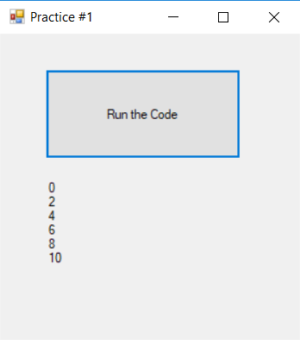
For…Next Loop: Practice #1
Write a For…Next loop that will start at 0 and end at 10 counting by 2. The variable should be named intCount. Put the value of intCount on a label with a separate line for each loop.

Slide 3
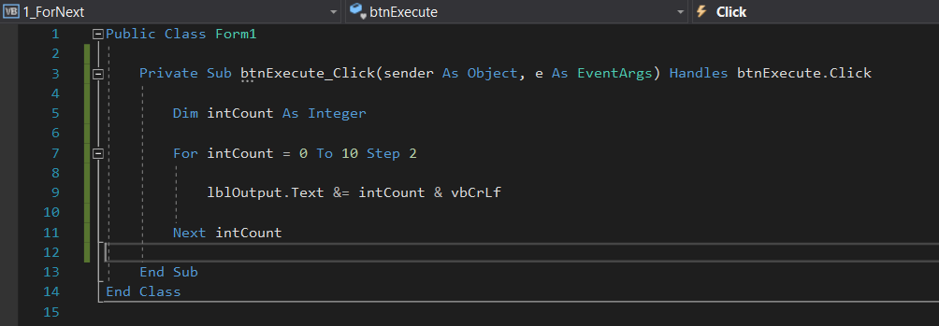
For…Next Loop: Practice #1

Slide 4
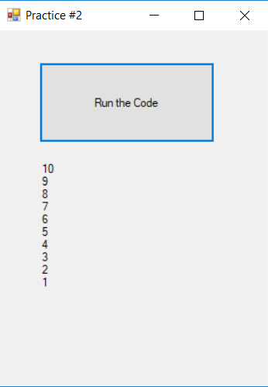
For…Next Loop: Practice #2
Write a For…Next loop that will count backwards from 10 to 1.
The variable should be named intCount. Put the value of intCount on a label with a separate line for each loop.

Slide 5
For…Next Loop: Practice #2

Slide 6
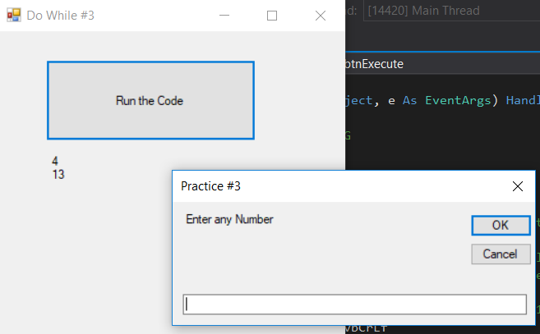
Do While… Loop: Practice #3
Write a Do While loop that will loop until the user enters -1.
The variable should be named intCount. Put the value of intCount on a label with a separate line for each loop until the user ends the loop.

Slide 7
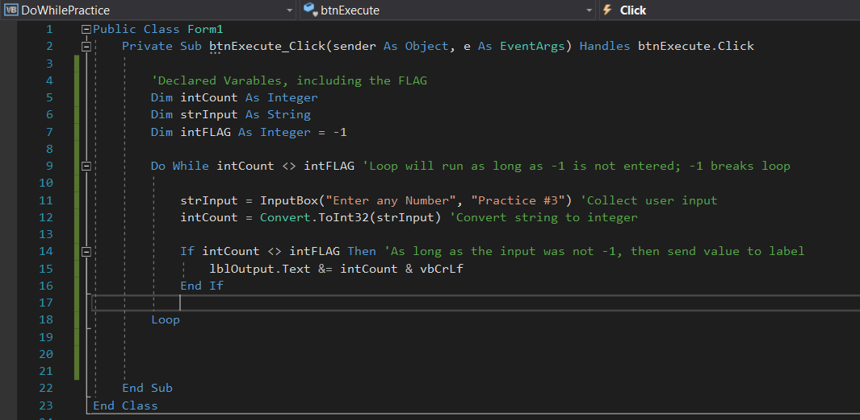
Do While: Practice #3

