Slide 1
Basic Assembly Constraints
Introduction to Engineering Design
© 2012 Project Lead The Way, Inc.

Slide 2
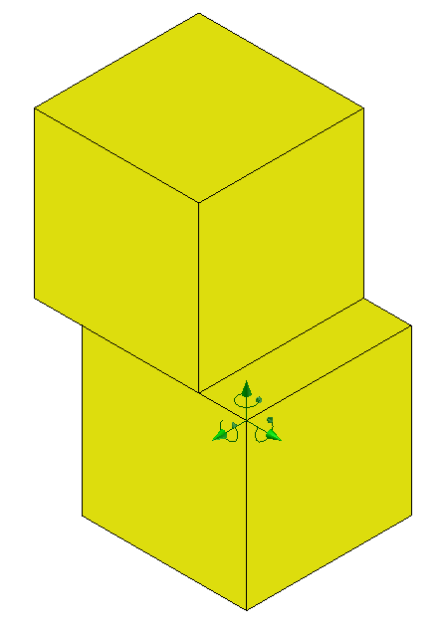
Basic Assembly Constraints
Define how parts relate to each other
Restrict the movement between parts
Six Degrees of Freedom
Three Rotational about X, Y, and Z axes
Three Translational along X, Y, and Z axes
Degrees of freedom are systematically removed in an assembly until each component is constrained to allow the desired behavior.

Slide 3
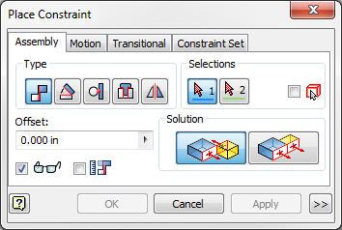
Basic Assembly Constraints
Four Basic Constraints
Mate/Flush Angle Tangent Insert

Slide 4
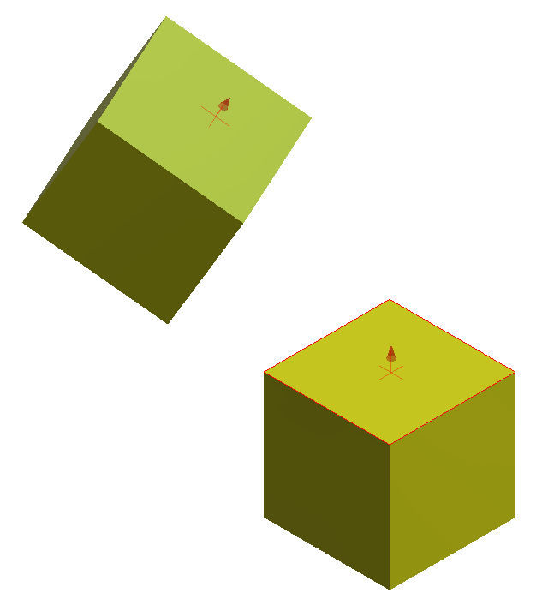
Basic Assembly Constraints
Mate
Constrains two faces, edges, points, or axes together
Notes:
Red arrows represent normal vectors and point toward each other.

Slide 5
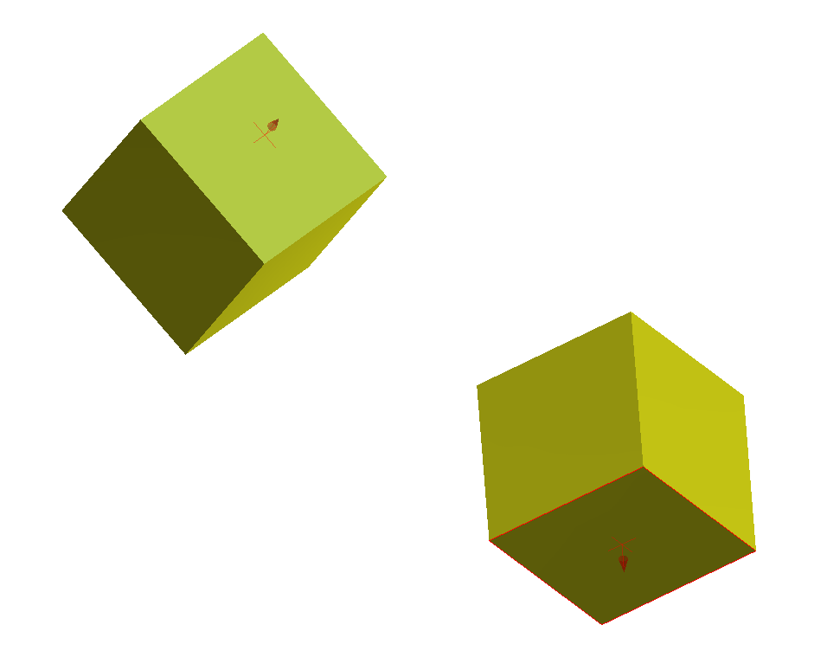
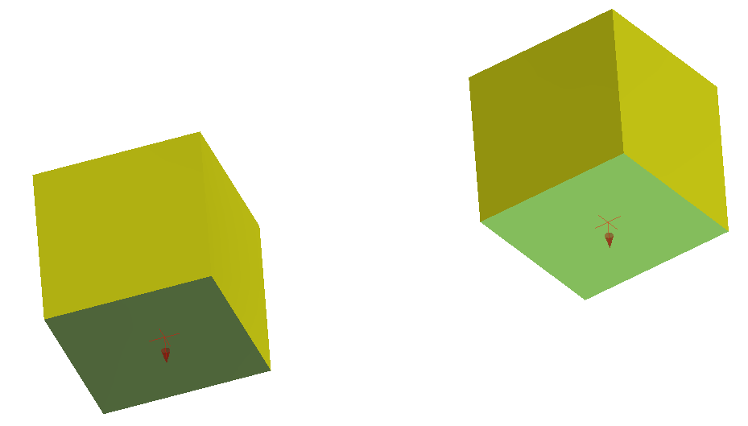
Basic Assembly Constraints
Flush
Constrains two faces, edges, points, or work features together with geometry side by side
Notes:
Normal vectors will point in the same direction

Slide 6
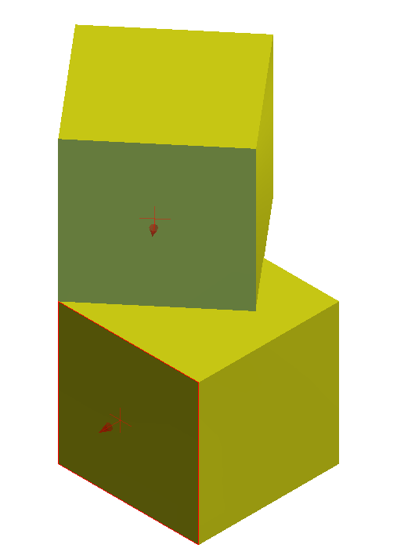
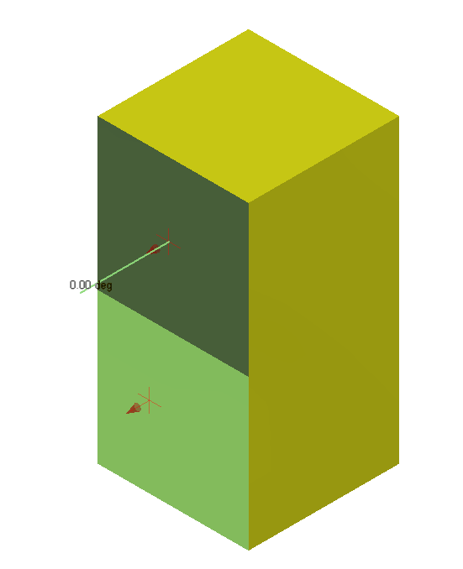
Basic Assembly Constraints
Angle
Constrains two faces or edges at an angle to one another
Notes:
Normal vectors parallel to each other equal 0° angle.

Slide 7
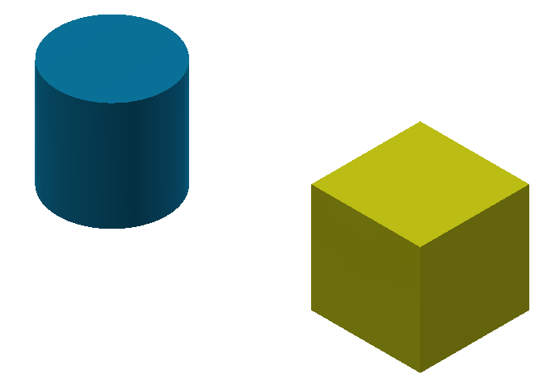
Basic Assembly Constraints
Tangent
Constrains a curved surface to a plane or another curved surface

Slide 8
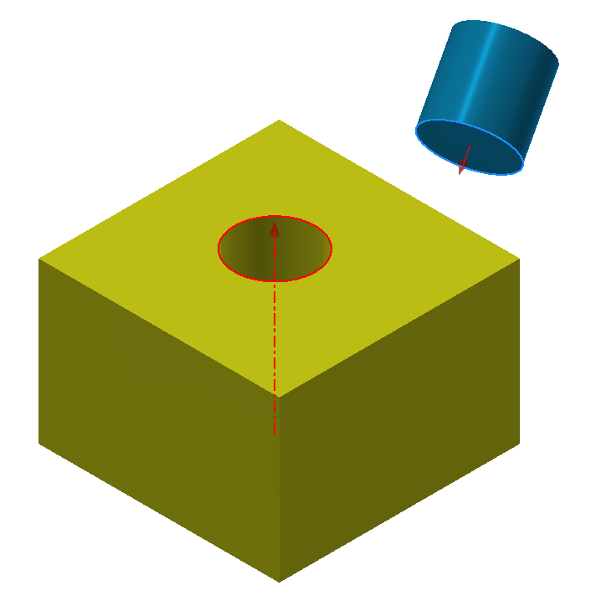
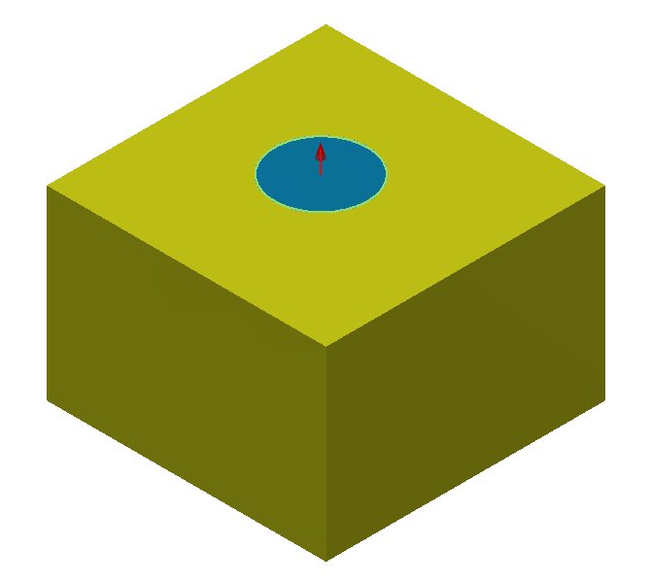
Basic Assembly Constraints
Insert
Constrains a cylinder flush into a hole

Slide 9
Base Component
First component placed in an assembly should be a fundamental part or subassembly
E.g., a frame or base plate, on which the remainder of the assembly is attached
First component in an assembly file sets orientation of subsequent parts and subassemblies

Slide 10
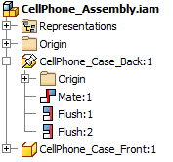
Grounded Component
When the first component is placed in the assembly, its origin is coincident and aligned with the assembly coordinate origin.
Base component should be grounded to remove all degrees of freedom

Slide 11
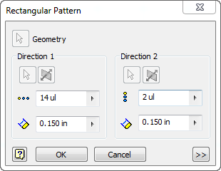
Patterning Component
Function duplicates one or more components
Arranges the resulting occurrences in a circular or rectangular pattern

Slide 12
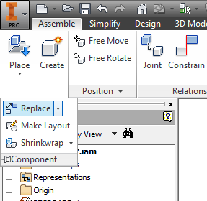
Replace Component
Design process is often nonlinear, so one or more components in an assembly may need replacement
New component placed in the same location as the original component, but assembly constraints may be deleted

Slide 13
Editing Components
Double-click on a component to exit the assembly environment and enter part environment
Other components in the assembly will become translucent
When finished editing a part, save the part
Exit the part environment and return to the assembly environment

Slide 14
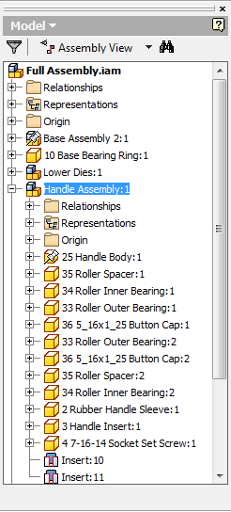
Subassemblies
Group of components constrained to act as one component in a larger assembly

